Slide 1
This slide is a supplement to A Geography of Russia and Its Neighbors, Second Edition by Mikhail S. Blinnikov. Copyright © 2021 The Guilford Press.
Chapter 1. Introduction: Russia and Post-Soviet Northern Eurasia
Definitions
FSU – former Soviet Union, 15 republics
CIS – Commonwealth of Independent States (12 out of 15 in 1992, less in use now)
NIS – Newly Independent States, even less used now
Near Abroad – more or less the same, even less in use now
Northern Eurasia – geographical definition
Siberia – part of Russia east of the Urals and west of the Pacific Coast
Why study this region? Let’s think of some good examples!
Unique and turbulent history
(Still) a major political player
An energy giant
Language and culture
Arts and music
Sports
Science
Travel

Slide 2
This slide is a supplement to A Geography of Russia and Its Neighbors, Second Edition by Mikhail S. Blinnikov. Copyright © 2021 The Guilford Press.
Russia in the world (2019)
Land and population
USSR covered 1/6th of land in the world with 280 million people
Russia covers about 1/8th of 17 million km² with 145 million people
6th largest economy ($1.6 trillion nominal GDP, $4.0 trillion GDP PPP in 2017)
“High-middle” income $27,900 PPP/capita in 2017 (#74)
  Similar to Greece or Turkey
  US $60,000, World average $17,500 PPP/capita
Look at Russia vs. USA on the globe (Fig. 3.1)
Russia is a much more northern country than USA, a lot like Canada
By latitude
Murmansk~ Prudhoe Bay
St. Petersburg~ Anchorage
Moscow~ Edmonton, AB
Krasnodar~ Minneapolis
Baku (Azerb)~ Baltimore
Kushka (Turkm)~ Las Vegas
The Arctic is very compact. So, we are neighbors!
http://legacy.lib.utexas.edu/maps/islands_oceans_poles/arctic_region_pol_2012.pdf

Slide 3
This slide is a supplement to A Geography of Russia and Its Neighbors, Second Edition by Mikhail S. Blinnikov. Copyright © 2021 The Guilford Press.
USA 330 million people 9.4 million km² 50 states 2017 GDP PPP $18.6 billion About 6800 nuclear warheads (2017) 10% of world’s forests 3% of oil reserves | Russia 145 million 17 million km² 87 “subjects of federation” 2017 GDP PPP $3.7 billion About 7000 nuclear warheads (2017) 25% of world’s forests 8% of oil reserves
Russian land borders
Longest in the world: >Canada > China > USA
Borders are 58,562 km (without Crimea)
with 14,253 km bordering other states and 44,309 km bordering the sea
14 countries on land + 2 at sea
North – Arctic Ocean
West – Europe (Norway, Finland, Estonia, Latvia, Lithuania, Poland, Belarus, Ukraine, Georgia, Azerbaijan) Note: Crimea annexation in 2014
South and East – Kazakhstan (33%), Mongolia, China (2 places!), N. Korea, Japan, United States
See more details in book text, Chapter 1

Slide 4
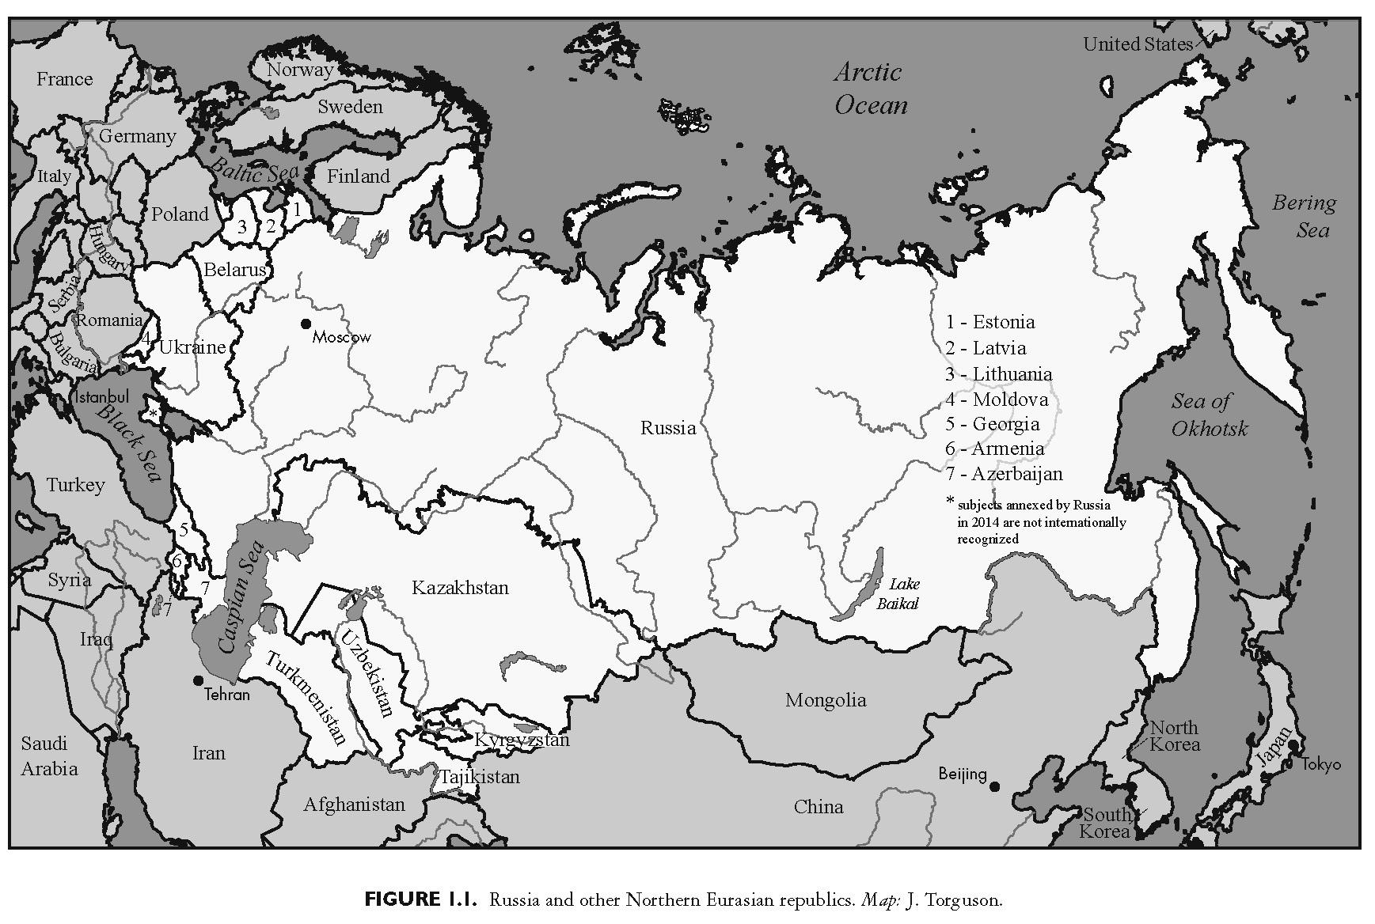
This slide is a supplement to A Geography of Russia and Its Neighbors, Second Edition by Mikhail S. Blinnikov. Copyright © 2021 The Guilford Press.

