Slide 1
This slide is a supplement to A Geography of Russia and Its Neighbors, Second Edition by Mikhail S. Blinnikov. Copyright © 2021 The Guilford Press.
Chapter 2. Relief and Hydrography
The main physical features (Map on Figure 2.1)
Seas
Lakes
Islands and peninsulas
Mountains and other orographic features
Rivers
Some unique features
Mt. Elbrus: tallest in Europe at 5,642 m
  Mt. Blanc in France “only” 4,807 m
Lowest point: Caspian Lowlands –28 m (below sea)
Peak Ismail Somoni (Communisma): 7,495 m in Tajikistan
Lake Baikal: deepest on Earth (1,620 m)
  20% of liquid fresh water by volume on the planet
Caspian Sea: world’s largest (saline) lake
  (L. Superior x4, about 371,000 km²)
Yenisei+Angara: 623 km³ annual runoff
  Mississippi + Missouri: 570 km³
Ob + Irtysh: 5,400 km long (Mississippi + Missouri 6,000 km)
Oymyakon: Coldest spot in N.H. –75°C!

Slide 2
This slide is a supplement to A Geography of Russia and Its Neighbors, Second Edition by Mikhail S. Blinnikov. Copyright © 2021 The Guilford Press.
Place to explore in photos or on Google Earth
Slightly undulating Russian (Eastern European) Plain north of Moscow
Valdai Hills – the end moraine of the last glaciation
Glacial Onega and Ladoga Lakes
Klyazma river near source (photo) – small river that becomes medium (Volga tributary)
Oka river near Kasimov (photo) – medium river that is another Volga tributary
The Volga – “Mother of Russia” – longest river in Europe, flows into the Caspian Sea
Irtysh – large Siberian river (photo)
Ob’ – the longest river (photo), if you start from the Irtysh source
Yenisei – the strongest river
Lake Baikal
Lena delta
The Caucasus Mountain Range
Tien Shan and Lake Issyk-Kul in Kyrgyzstan
Pamirs in Tajikistan
Volcanoes of Kamchatka Peninsula

Slide 3
This slide is a supplement to A Geography of Russia and Its Neighbors, Second Edition by Mikhail S. Blinnikov. Copyright © 2021 The Guilford Press.
Northern Eurasia Geological History
Old and very complicated
European vs Siberian platforms – evidence for former separate tectonic plates
Oldest platforms – metals and diamonds – Kola Peninsula, Anabar Shield in Siberia (>3 billion years ago)
Much of Central Russia – carboniferous period
Late Permian period – coal formed already in coastal swamps – NE parts of European Russia towards the Urals
Late Jurassic – oil and gas in West Siberia (shallow tropical sea at the time)
KT boundary extinction event
Middle Miocene grasslands
Ice Ages (4 major glacial advances are notable in deposits in Europe), much less ice in Siberia due to extreme dryness and cold
Pleistocene Extinctions
Many large animals (“megafauna”) went extinct at the end of the Pleistocene
(some 40,000 years ago, but especially 10–15,000 years ago)
Paleontology Museum in Moscow (PIN)
https://www.paleo.ru/museum/
Wooly mammoth (picture and dwellings in Ukraine made out of its bones)
Wrangel Island, the last place where mammoth went extinct, just about 4,000 years ago!
Wooly rhinoceros and other large animals

Slide 4
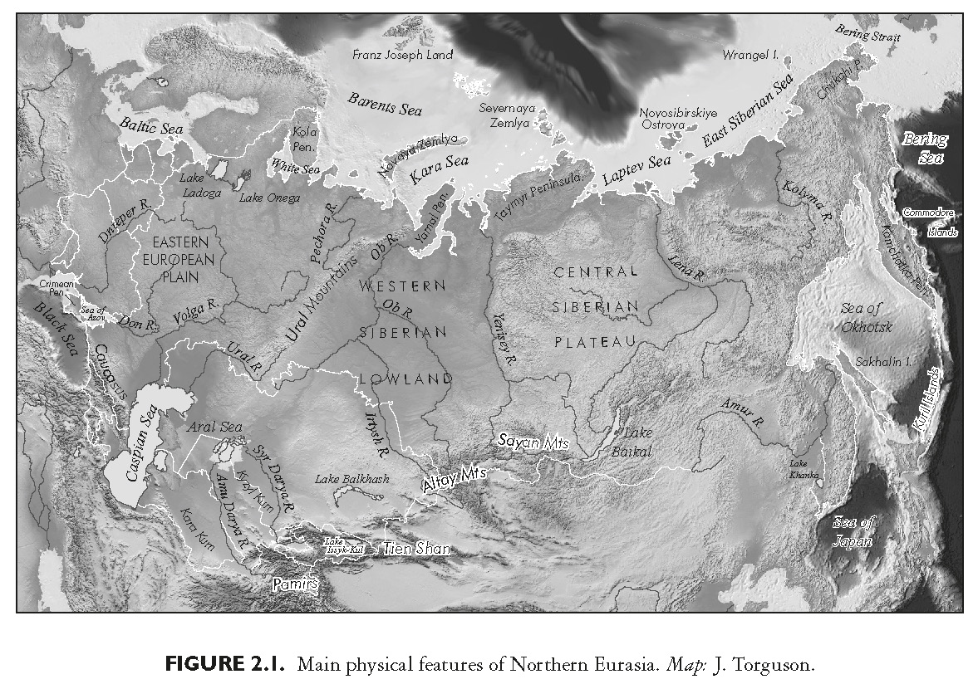
This slide is a supplement to A Geography of Russia and Its Neighbors, Second Edition by Mikhail S. Blinnikov. Copyright © 2021 The Guilford Press.

Slide 5
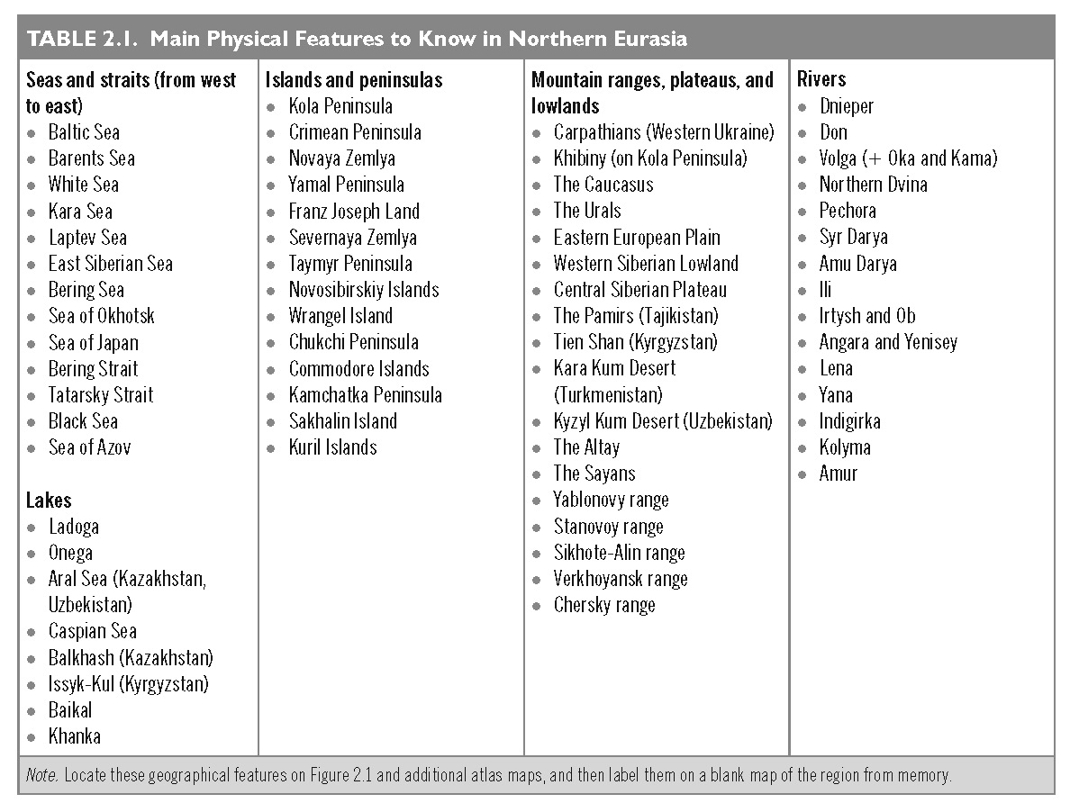
This slide is a supplement to A Geography of Russia and Its Neighbors, Second Edition by Mikhail S. Blinnikov. Copyright © 2021 The Guilford Press.

Slide 6
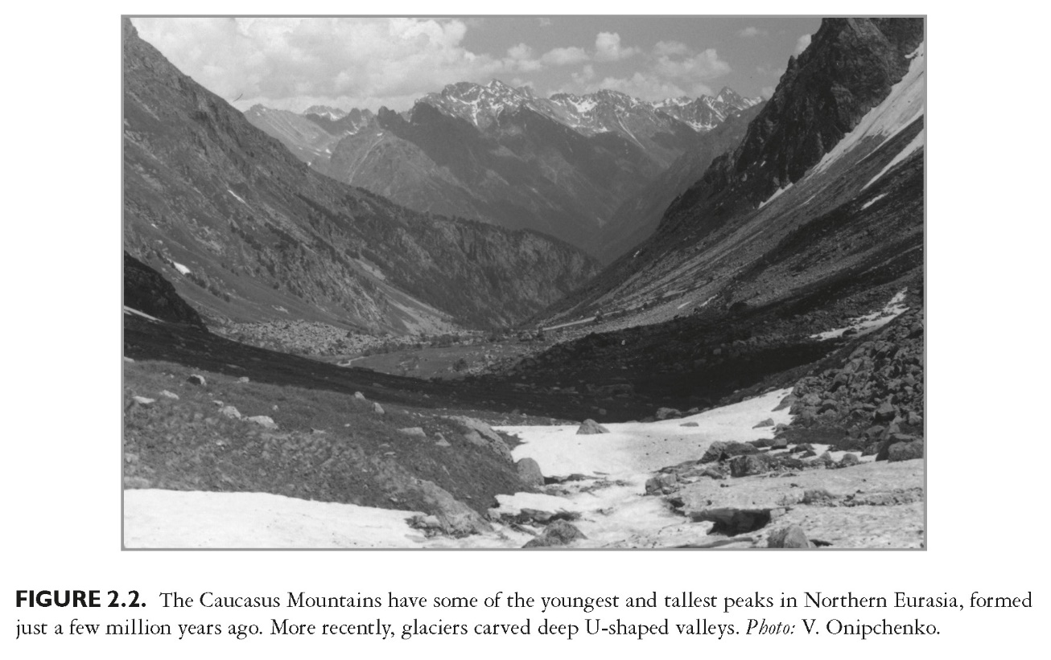
This slide is a supplement to A Geography of Russia and Its Neighbors, Second Edition by Mikhail S. Blinnikov. Copyright © 2021 The Guilford Press.

Slide 7
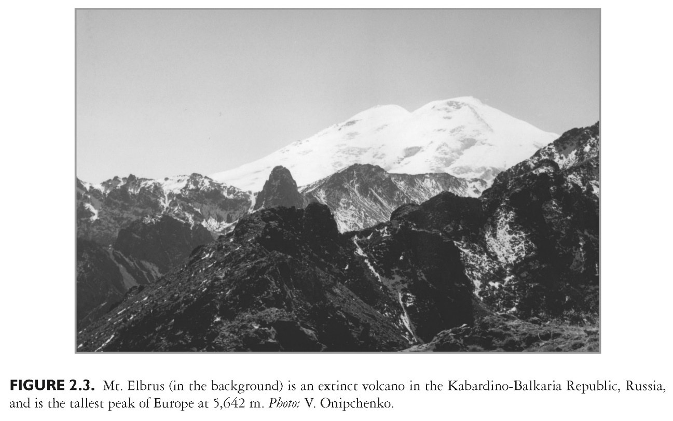
This slide is a supplement to A Geography of Russia and Its Neighbors, Second Edition by Mikhail S. Blinnikov. Copyright © 2021 The Guilford Press.

Slide 8
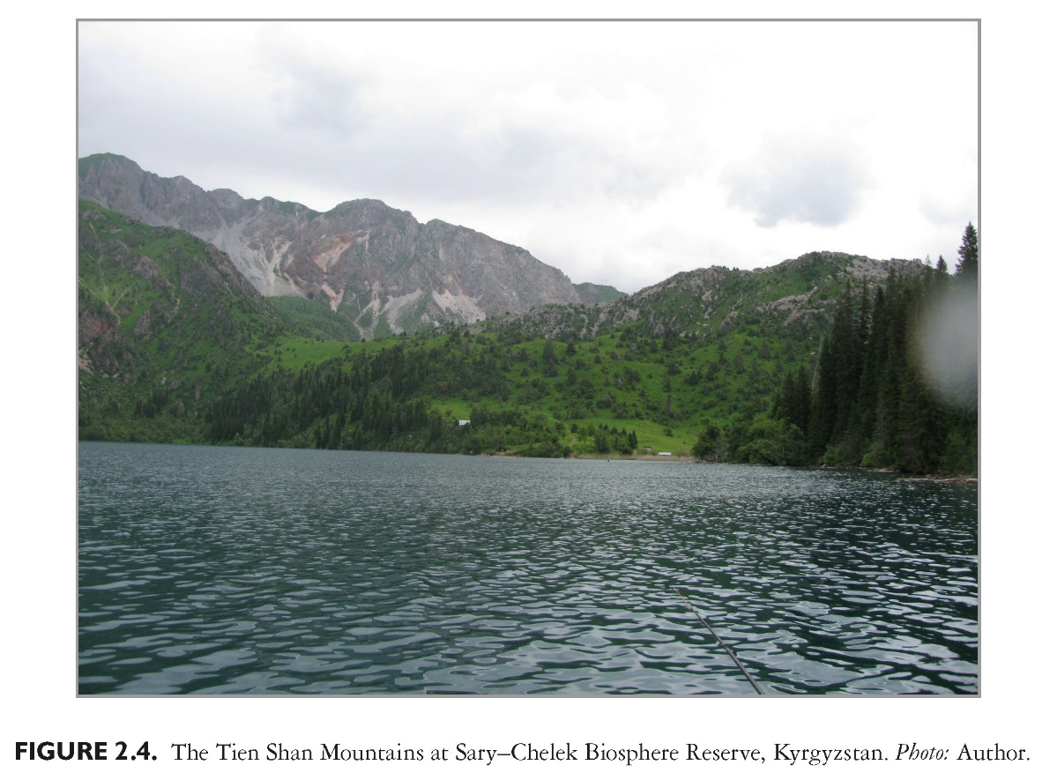
This slide is a supplement to A Geography of Russia and Its Neighbors, Second Edition by Mikhail S. Blinnikov. Copyright © 2021 The Guilford Press.

Slide 9
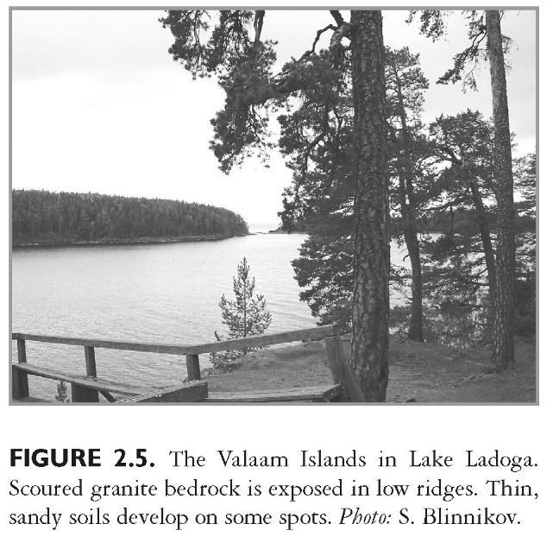
This slide is a supplement to A Geography of Russia and Its Neighbors, Second Edition by Mikhail S. Blinnikov. Copyright © 2021 The Guilford Press.

Slide 10
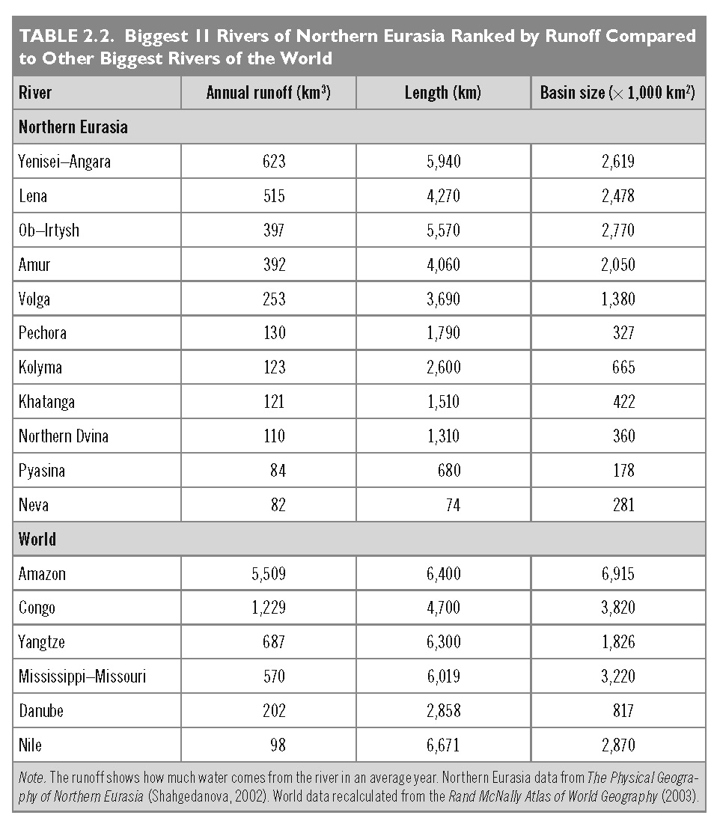
This slide is a supplement to A Geography of Russia and Its Neighbors, Second Edition by Mikhail S. Blinnikov. Copyright © 2021 The Guilford Press.

Slide 11
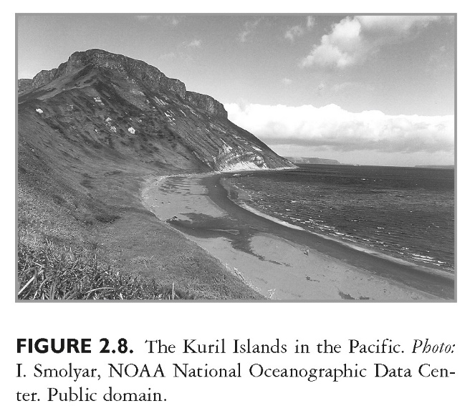
This slide is a supplement to A Geography of Russia and Its Neighbors, Second Edition by Mikhail S. Blinnikov. Copyright © 2021 The Guilford Press.

Slide 12
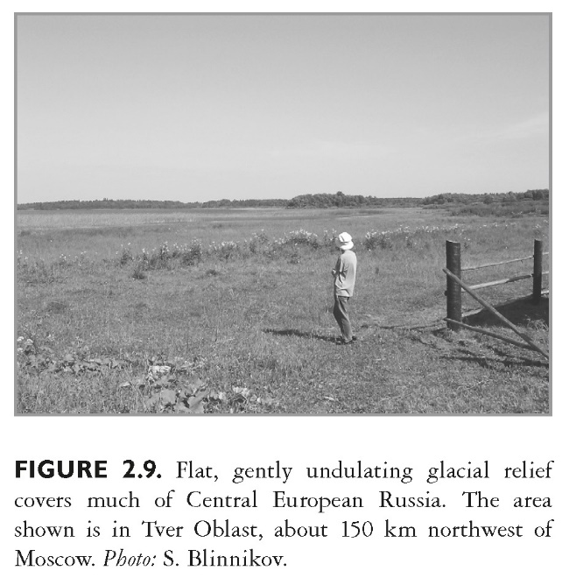
This slide is a supplement to A Geography of Russia and Its Neighbors, Second Edition by Mikhail S. Blinnikov. Copyright © 2021 The Guilford Press.

