Slide 1
This slide is a supplement to A Geography of Russia and Its Neighbors, Second Edition by Mikhail S. Blinnikov. Copyright © 2021 The Guilford Press.
Chapter 3. Climate
Climate is your average weather
Mean Annual Temperature
Mean Annual Precipitation
Seasonality
Insolation angle
Is there a frost ever?
Wind and related weather phenomena
Climate diagrams (Figure 3.2) and also
http://www.globalbioclimatics.org/map/index.htm
Wladmir Koeppen developed a global system of climates with letter codes A, B, C, D, and E
Northern Eurasia has no true tropical climates (A) and very little mesothermal temperate climates (C), but has lots of D (microthermal continental) and B (arid) climates and a fair amount of E (polar)
Global temperatures map
temp. January – isotherms run north–south, basically it gets much colder as you travel from Europe to Siberia towards the east
temp. July – more latitudinal pattern with the Arctic coast coldest and Central Asian deserts warmest

Slide 2
This slide is a supplement to A Geography of Russia and Its Neighbors, Second Edition by Mikhail S. Blinnikov. Copyright © 2021 The Guilford Press.
Global precipitation map
Precipitation is highest along the Black Sea coast and lowest in Central Asian deserts
Minneapolis vs. Moscow – compare their climate diagrams, overall similar
https://www.globalbioclimatics.org/map/index.htm
Analyzing climate diagram
Mean monthly and annual temperature
Length of freezing season
Length of vegetative season
Coldest month, warmest month
Extreme cold and hot
Mean precipitation by month
Wettest and driest month
Adequate moisture year round?

Slide 3
This slide is a supplement to A Geography of Russia and Its Neighbors, Second Edition by Mikhail S. Blinnikov. Copyright © 2021 The Guilford Press.
Synopsis
Generally very continental climate everywhere in the region
Moscow is similar to Minneapolis
The Baltics, Georgia w coast and Crimea are milder, more like mid-Atlantic US states (except never as humid)
Most of the country – even more continental than Moscow
Highest contrast of temperature in winter
Coldest spots in N.H. – Verkhoyansk and Oymyakon in NE Siberia
Arctic and Central Asia are very dry
Wettest and warmest – Batumi, Georgia and, within Russia, it is Sochi
Climate change is very significant all over the region, especially in the Arctic
Russia has ~50% of the Arctic
Arctic (and NH) warms a few times faster than the rest
+2C – world, +5–10C Arctic

Slide 4
This slide is a supplement to A Geography of Russia and Its Neighbors, Second Edition by Mikhail S. Blinnikov. Copyright © 2021 The Guilford Press.
Pros on climate change for Russia
More arable land
Milder winters, less heat
Opening shipping lanes
Cons on climate change for Russia
Heat waves, fires in summer
Permafrost melt
Inundating coasts (although Russia has very few major cities as seaports compared to Europe or USA)
Russia is unprepared for climate change
Very low public awareness
Politicians and scientists’ denial (why?)
Almost no renewables in use (except hydropower)
Assumption is that being northern and landlocked helps (true?)
Slow change, education is key (WWF, Greenpeace are active; some academic researchers)
Compared to USA, even fewer Russians consider climate change a serious threat

Slide 5
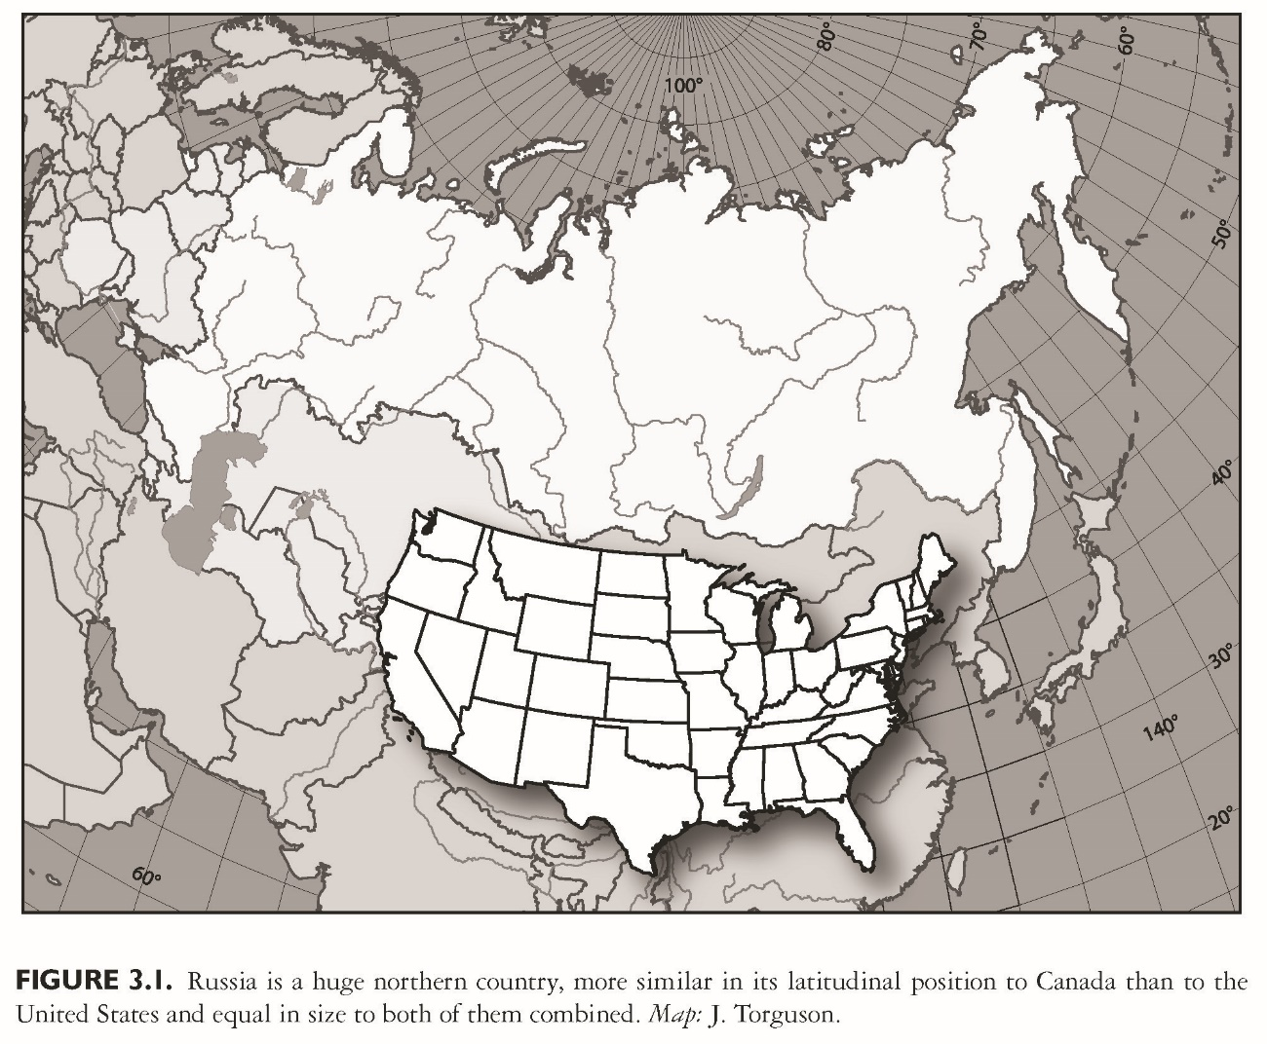
This slide is a supplement to A Geography of Russia and Its Neighbors, Second Edition by Mikhail S. Blinnikov. Copyright © 2021 The Guilford Press.

Slide 6
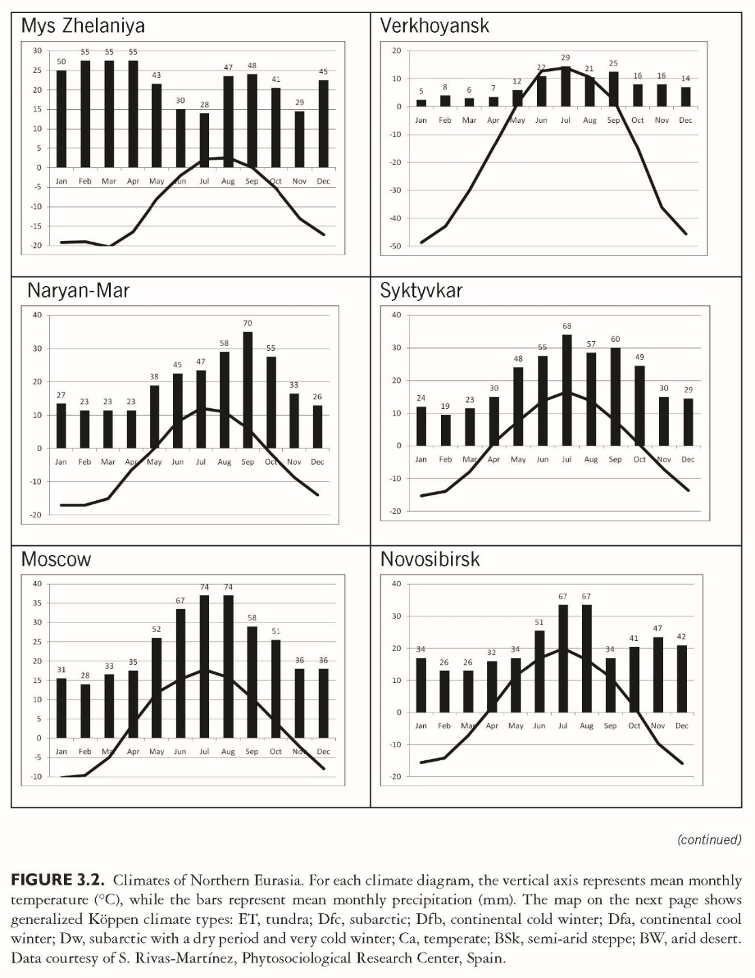
This slide is a supplement to A Geography of Russia and Its Neighbors, Second Edition by Mikhail S. Blinnikov. Copyright © 2021 The Guilford Press.

Slide 7
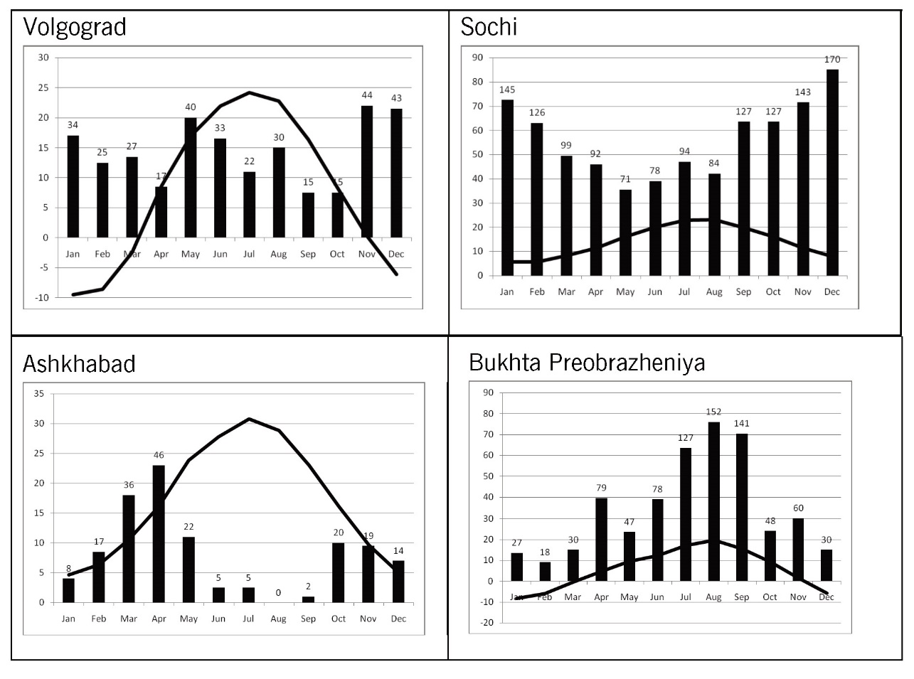

This slide is a supplement to A Geography of Russia and Its Neighbors, Second Edition by Mikhail S. Blinnikov. Copyright © 2021 The Guilford Press.

Slide 8
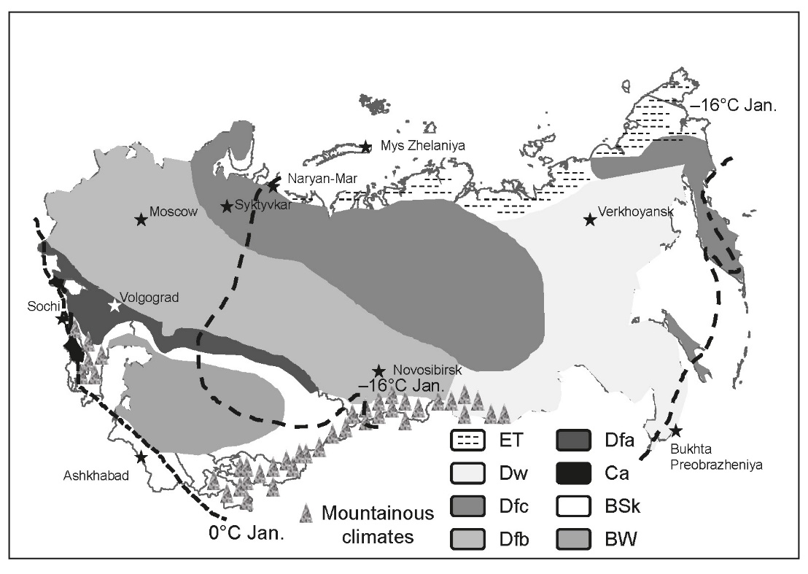
This slide is a supplement to A Geography of Russia and Its Neighbors, Second Edition by Mikhail S. Blinnikov. Copyright © 2021 The Guilford Press.

Slide 9
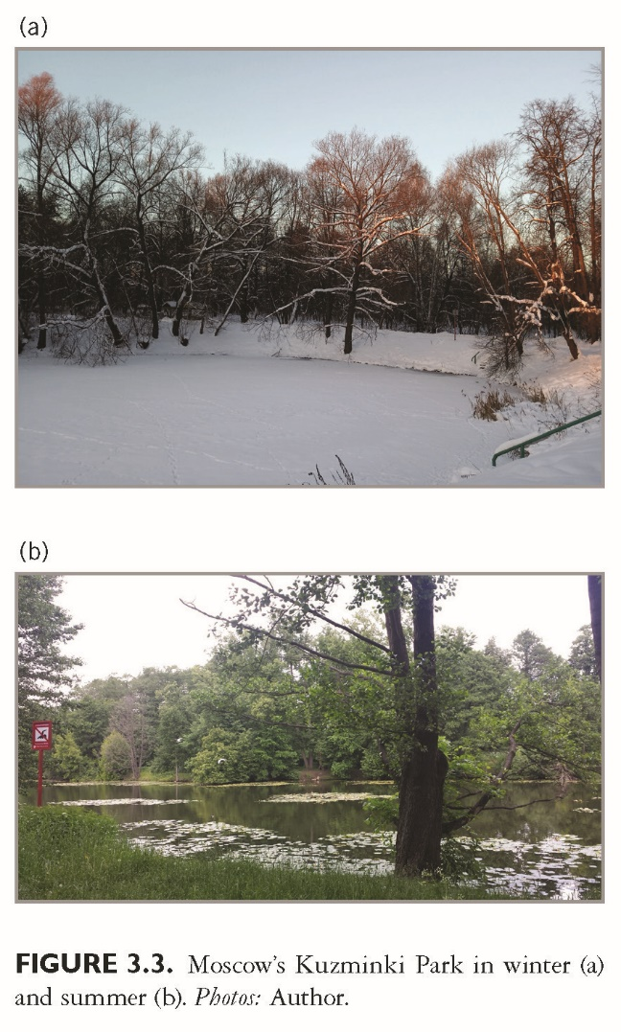
This slide is a supplement to A Geography of Russia and Its Neighbors, Second Edition by Mikhail S. Blinnikov. Copyright © 2021 The Guilford Press.

Slide 10
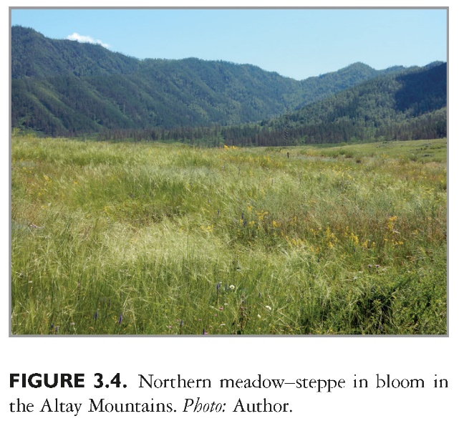
This slide is a supplement to A Geography of Russia and Its Neighbors, Second Edition by Mikhail S. Blinnikov. Copyright © 2021 The Guilford Press.

Slide 11
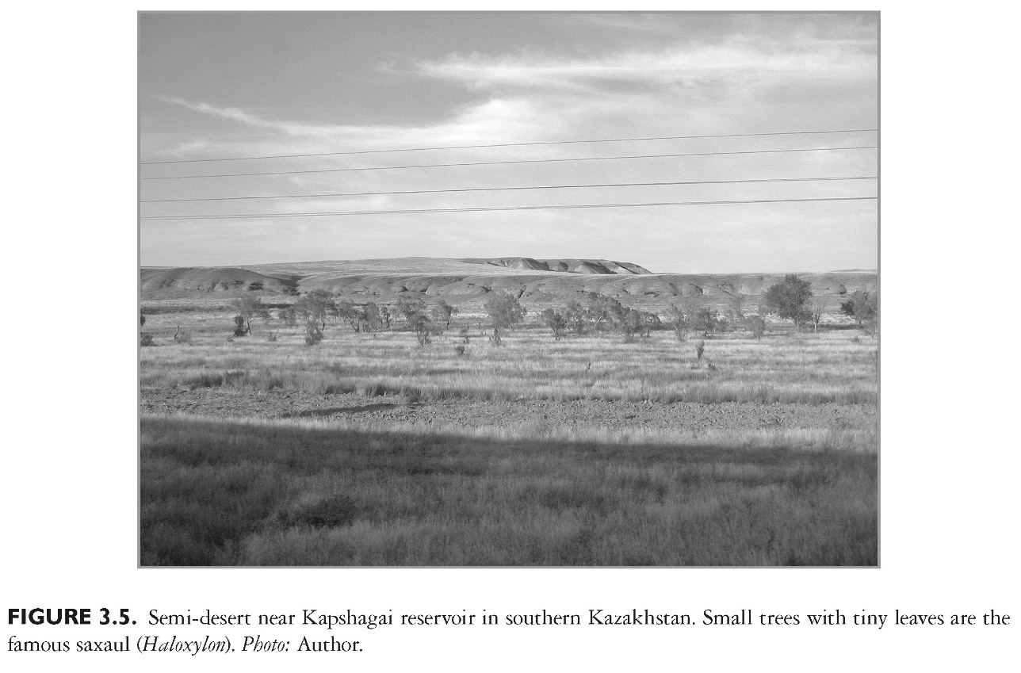
This slide is a supplement to A Geography of Russia and Its Neighbors, Second Edition by Mikhail S. Blinnikov. Copyright © 2021 The Guilford Press.

Slide 12
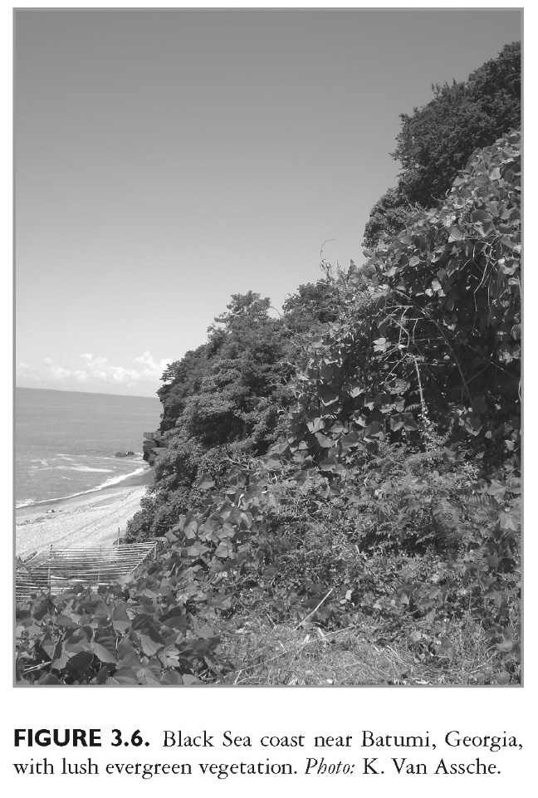
This slide is a supplement to A Geography of Russia and Its Neighbors, Second Edition by Mikhail S. Blinnikov. Copyright © 2021 The Guilford Press.

Slide 13
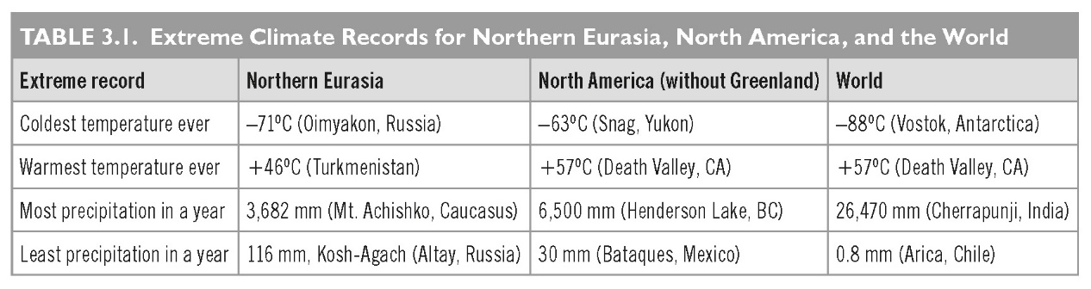
This slide is a supplement to A Geography of Russia and Its Neighbors, Second Edition by Mikhail S. Blinnikov. Copyright © 2021 The Guilford Press.

Slide 14
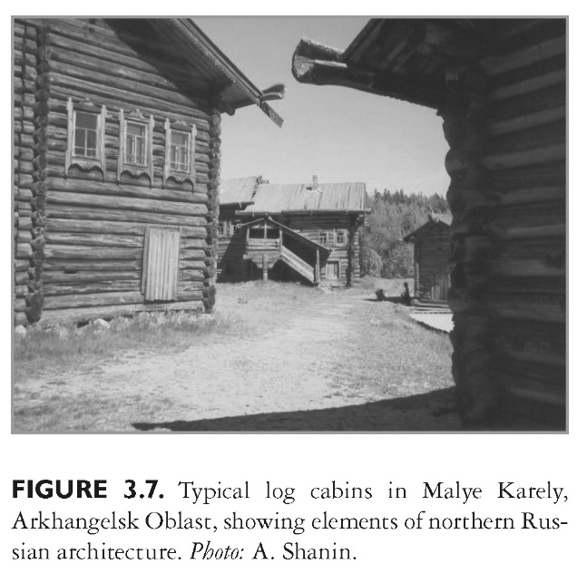
This slide is a supplement to A Geography of Russia and Its Neighbors, Second Edition by Mikhail S. Blinnikov. Copyright © 2021 The Guilford Press.

Slide 15
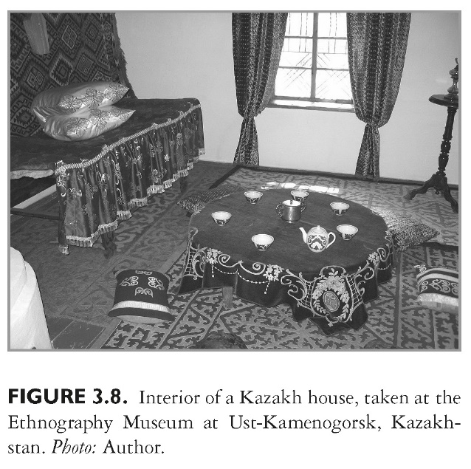
This slide is a supplement to A Geography of Russia and Its Neighbors, Second Edition by Mikhail S. Blinnikov. Copyright © 2021 The Guilford Press.

Slide 16
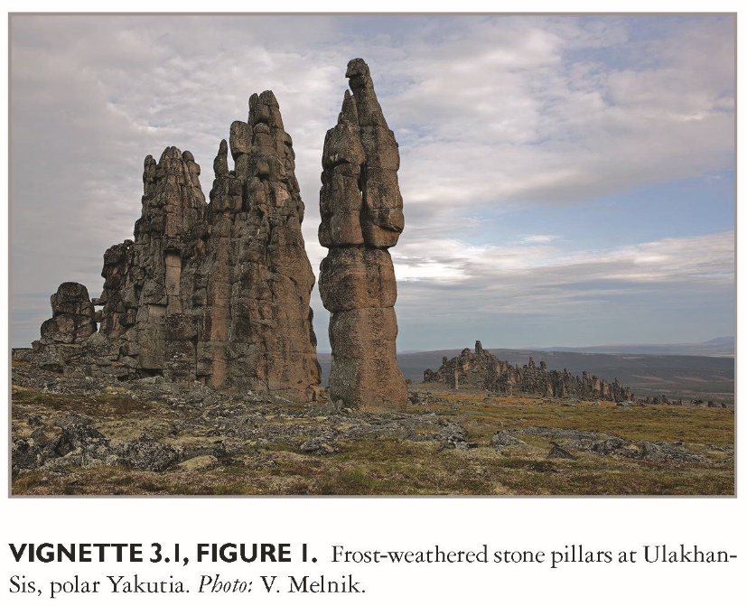
This slide is a supplement to A Geography of Russia and Its Neighbors, Second Edition by Mikhail S. Blinnikov. Copyright © 2021 The Guilford Press.

Slide 17
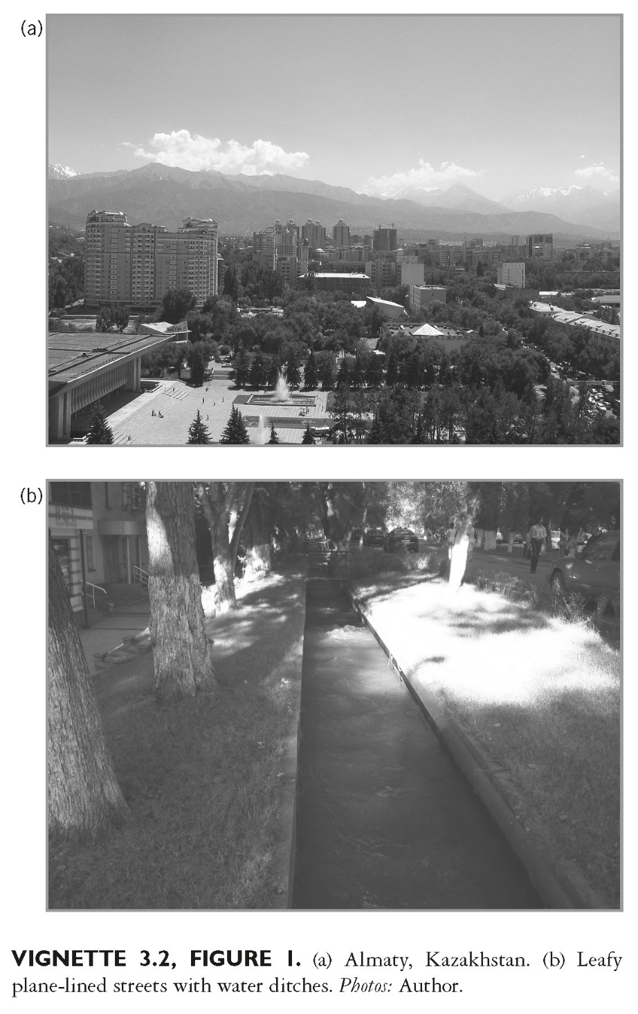
This slide is a supplement to A Geography of Russia and Its Neighbors, Second Edition by Mikhail S. Blinnikov. Copyright © 2021 The Guilford Press.

