Slide 1
This slide is a supplement to A Geography of Russia and Its Neighbors, Second Edition by Mikhail S. Blinnikov. Copyright © 2021 The Guilford Press.
Chapter 4. Biomes
Biomes of Northern Eurasia
Tundra
Taiga (boreal forest)
Deciduous forest (two distinct types, one in Europe and one along the Pacific Coast)
Steppe
Deserts
Little bit of dry (Crimea) and wet (Black Sea Coast) subtropical Mediterranean scrub or forest
See Table 4.1 for details on each
Typical Wildlife – Arctic (Polar deserts)
Puffins, seals, sea otters, Arctic fox, walrus, polar bear
Plants – almost none, some mosses and lichens
Typical Wildlife – Tundra Zone
Reindeer, musk ox (reintroduced from Greenland), snowy owl, red-breasted goose, wolf, gyrfalcon, many shorebirds, swans, weasel, rodents (cf. with northern Alaska)
Plants – mosses, lichens, small shrubs from heath family, sedges, grasses, willows and birch

Slide 2
This slide is a supplement to A Geography of Russia and Its Neighbors, Second Edition by Mikhail S. Blinnikov. Copyright © 2021 The Guilford Press.
Typical Wildlife – Taiga (cf. with much of Canada)
Brown bear, moose, lynx, woodpeckers, owls, capercaille grouse, chipmunks, sable, wolverine, grosbeaks, cross-bills
Plants – mainly conifers, especially fir, spruce, larch, pine, etc.
Typical Wildlife – Deciduous Forest European part (cf. Eastern USA or Germany)
Squirrel, flying squirrel, roe deer, elk, barred owl, dormice, red fox, hares, warblers, cuckoo, woodpeckers, titmice
Plants – oak, linden, maple, elm, ash, many wildflowers
Typical Wildlife – Deciduous Forest Far East
Many of the same, but add Siberian tiger, Amur leopard, Blakiston’s fish owl, sea eagles
Plants – most diverse flora of trees in Russia (over 50 species), some bamboos and even lianas
Typical Wildlife – Steppe Zone
Saiga antelope, wild donkey, eagles, bustard, ground squirrel
Plants – shrubs, bunchgrasses, wildflowers

Slide 3
This slide is a supplement to A Geography of Russia and Its Neighbors, Second Edition by Mikhail S. Blinnikov. Copyright © 2021 The Guilford Press.
Typical Wildlife – Desert Zone
Lizards, snakes, tortoise, desert cat, long-eared hedgehog, camel
Plants – scarce, mainly annual that bloom after rain, saksaul tree
Typical Wildlife – Southern Mountains
Mountain goat, mountain sheep (argali), snow leopard, marmots, pikas, falcons, pipits
Plants – many very different ones depending on the elevation belt

Slide 4
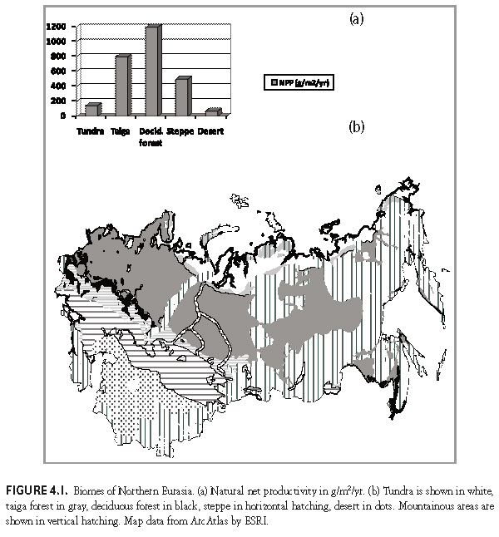
This slide is a supplement to A Geography of Russia and Its Neighbors, Second Edition by Mikhail S. Blinnikov. Copyright © 2021 The Guilford Press.

Slide 5
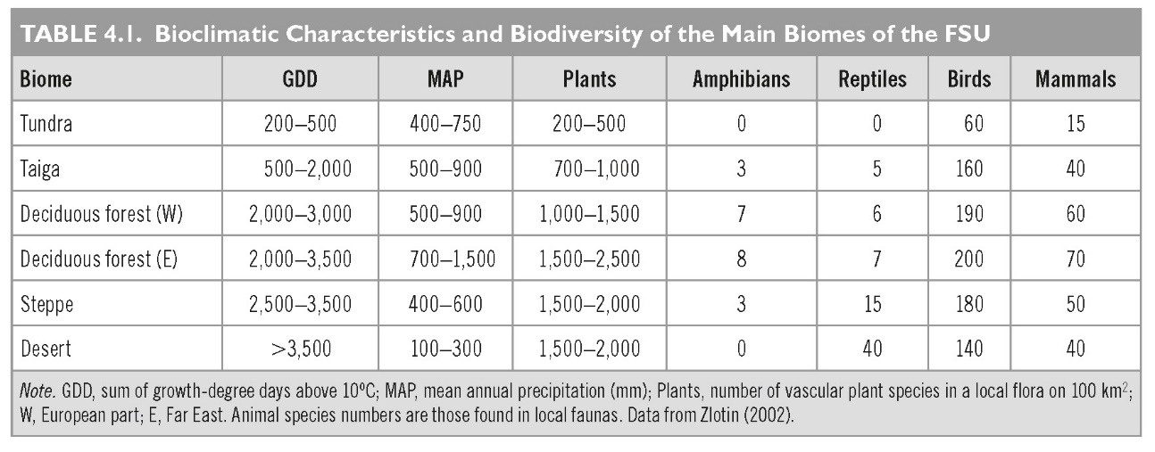
This slide is a supplement to A Geography of Russia and Its Neighbors, Second Edition by Mikhail S. Blinnikov. Copyright © 2021 The Guilford Press.

Slide 6
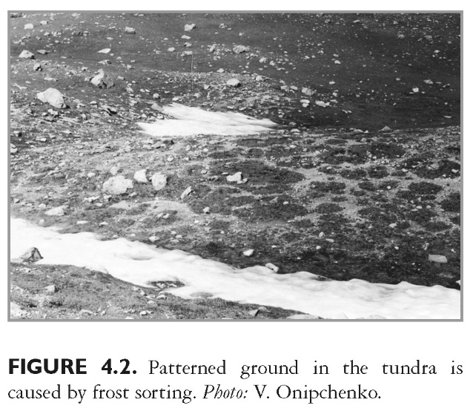
This slide is a supplement to A Geography of Russia and Its Neighbors, Second Edition by Mikhail S. Blinnikov. Copyright © 2021 The Guilford Press.

Slide 7
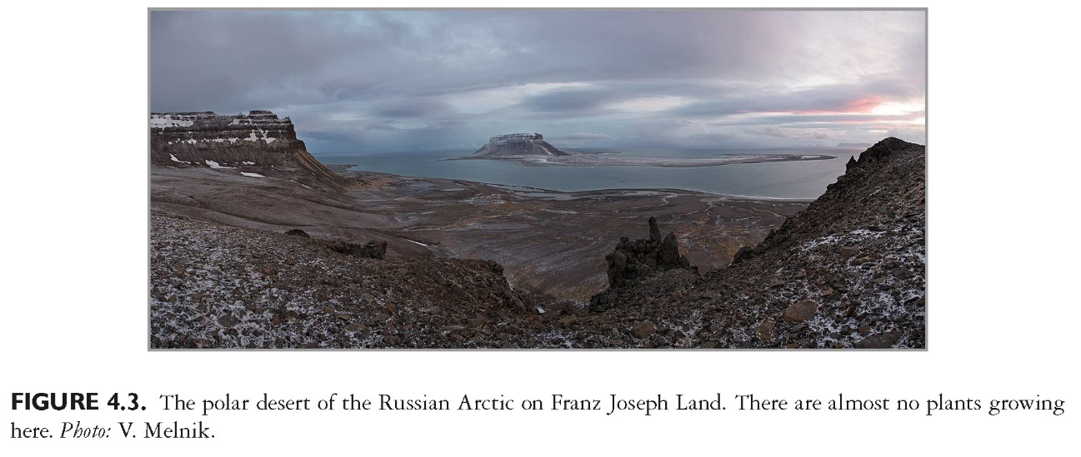
This slide is a supplement to A Geography of Russia and Its Neighbors, Second Edition by Mikhail S. Blinnikov. Copyright © 2021 The Guilford Press.

Slide 8
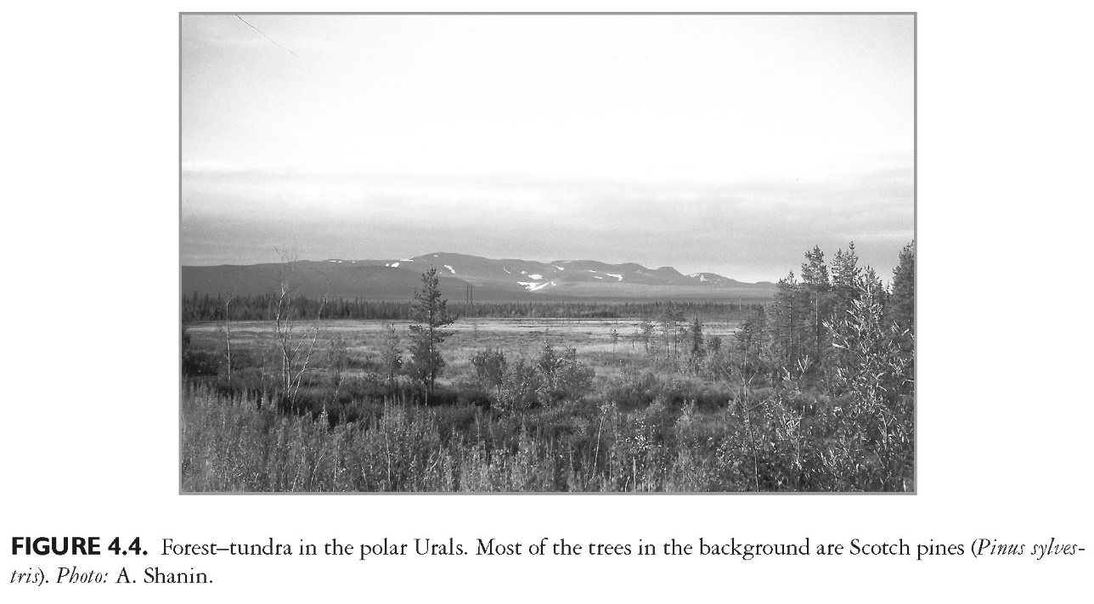
This slide is a supplement to A Geography of Russia and Its Neighbors, Second Edition by Mikhail S. Blinnikov. Copyright © 2021 The Guilford Press.

Slide 9
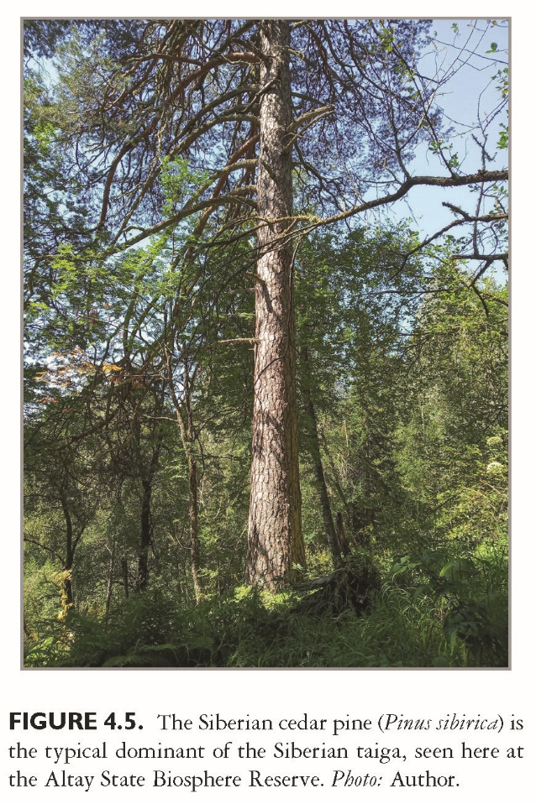
This slide is a supplement to A Geography of Russia and Its Neighbors, Second Edition by Mikhail S. Blinnikov. Copyright © 2021 The Guilford Press.

Slide 10
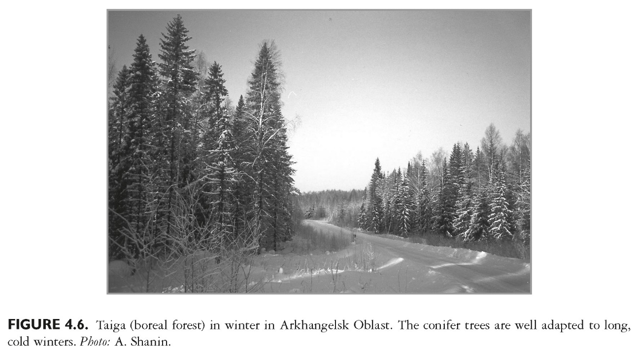
This slide is a supplement to A Geography of Russia and Its Neighbors, Second Edition by Mikhail S. Blinnikov. Copyright © 2021 The Guilford Press.

Slide 11
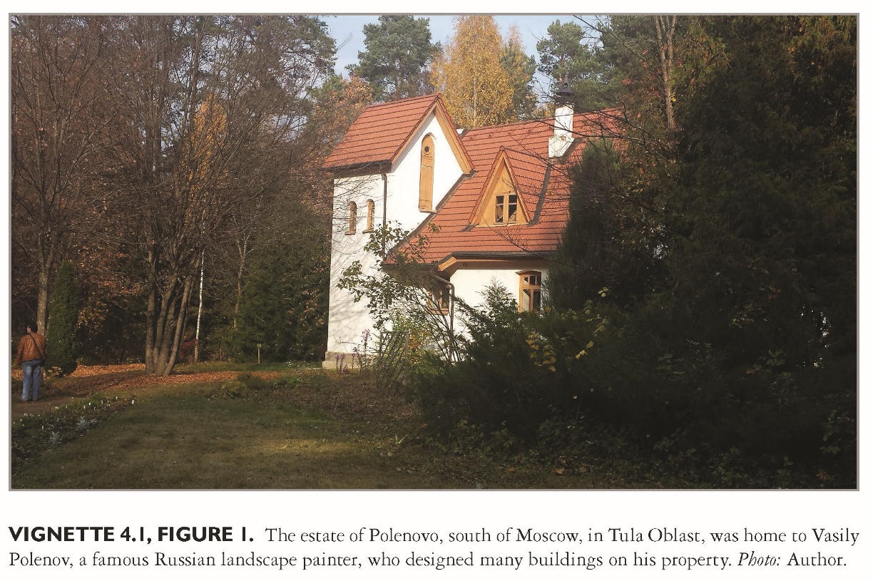
This slide is a supplement to A Geography of Russia and Its Neighbors, Second Edition by Mikhail S. Blinnikov. Copyright © 2021 The Guilford Press.

Slide 12
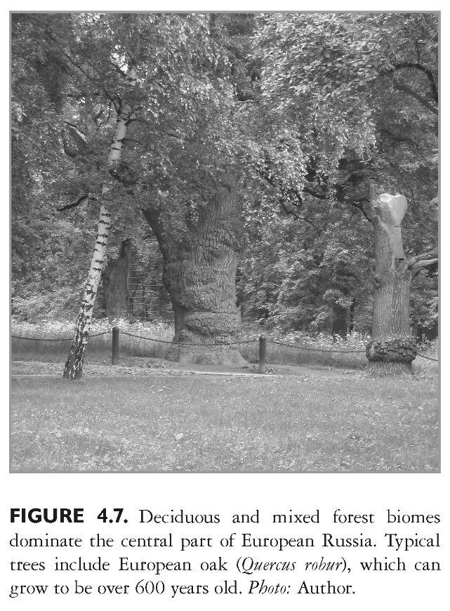
This slide is a supplement to A Geography of Russia and Its Neighbors, Second Edition by Mikhail S. Blinnikov. Copyright © 2021 The Guilford Press.

Slide 13
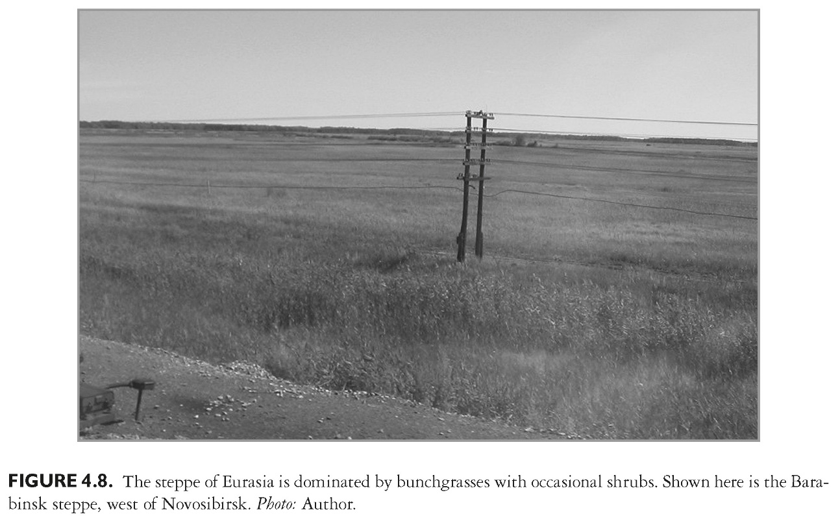
This slide is a supplement to A Geography of Russia and Its Neighbors, Second Edition by Mikhail S. Blinnikov. Copyright © 2021 The Guilford Press.

Slide 14
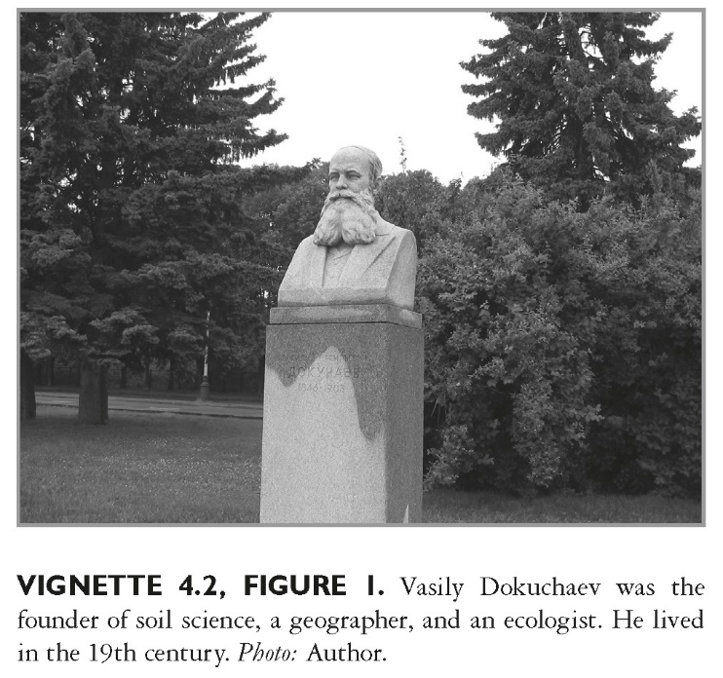
This slide is a supplement to A Geography of Russia and Its Neighbors, Second Edition by Mikhail S. Blinnikov. Copyright © 2021 The Guilford Press.

