Slide 1
This slide is a supplement to A Geography of Russia and Its Neighbors, Second Edition by Mikhail S. Blinnikov. Copyright © 2021 The Guilford Press.
Chapter 6. Formation of the Russian State
Late Paleolithic (30,000–10,000) – many sites known from Crimea, the Don and Dnieper basins
Neolithic (7000–5000 BP) – comb ceramic culture along the Baltic coast, another culture in the Dnieper basin
Indo-European origins – somewhere north of the Caspian Sea (ca. 5000 BP)
Kurgan culture (4000–2000 BCE)
  Ice burial mounds
Scythians (800–300 BC)
  Horses and gold
Dyakovo culture Iron Age earliest in the Moscow region 7th c BC–5th c CE
Time of Great Migrations (4–7th c CE)
Slavs around 7th century AD begin to separate into
Western…
Eastern…
Southern…

Slide 2
This slide is a supplement to A Geography of Russia and Its Neighbors, Second Edition by Mikhail S. Blinnikov. Copyright © 2021 The Guilford Press.
Rus’ origins
Forest/steppe interface
Furs, timber, amber from North
Horses, fruit, silk, jewelry from South
Vikings to Greeks waterway
Sarskoe hill-fort near Rostov – 8–10th century – combination of local Merya people and Scandinavian Vikings’ influences
Kievan Rus (900–1200) on the Dnieper
Prince Vladimir
Novgorod (12th–15th) was another important early city in the north
Location of old Russian cities (map)
On a river or lake
High above the floodplain
At the confluence of two rivers

Slide 3
This slide is a supplement to A Geography of Russia and Its Neighbors, Second Edition by Mikhail S. Blinnikov. Copyright © 2021 The Guilford Press.
Examples of such sites include Rostov, Yaroslavl, Vladimir, Murom, Smolensk, Pskov, Moscow and many others
Moscow
1147 CE – first mention of a fort
  On Moskva river, a tributary to the Oka, which is a tributary to the Volga, so location was out of the way
  St. Daniil of Moscow, son of Alexander Nevsky (1261–1303) – built first monasteries
St. Dmitry Donskoy (1350–1389) – defeated the Tatars on Kulikovo battlefield in 1380
The Kremlin of Moscow – how it grew
Dormition Cathedral – for coronation of grand princes, some bishops buried in it
Archangels’ Cathedral – burial church for the princes
Annunciation Cathedral – to serve weekly liturgies
  There were also churches for daily services
Most of the kremlin as we see it today was completed under Ivan III in the late 1400s
St. Basil’s Cathedral on the Red Square (1556) – to commemorate conquest of Kazan tatars

Slide 4
This slide is a supplement to A Geography of Russia and Its Neighbors, Second Edition by Mikhail S. Blinnikov. Copyright © 2021 The Guilford Press.
The Empire Expands eastward rapidly in the 15th century
Biggest expansion in the 1600s – all the way to the Pacific!
Ukraine + Russia join in 1654
Alaska added – 1741–1867
Poland and Finland – 1815–1917
Georgia joined 1783–1801
Caucasus and Central Asia by 1860
Think together: why east first? Not west? Or south?
Yermak’s conquest of Siberia (1582) – a painting
Siberia conquered by 1700, this is also the time of construction of St. Petersburg in the west
Cross the Urals (1581)
Tyumen (1586)
Tobolsk (1587)
Surgut (1594)
Tomsk (1604)
Yeniseisk (1619)
Yakutsk (1632)
Okhotsk (1649)
Petropavlovsk-Kamchatsky (1697)

Slide 5
This slide is a supplement to A Geography of Russia and Its Neighbors, Second Edition by Mikhail S. Blinnikov. Copyright © 2021 The Guilford Press.
Discuss strategic location of St. Petersburg and why Peter the Great wanted the capital to be moved there
“Novorossiya” – lands north of the Black Sea
Last pieces of the empire puzzle come into place in the 19th century as the Caucasus and Central Asia are added
Russian America in Alaska and down to Fort Ross, California
Capital New Arkhangelsk, now Sitka
Baranov house in Kodiak, AK
Helsinki, Finland was a fort built by the Russians to defend northeastern Baltic from the Swedes. Finland was added to the Russian Empire from Sweden
Geographical limits are physical out North and East and more cultural out West and South
Late Russian empire – second biggest on Earth in 1917 (after British)
Contiguous (on land)
West growth checked by Austro-Hungary, Germany, Poland and Sweden
South – by Turkey, Persia, mountains
East – Pacific Ocean and distance
North – Arctic Ocean

Slide 6
This slide is a supplement to A Geography of Russia and Its Neighbors, Second Edition by Mikhail S. Blinnikov. Copyright © 2021 The Guilford Press.
At the first all-Russian census in 1897, it had 125,640,000 inhabitants
Russia today has 145 million on about ¾ of the former territory
USSR had 280 million in 1989
Heartland theory
Halford Mackinder (1904, 1920)
Eurasia as geographical pivot of history
Alfred Mahan and sea power thesis
Nicholas Spykman (1944) and his Rimland thesis

Slide 7
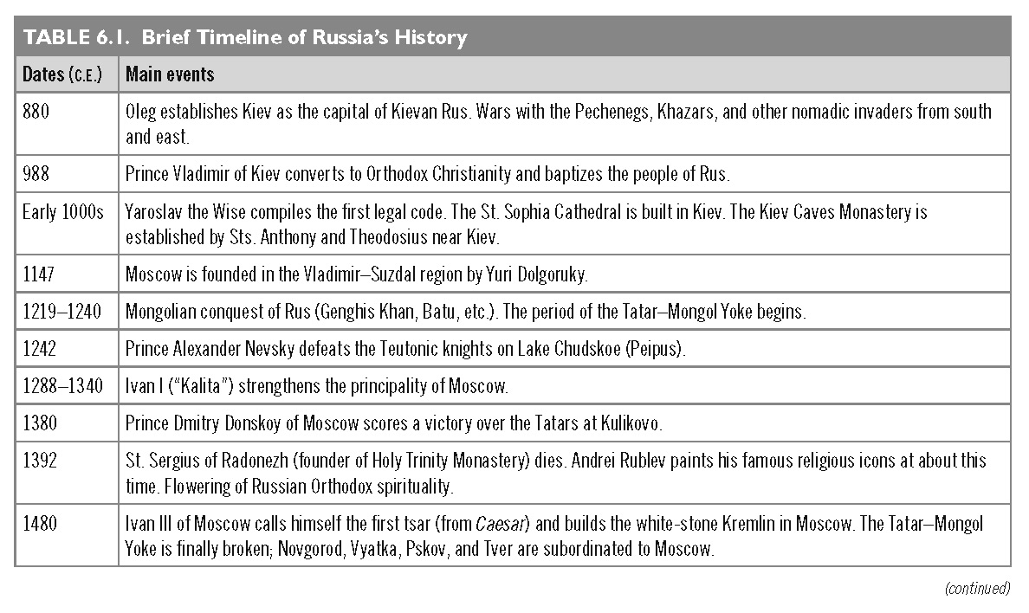
This slide is a supplement to A Geography of Russia and Its Neighbors, Second Edition by Mikhail S. Blinnikov. Copyright © 2021 The Guilford Press.

Slide 8
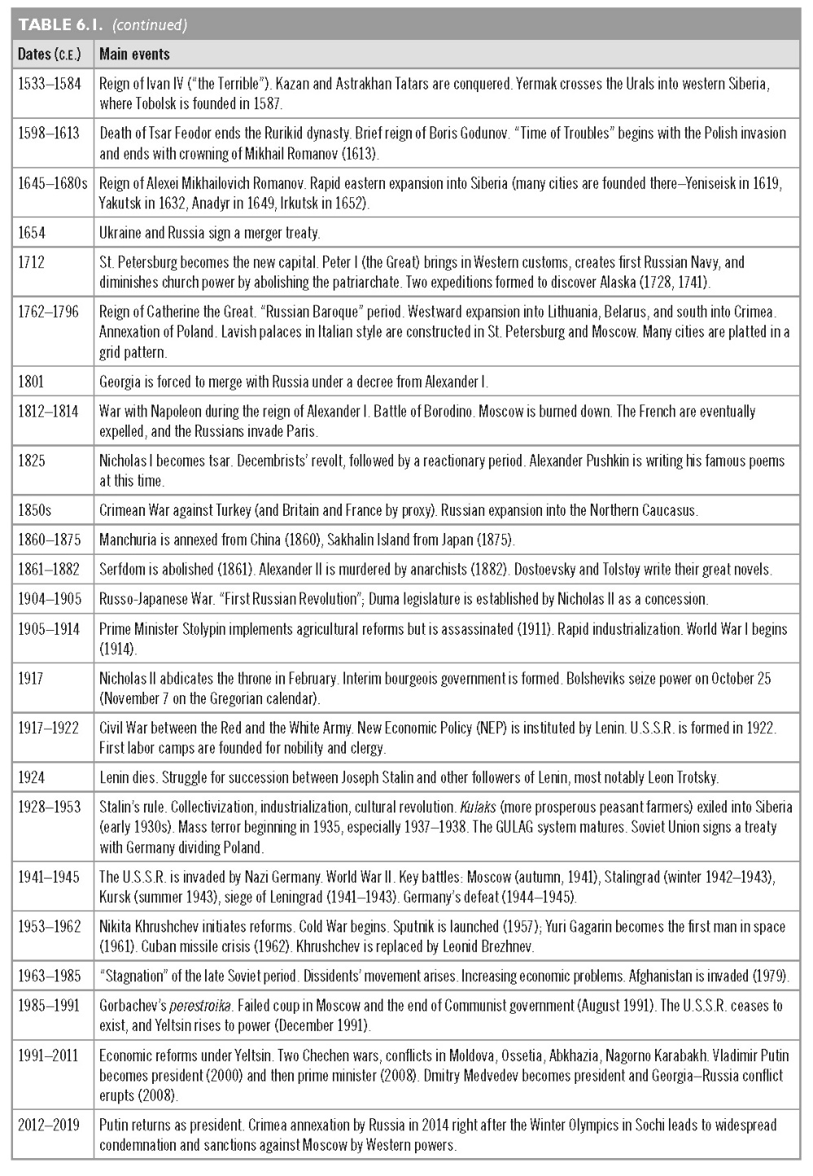
This slide is a supplement to A Geography of Russia and Its Neighbors, Second Edition by Mikhail S. Blinnikov. Copyright © 2021 The Guilford Press.

Slide 9
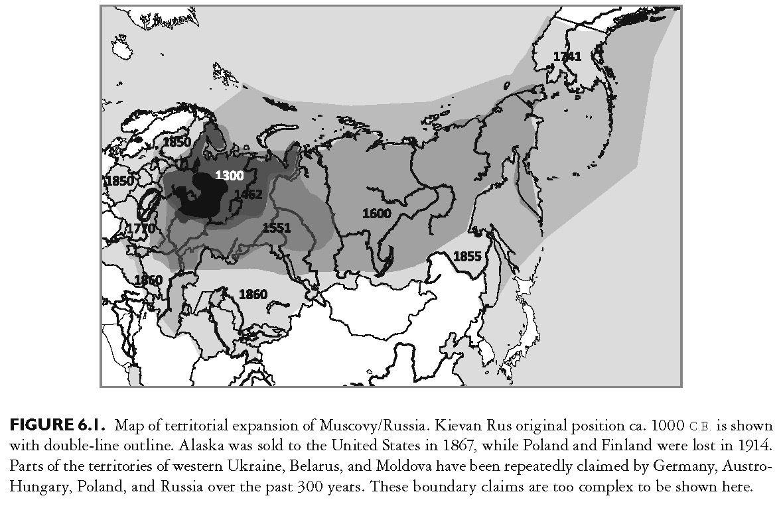
This slide is a supplement to A Geography of Russia and Its Neighbors, Second Edition by Mikhail S. Blinnikov. Copyright © 2021 The Guilford Press.

Slide 10
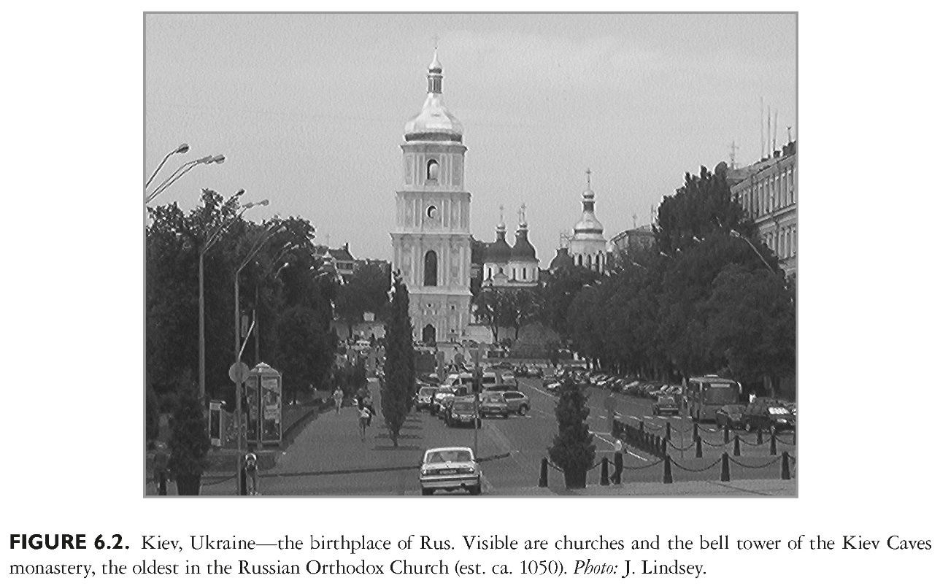
This slide is a supplement to A Geography of Russia and Its Neighbors, Second Edition by Mikhail S. Blinnikov. Copyright © 2021 The Guilford Press.

Slide 11
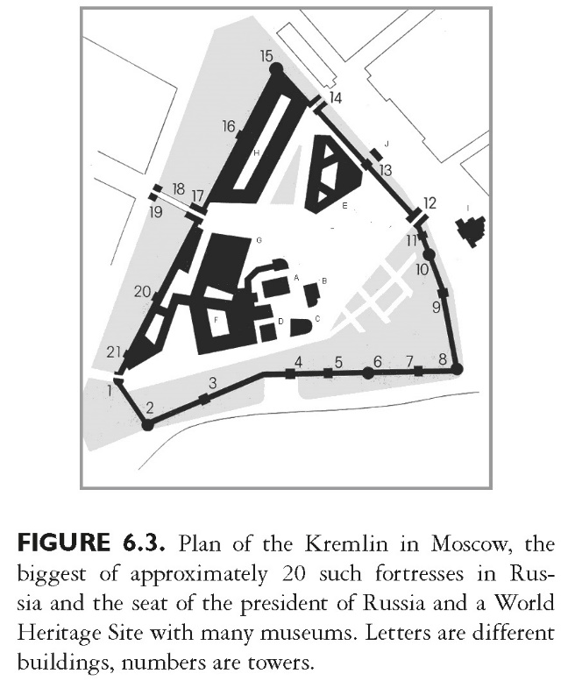
This slide is a supplement to A Geography of Russia and Its Neighbors, Second Edition by Mikhail S. Blinnikov. Copyright © 2021 The Guilford Press.

Slide 12
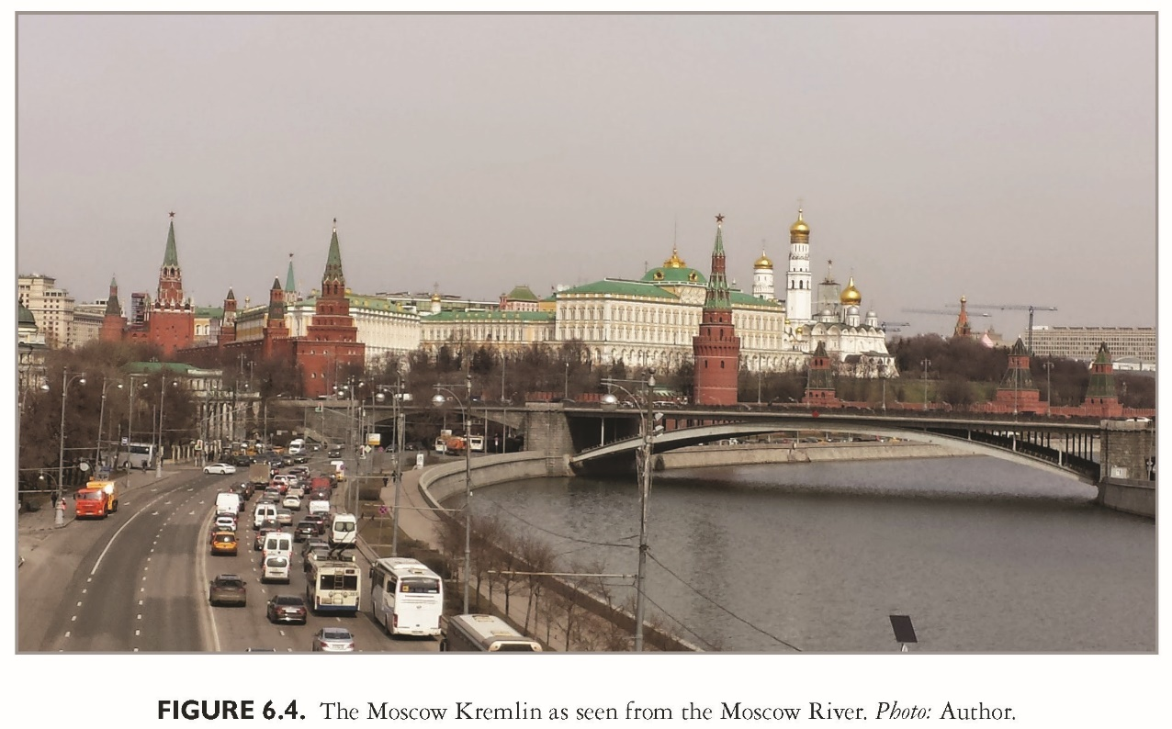
This slide is a supplement to A Geography of Russia and Its Neighbors, Second Edition by Mikhail S. Blinnikov. Copyright © 2021 The Guilford Press.

Slide 13
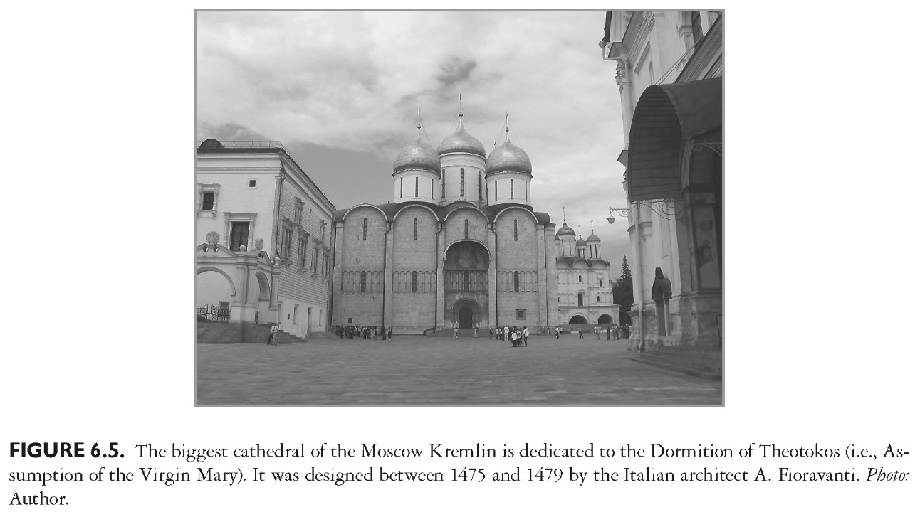
This slide is a supplement to A Geography of Russia and Its Neighbors, Second Edition by Mikhail S. Blinnikov. Copyright © 2021 The Guilford Press.

Slide 14
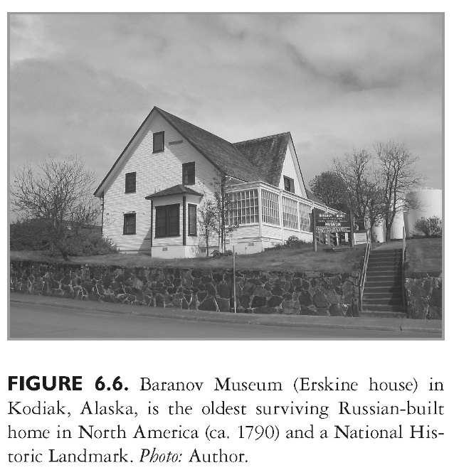
This slide is a supplement to A Geography of Russia and Its Neighbors, Second Edition by Mikhail S. Blinnikov. Copyright © 2021 The Guilford Press.

Slide 15
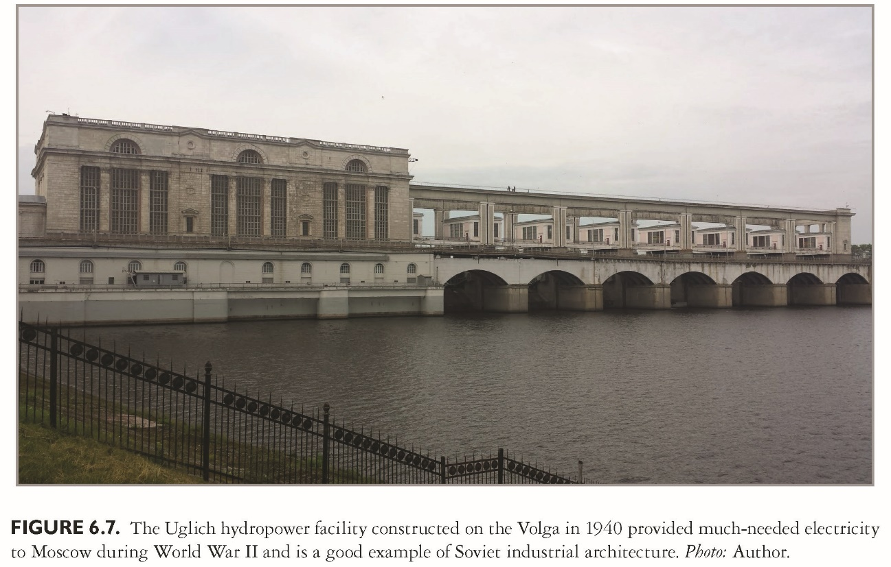
This slide is a supplement to A Geography of Russia and Its Neighbors, Second Edition by Mikhail S. Blinnikov. Copyright © 2021 The Guilford Press.

Slide 16
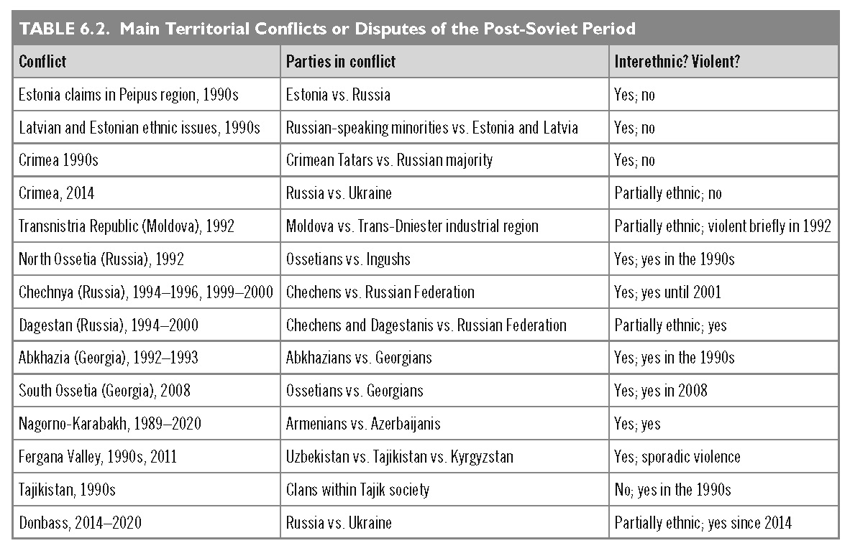
This slide is a supplement to A Geography of Russia and Its Neighbors, Second Edition by Mikhail S. Blinnikov. Copyright © 2021 The Guilford Press.

