Slide 1
This slide is a supplement to A Geography of Russia and Its Neighbors, Second Edition by Mikhail S. Blinnikov. Copyright © 2021 The Guilford Press.
Chapter 7. The Soviet Legacy
Soviet system as an alternative to capitalism/imperialism of the West
Soviet Union was born in the October Revolution (some call it revolt) of the Bolsheviks in 1917
Officially proclaimed in 1922 (after Civil War ended)
Politically – rule of one Communist party
No contested elections
No freedom of speech or religion
Totalitarian ideology (read G. Orwell’s 1984)
Economically – socialism (not communism yet, that was only promised)
Centralized planned economy
Collectivization of agriculture in the 1930s
Heavy industrialization in the 1930s
Welfare state (what does it mean?)
Cultural Sovetization
Based on Russian language
Support for arts and sciences
Global reach – Europe, Cuba, Vietnam, Africa

Slide 2
This slide is a supplement to A Geography of Russia and Its Neighbors, Second Edition by Mikhail S. Blinnikov. Copyright © 2021 The Guilford Press.
Cult of Joseph Stalin and purges of Party leadership
3 pillars of Stalinism fully implemented in the 1930s
Collectivization
Industrialization
Cultural Revolution
Why needed? To compete with the capitalist West
Collectivization
Serfdom abolished in 1861 – but no land given to the peasants to farm
PM Stolypin tried reforms to make real farmers, but got killed
V. Lenin promised land to peasants, but lied
J. Stalin put them all in kolkhozy instead
“Kulaks” exiled to Siberia or died of hunger, known as Golodomor (almost 2 million!)

Slide 3
This slide is a supplement to A Geography of Russia and Its Neighbors, Second Edition by Mikhail S. Blinnikov. Copyright © 2021 The Guilford Press.
Industrialization
Needed to prove to the world that socialism was better than capitalism
Looming possibility of another world war
“Heroes of labor” real or not – sovietposters.ru
Large projects in remote areas
Development of the North and Siberia
“Free” prison labor (millions of people!)
Dams, canals, railroads, cities in the Arctic, coal and oil extraction, timber, steel, gold
Isolationism in external affairs, but limited exports/imports allowed
Some of the first cars and tractors and entire metallurgy plants purchased from the United States
Grain, timber exported, later oil and gas
Some heavy machinery and especially “know-how” imported until the end of the Soviet Union

Slide 4
This slide is a supplement to A Geography of Russia and Its Neighbors, Second Edition by Mikhail S. Blinnikov. Copyright © 2021 The Guilford Press.
Large projects of Stalinism (map Figure 7.2)
Some results of industrialization (table)
Territorial–Industrial Complex (TPK) model
Localization
Integration
Utilization
Most common for steel, fertilizers, petrochemicals, advanced machine building
Examples?
Cultural Sovietization
A new “Soviet nation” will be based on
Russification
Education, health care, arts, sports – free!
Common military experience

Slide 5
This slide is a supplement to A Geography of Russia and Its Neighbors, Second Edition by Mikhail S. Blinnikov. Copyright © 2021 The Guilford Press.
There was no official unemployment and most workers were assigned jobs fresh out of school or college
Atheist state – so religions were suppressed
Communal living encouraged
Concessions to local languages and cultural traditions (newspapers, radio, arts, crafts, sports, etc.) in ethnically non-Russian areas
Who are the residents of Donbass in 2015?
Impact of World War II
Most destructive military conflict ever
  Worldwide losses
24 million soldiers and 46.7 million civilians
  USSR losses
8.8 million soldiers and 15.6 million civilians (still unconfirmed, probably even more)
  Germany losses
5.3 million soldiers and 1.4 million civilians
  USA losses
405,000 soldiers and 3,000 civilians

Slide 6
This slide is a supplement to A Geography of Russia and Its Neighbors, Second Edition by Mikhail S. Blinnikov. Copyright © 2021 The Guilford Press.
Many factories were relocated from West European Russia and Ukraine to the Volga, Siberia and Kazakhstan
Soviets also looted a lot of Germany factories for quality equipment as reparations for the war damage
After the war Kaliningrad Oblast was gained from Germany in the Baltic Sea region and Sakhalin and 4 Kuril Islands were gained from Japan
Structure of the Soviet state (diagram showing three branches of government)
Planned economy (5 year plans) – Gosplan
Slow feedback, no market to regulate
Command-and-(maybe) control
Secrecy, double-speak
Inefficient
Duplicate functions
People chosen for loyalty, not quality
Lack of incentives

Slide 7
This slide is a supplement to A Geography of Russia and Its Neighbors, Second Edition by Mikhail S. Blinnikov. Copyright © 2021 The Guilford Press.
Nikita Khruschev started many reforms after Stalin died in 1953
Released millions of political prisoners
In agriculture, opened 35 million ha of "virgin lands" in northern Kazakhstan and Siberia to new grain production
Also corn in Kuban and cotton in Uzbekistan
In industry, moved into more consumer-oriented sectors (apartments, appliances, cars)
He improved Soviet diplomatic relations
He visited India, China, Yugoslavia, Europe, even USA! Fell in love with hogs in Iowa and corn and cotton production greatly increased as a result of his visit
Space program started (Sputnik! Gagarin!)
Baykonur launch pad is leased by Russia from Kazakhstan
6717 km²
Since 1955
21 launches per year on average
Virgin Lands in North Kazakhstan – Целина – breadbasket

Slide 8
This slide is a supplement to A Geography of Russia and Its Neighbors, Second Edition by Mikhail S. Blinnikov. Copyright © 2021 The Guilford Press.
Examples of technology developed in 1960–1970s
Supersonic jets (Tu–144)
Nuclear icebreakers
Lasik surgery
Electric trains everywhere
Some consumer-oriented products such as microwave ovens and basic cars (LADA)
Nomenklatura – Mikhail Voslensky book (1984)
“The secret ruling class of the Soviet society”
About 3% of population were the Communist bureaucratic elite
Power = had all the real power, regular Communist members had none
Phone hierarchy system – status symbol
Perks
Chauffeurs, dachas, “distribution stores”, seaside resorts, cheap and free meals, concerts, trips abroad
Non-hereditary, so recruitment of new people was needed
Central Clinical Hospital photo
Chaika limo photo

Slide 9
This slide is a supplement to A Geography of Russia and Its Neighbors, Second Edition by Mikhail S. Blinnikov. Copyright © 2021 The Guilford Press.
Sanatoria in Sochi photo
Nice apartments and dachas outside the city photos
Soviet period impact on geography
Strong core – periphery dichotomy maintained
Hierarchy of settlements
Monocities (single factory or a cluster of factories provided most jobs)
Too much heavy industry
Military–industrial complex
Machinery for making more machinery
Few consumer goods and services and of inferior quality
What? No bubble gum? No jeans? No good stereos?
Extensive, not intensive, development
Waste of resources, environmental damage
Departmentalism of the economy (40+ ministries!)
Why did USSR collapse?
Bound by the same chain (1986) song by Nautilus Pompilius band highlights the stifling nature of the late Soviet society (www.nautilus.ru)

Slide 10
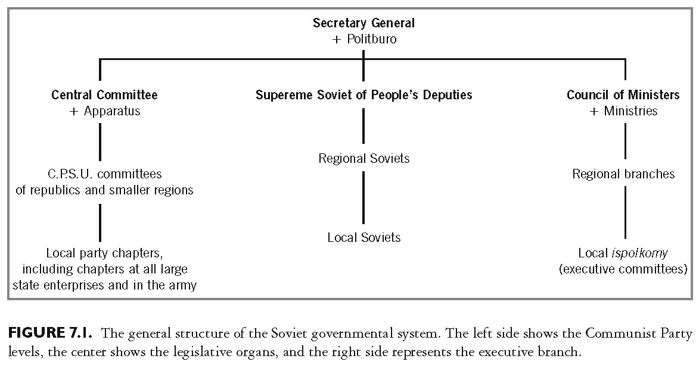
This slide is a supplement to A Geography of Russia and Its Neighbors, Second Edition by Mikhail S. Blinnikov. Copyright © 2021 The Guilford Press.

Slide 11
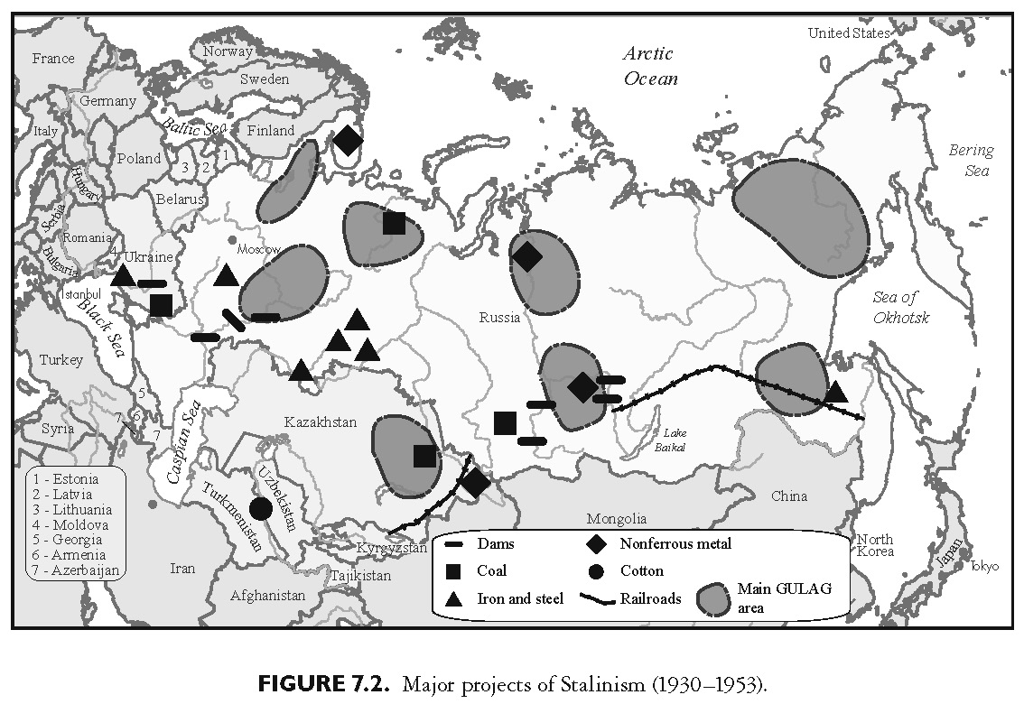
This slide is a supplement to A Geography of Russia and Its Neighbors, Second Edition by Mikhail S. Blinnikov. Copyright © 2021 The Guilford Press.

Slide 12
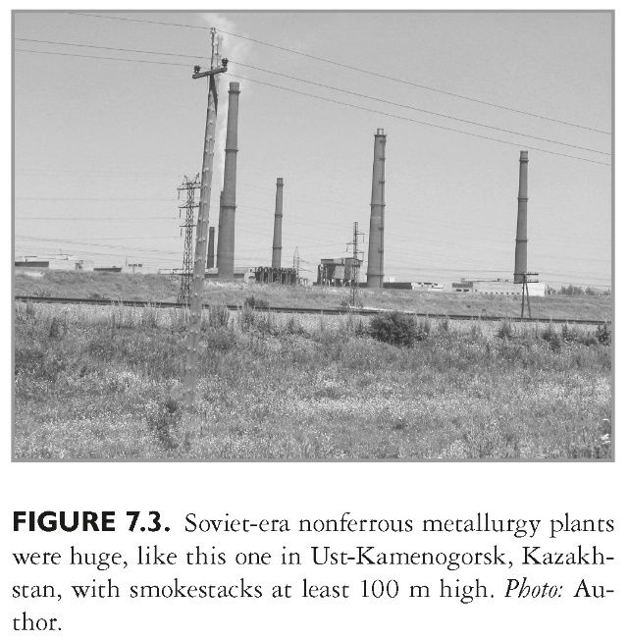
This slide is a supplement to A Geography of Russia and Its Neighbors, Second Edition by Mikhail S. Blinnikov. Copyright © 2021 The Guilford Press.

Slide 13
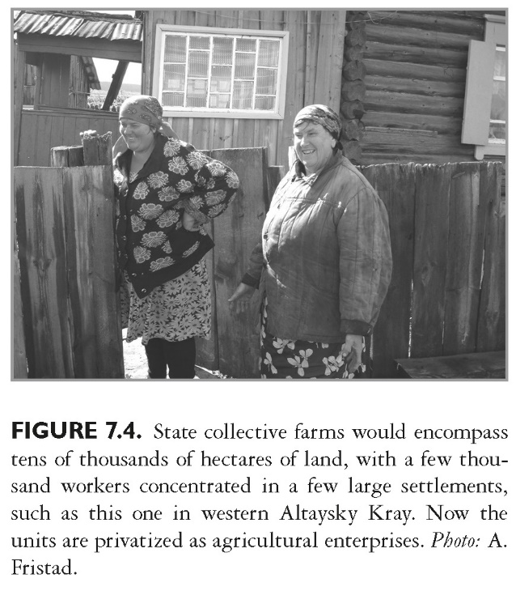
This slide is a supplement to A Geography of Russia and Its Neighbors, Second Edition by Mikhail S. Blinnikov. Copyright © 2021 The Guilford Press.

Slide 14
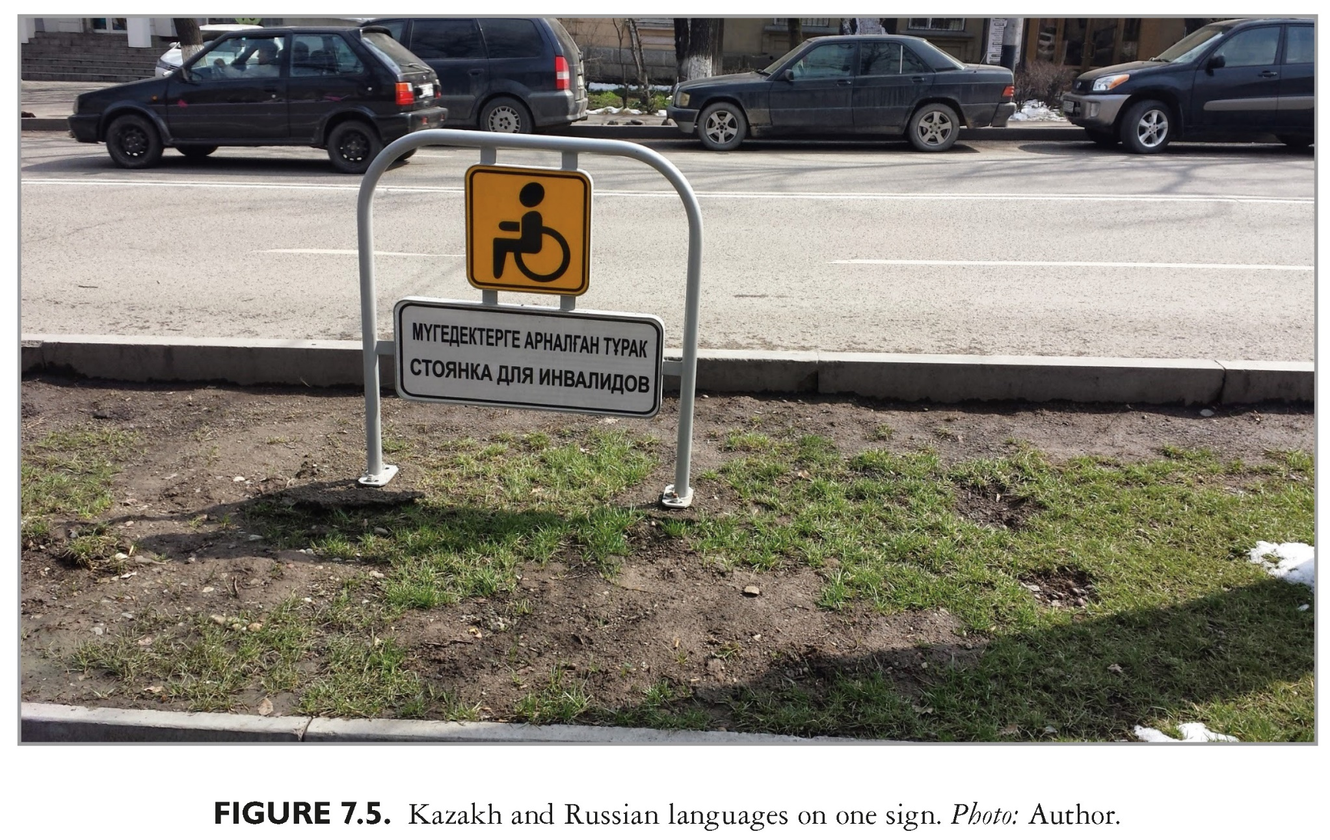
This slide is a supplement to A Geography of Russia and Its Neighbors, Second Edition by Mikhail S. Blinnikov. Copyright © 2021 The Guilford Press.

Slide 15
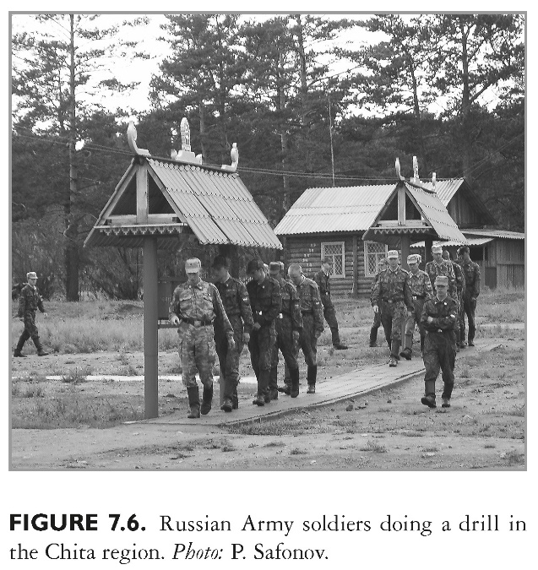
This slide is a supplement to A Geography of Russia and Its Neighbors, Second Edition by Mikhail S. Blinnikov. Copyright © 2021 The Guilford Press.

Slide 16
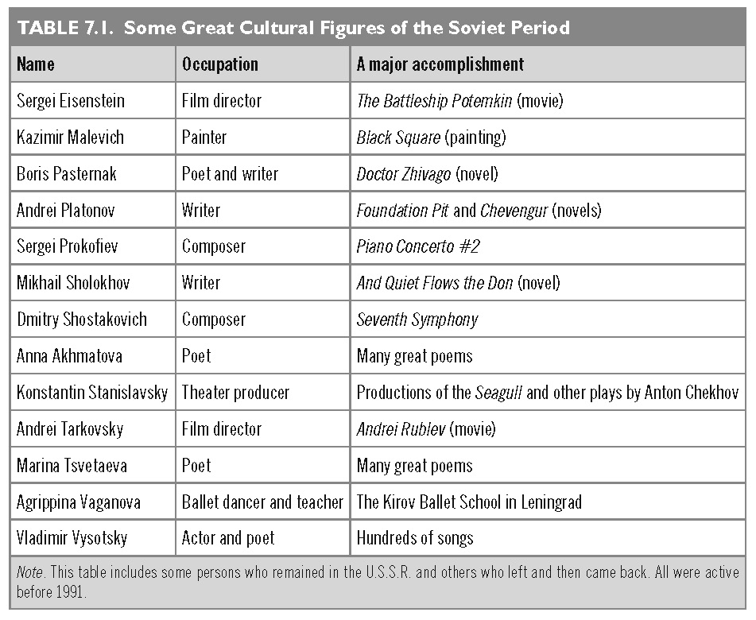
This slide is a supplement to A Geography of Russia and Its Neighbors, Second Edition by Mikhail S. Blinnikov. Copyright © 2021 The Guilford Press.

Slide 17
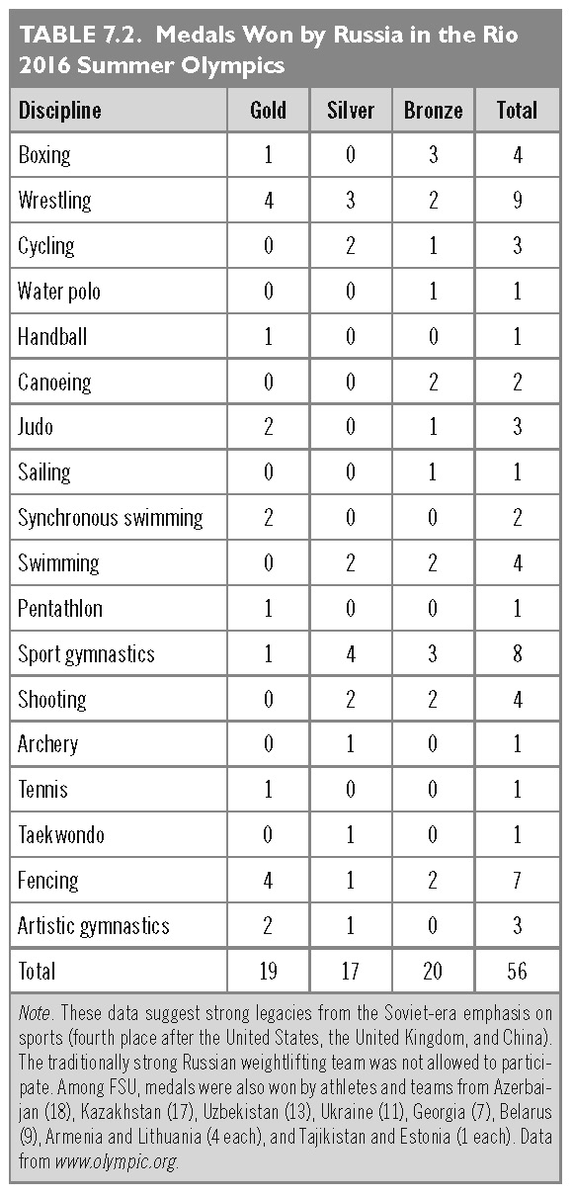
This slide is a supplement to A Geography of Russia and Its Neighbors, Second Edition by Mikhail S. Blinnikov. Copyright © 2021 The Guilford Press.

Slide 18
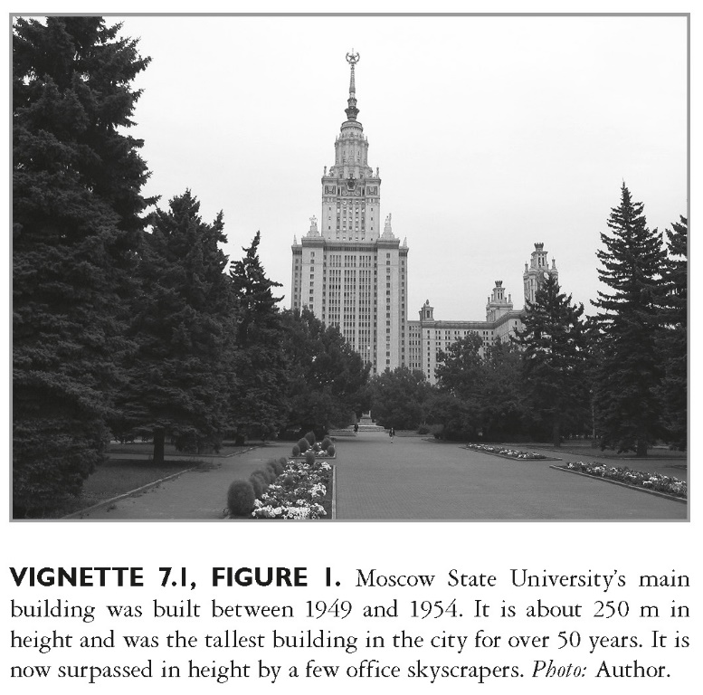
This slide is a supplement to A Geography of Russia and Its Neighbors, Second Edition by Mikhail S. Blinnikov. Copyright © 2021 The Guilford Press.

Slide 19
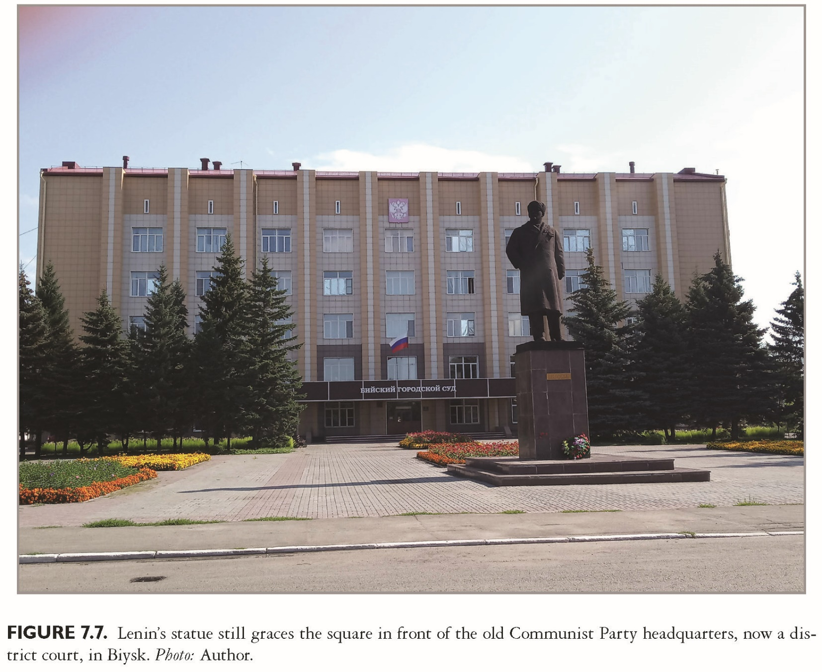
This slide is a supplement to A Geography of Russia and Its Neighbors, Second Edition by Mikhail S. Blinnikov. Copyright © 2021 The Guilford Press.

