Slide 1
This slide is a supplement to A Geography of Russia and Its Neighbors, Second Edition by Mikhail S. Blinnikov. Copyright © 2021 The Guilford Press.
Chapter 11. Cities and Villages
All cities (goroda) and towns of Russia
Urbanization rate: USA 81%, Russia 74%
TABLE 11.1. The Soviet Typology of Settlements
Settlement type | Russian name | Population size | % of total population
 |  |  | 1994 | 2010
Largest city | Krupnejshij gorod | 1–10 million | 17% | 19.7%
Large city | Krupnyj gorod | 100,000–1 million | 30% | 29.4%
Medium city | Srednij gorod | 50,000–100,000 | 8% | 7.6%
Small city | Malyj gorod | 20,000–50,000 | 8% | 10.8%
Town | Poselok gorodskogo tipa | 5,000–20,000 | 9% | 5.5%
Big village | Selo | 1,000–5,000 | 20% | 21%
Regular village | Derevnya | <1,000 | 7% | 6%

Slide 2
This slide is a supplement to A Geography of Russia and Its Neighbors, Second Edition by Mikhail S. Blinnikov. Copyright © 2021 The Guilford Press.
Population of the top cities: USA vs. Russia (thousands, 2014)
USA New York 8,491 Los Angeles 3,929 Chicago 2,722 Houston 2,240 Philadelphia 1,560 Phoenix 1,537 San Antonio 1,437 San Diego 1,381 | RUSSIA Moscow 12,198 St. Petersburg 5,192 Novosibirsk 1,567 Yekaterinburg 1,428 Nizhniy Novgorod 1,268 Kazan 1,206 Chelyabinsk 1,183 Omsk 1,174
Russia has one primary city (Moscow) that dwarfs all the rest – over 12 million
No cities of 3–4 million
High concentration of power and money in one place (think: Paris, France)
Think: what do urban areas over 1 million have that most smaller cities don’t?
Subway (e.g., Metro in Moscow)
World-class universities
World-class hospitals
Major governmental offices
World-class stadiums

Slide 3
This slide is a supplement to A Geography of Russia and Its Neighbors, Second Edition by Mikhail S. Blinnikov. Copyright © 2021 The Guilford Press.
The oldest city in the European part? Chersonesus, Crimea (est. 6th century BC)
Derbent in Dagestan may be even older
15 “million+” cities in Russia in 2017 (Table 11.3)
How did Soviet cities differ from US cities?
Many are much older – inherited medieval patterns
Like in Europe in general; few, if any, skyscrapers (Moscow is an exception, St. Petersburg has one, but tallest in Europe)
Centrally planned in the Soviet times – e.g., microrayony concept
Little sprawl: Urban Growth Boundary well defined and enforced
Wider streets, larger blocks (typically 150 m + long)
Larger parks with more trees
Much higher residential density (x10 in some cases)
Mass transit, not car, as the main mode of transportation
Little racial or ethnic segregation existed in the Soviet-era cities (some begins to appear now)
Note: governmental officials were segregated from the “common masses” on dachas and in the exclusive apartment buildings and administrative offices

Slide 4
This slide is a supplement to A Geography of Russia and Its Neighbors, Second Edition by Mikhail S. Blinnikov. Copyright © 2021 The Guilford Press.
Typical transportation options in Russian cities:
Buses
Street car (tramway)
Trolleybus –increasingly replaced with electric buses
Marshrutka (small bus making stops on demand)
Taxis and ride-sharing (Yandex taxi, Citimobil)
Car sharing apps
Moscow Metro is one of the busiest in the world and arguably the most beautiful
metro.ru
12 million commuters/day!
Convenient connections everywhere
Single zone tickets, touch and go
Trains run every 1–2 minutes in rush hour, from 5:30 am until about 1 am
About 10 new stations have been opened per year in recent years
Also combined with above-ground trains in the city core

Slide 5
This slide is a supplement to A Geography of Russia and Its Neighbors, Second Edition by Mikhail S. Blinnikov. Copyright © 2021 The Guilford Press.
Suburban trains – elektrichka extend options for about 150 km outward
Map of Moscow zones (Fig. 11.8)
Historic core about 5 km in diameter and centered on the Kremlin
Old residential
Industrial rust belt
Sleeping quarters for the masses
Look of an older neighborhood from 1960s: Moscow, 5 floors, kruschevki
Mikrorayon – concept of 1970s, concrete panels, 9–16 floors, self-contained with everything one needs (schools, clinics, shops inside)
Mikrorayony in Saratov (pop. 836,000)
View of Biysk (pop. 220,000) combines both concrete panel housing and wood village-type homes
Modern residential: Orekhovo-Borisovo, Moscow, where the author grew up (300,000 people)
Modern housing is no longer panels, it is poured concrete and sometimes brick, stronger and more durable
Modern elite residential: Moscow suburbs, average house may be comparable to US, 4–5 bedrooms, 200 m2 or more, gated communities are common

Slide 6
This slide is a supplement to A Geography of Russia and Its Neighbors, Second Edition by Mikhail S. Blinnikov. Copyright © 2021 The Guilford Press.
Urban vs. rural divide
General trend away from countryside since 19th century
Pull factors: Education, marriage, employment quotas
Push factors: tough life on state farms
Propiska – Soviet-era residency quota permit system in the biggest cities to slow down urbanization
Now replaced with less stringent registration (people can now choose to voluntarily move)
High concentration of workers encouraged by the ministries – encouraged urbanization
Monocities formed – a single factory dominates (a few hundred exist)
Best life today – in the largest 10 or so
Huge opportunity to develop medium-size cities, under 1 million
Most small cities are “beyond repair”?
Medium city example: Murom in Vladimir oblast (110,000)
Medium-small city example: Kasimov in Ryazan oblast (population 25,000), had 20 factories in the Soviet period, 2 left now

Slide 7
This slide is a supplement to A Geography of Russia and Its Neighbors, Second Edition by Mikhail S. Blinnikov. Copyright © 2021 The Guilford Press.
Suzdal in Vladimir oblast is a historic city (only 12,000 pop.), survives on organized bus tourism
Village life
Peasants made up 85% in 1900; rural population 27% in 2000
Communal origins (+serfdom) selo vs. derevnya
Soviet villages – impact of collectivization
Today 3 forms of village life
“Classical village” based on kolkhoz farm (+forestry)
Individual farmers (new, however traditional hutor in Ukraine )
Urban residents using village as summer home
Images of Russian countryside

Slide 8
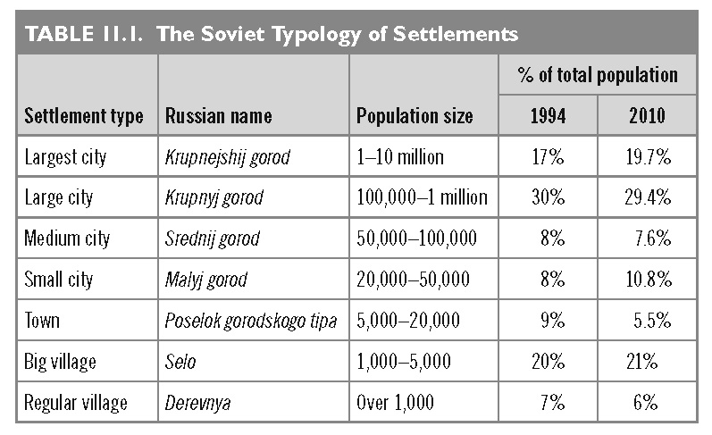
This slide is a supplement to A Geography of Russia and Its Neighbors, Second Edition by Mikhail S. Blinnikov. Copyright © 2021 The Guilford Press.

Slide 9
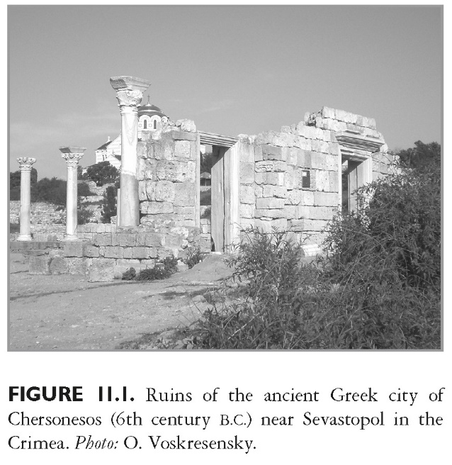
This slide is a supplement to A Geography of Russia and Its Neighbors, Second Edition by Mikhail S. Blinnikov. Copyright © 2021 The Guilford Press.

Slide 10
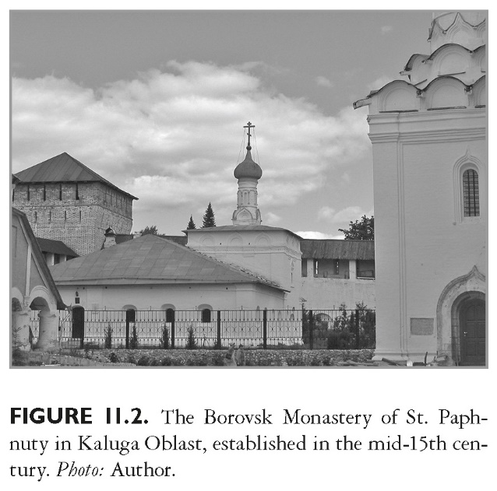
This slide is a supplement to A Geography of Russia and Its Neighbors, Second Edition by Mikhail S. Blinnikov. Copyright © 2021 The Guilford Press.

Slide 11
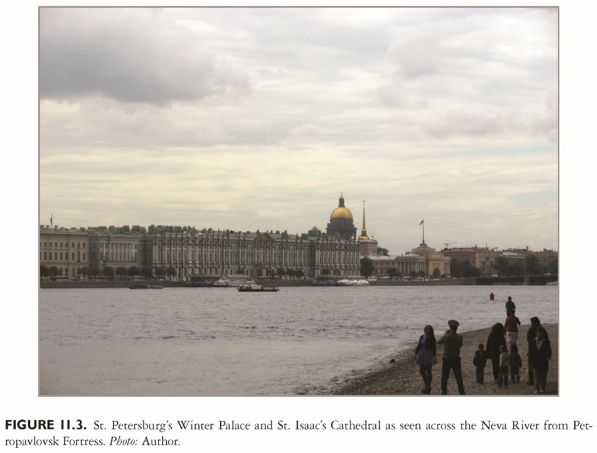
This slide is a supplement to A Geography of Russia and Its Neighbors, Second Edition by Mikhail S. Blinnikov. Copyright © 2021 The Guilford Press.

Slide 12
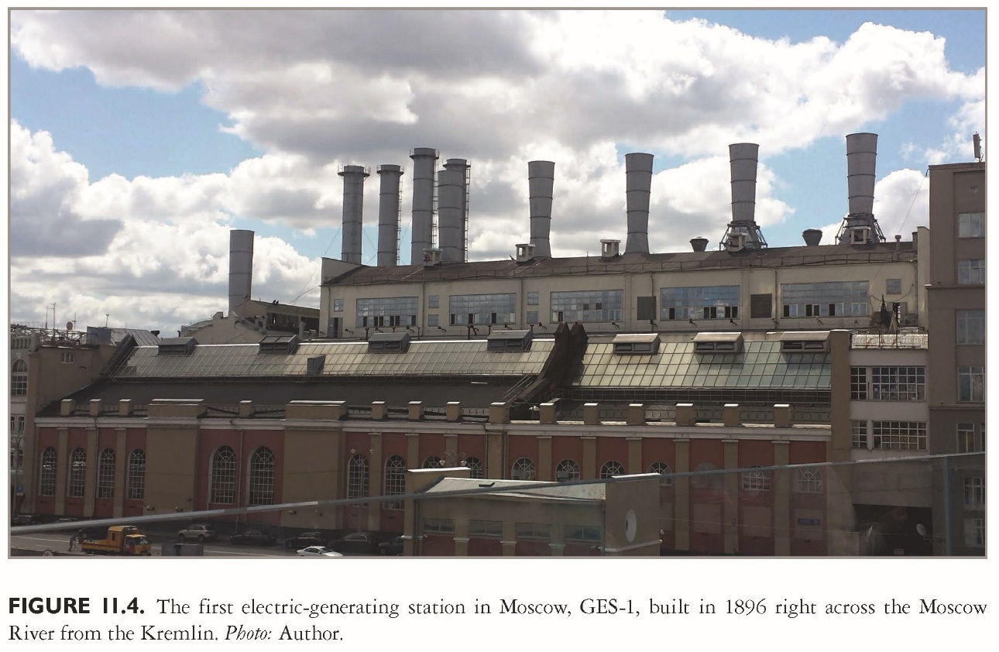
This slide is a supplement to A Geography of Russia and Its Neighbors, Second Edition by Mikhail S. Blinnikov. Copyright © 2021 The Guilford Press.

Slide 13
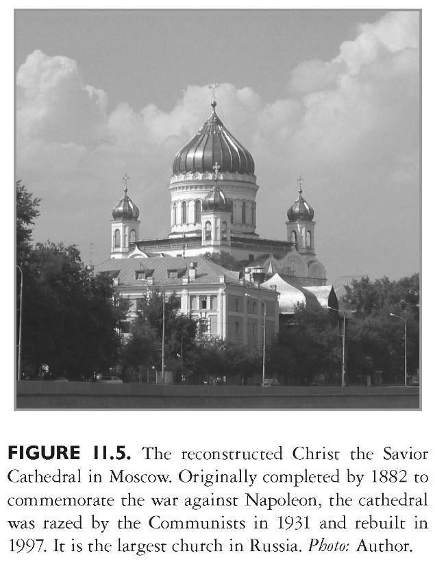
This slide is a supplement to A Geography of Russia and Its Neighbors, Second Edition by Mikhail S. Blinnikov. Copyright © 2021 The Guilford Press.

Slide 14
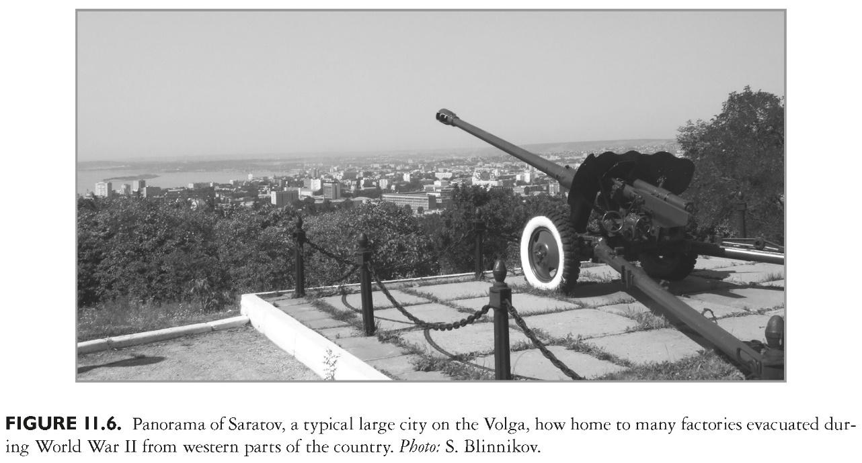
This slide is a supplement to A Geography of Russia and Its Neighbors, Second Edition by Mikhail S. Blinnikov. Copyright © 2021 The Guilford Press.

Slide 15
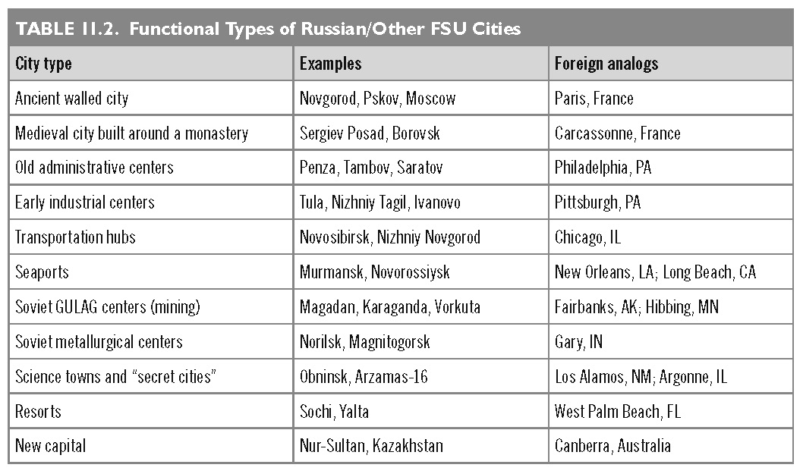
This slide is a supplement to A Geography of Russia and Its Neighbors, Second Edition by Mikhail S. Blinnikov. Copyright © 2021 The Guilford Press.

Slide 16
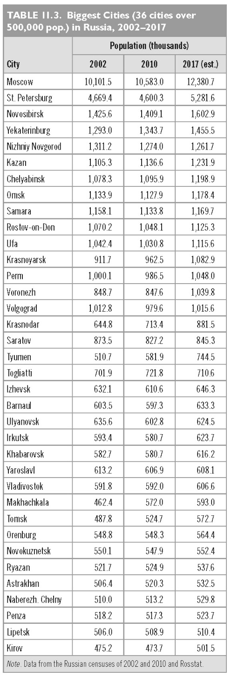
This slide is a supplement to A Geography of Russia and Its Neighbors, Second Edition by Mikhail S. Blinnikov. Copyright © 2021 The Guilford Press.

Slide 17
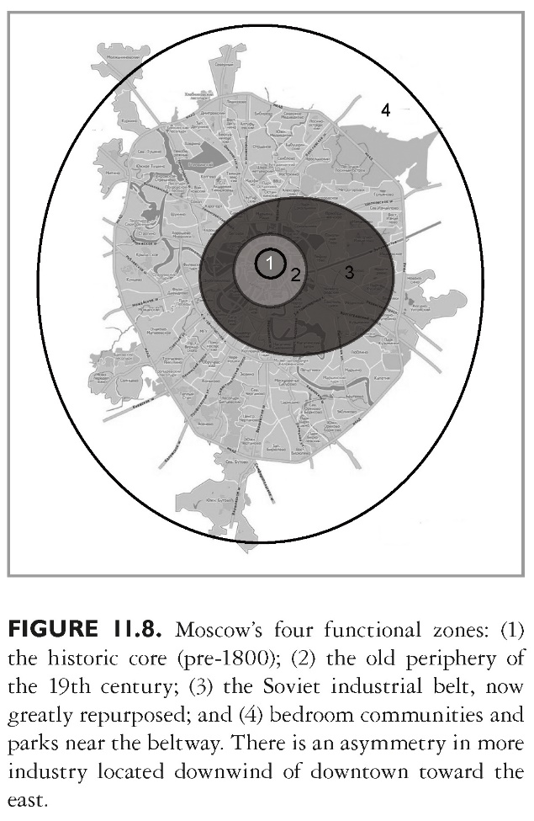
This slide is a supplement to A Geography of Russia and Its Neighbors, Second Edition by Mikhail S. Blinnikov. Copyright © 2021 The Guilford Press.

Slide 18
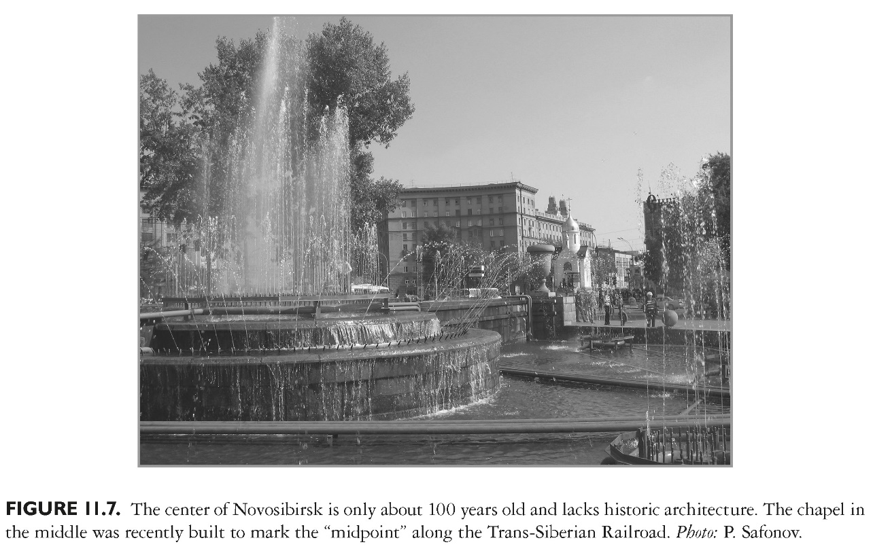
This slide is a supplement to A Geography of Russia and Its Neighbors, Second Edition by Mikhail S. Blinnikov. Copyright © 2021 The Guilford Press.

Slide 19
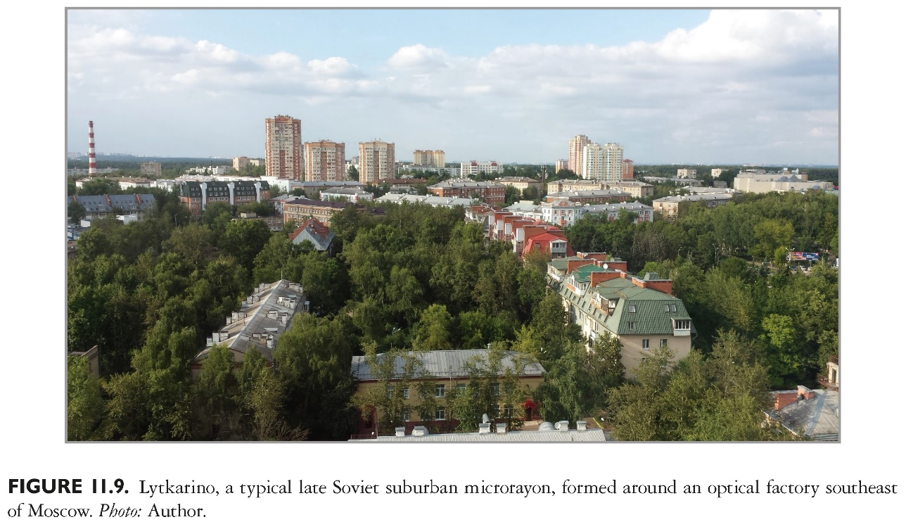
This slide is a supplement to A Geography of Russia and Its Neighbors, Second Edition by Mikhail S. Blinnikov. Copyright © 2021 The Guilford Press.

Slide 20
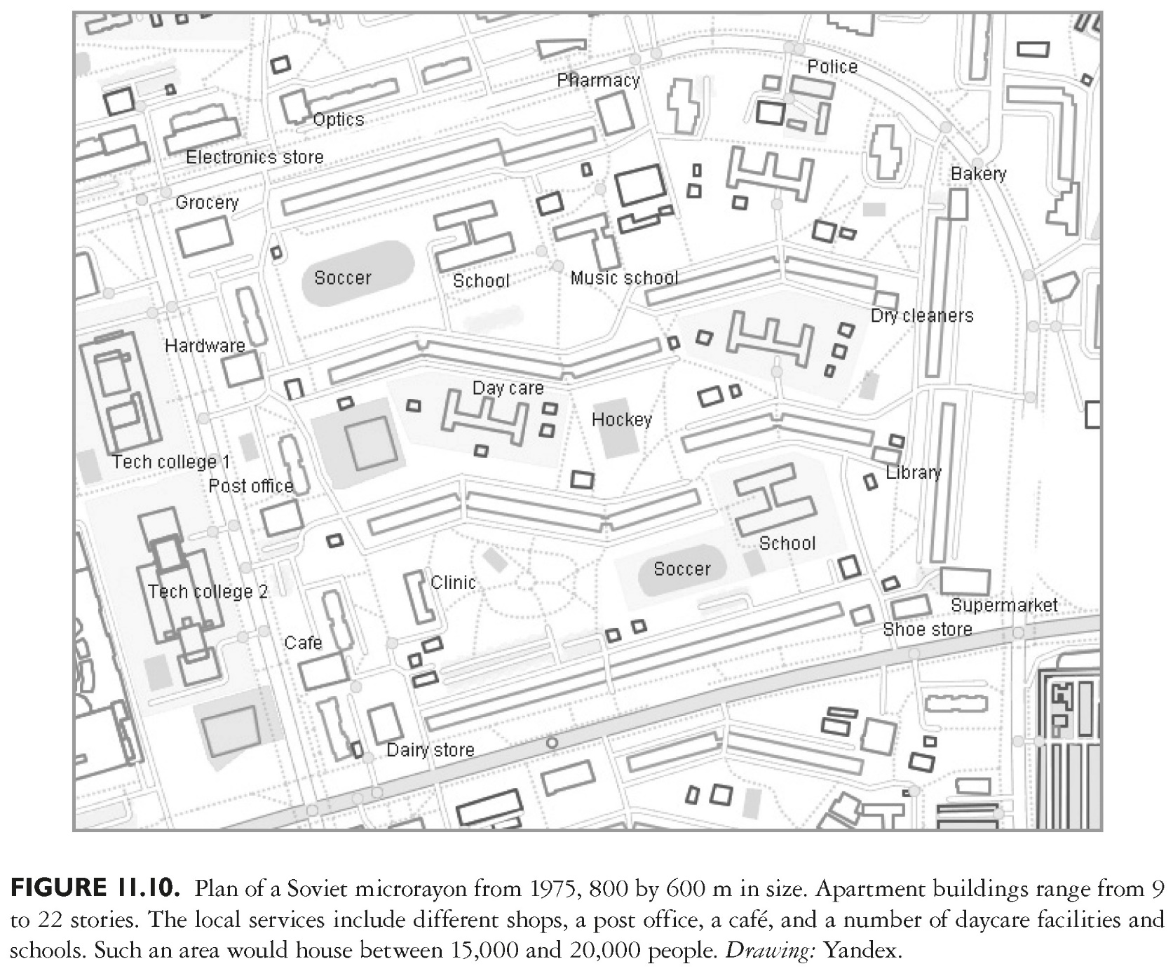
This slide is a supplement to A Geography of Russia and Its Neighbors, Second Edition by Mikhail S. Blinnikov. Copyright © 2021 The Guilford Press.

Slide 21
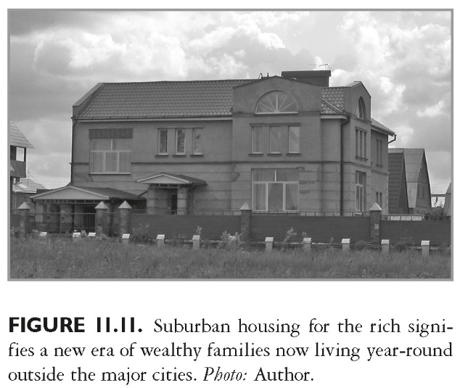
This slide is a supplement to A Geography of Russia and Its Neighbors, Second Edition by Mikhail S. Blinnikov. Copyright © 2021 The Guilford Press.

Slide 22
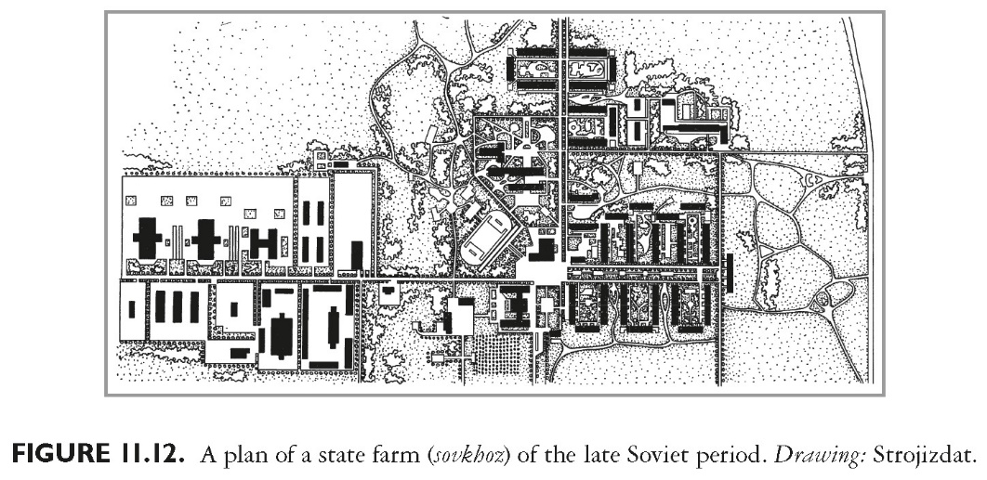
This slide is a supplement to A Geography of Russia and Its Neighbors, Second Edition by Mikhail S. Blinnikov. Copyright © 2021 The Guilford Press.

Slide 23
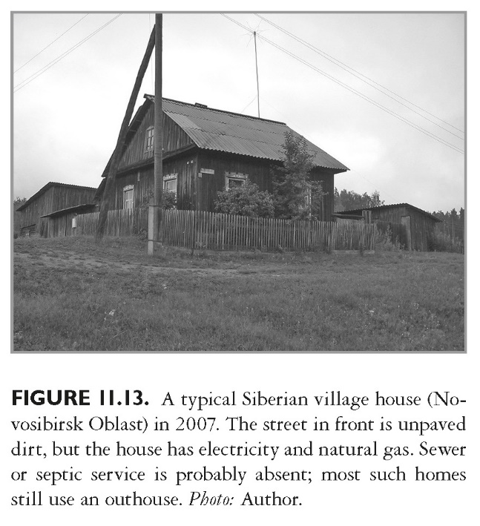
This slide is a supplement to A Geography of Russia and Its Neighbors, Second Edition by Mikhail S. Blinnikov. Copyright © 2021 The Guilford Press.

Slide 24
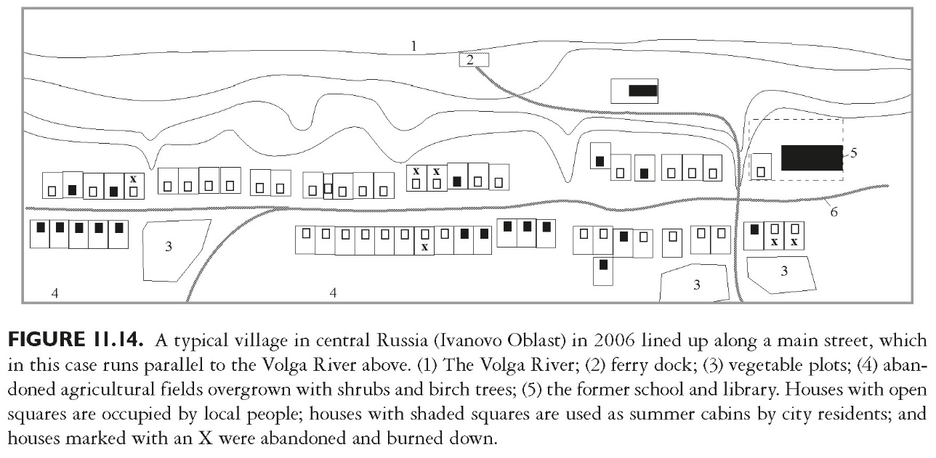
This slide is a supplement to A Geography of Russia and Its Neighbors, Second Edition by Mikhail S. Blinnikov. Copyright © 2021 The Guilford Press.

Slide 25
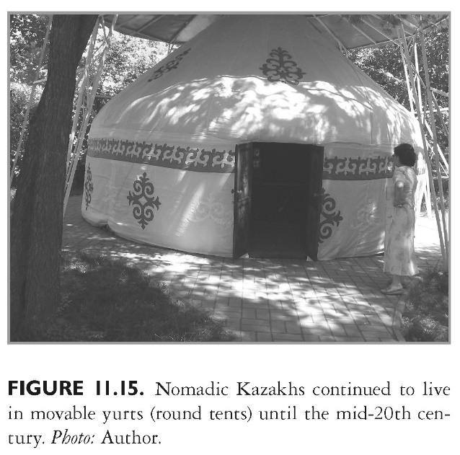
This slide is a supplement to A Geography of Russia and Its Neighbors, Second Edition by Mikhail S. Blinnikov. Copyright © 2021 The Guilford Press.

