Slide 1
This slide is a supplement to A Geography of Russia and Its Neighbors, Second Edition by Mikhail S. Blinnikov. Copyright © 2021 The Guilford Press.
Chapter 15. Education, Art, Sciences, and Sports
USSR was one of the most educated societies in the world
Close to 100% literacy achieved by 1959
Free compulsory education: 8 grades 1930s, 10(11) by 1950s
Yasli (“crib”)->Detsky sad->School
3 options after 8th grade
  PTU (vocational school)
  2 grades + tekhnicum
  2(3) grades + college (5 year diploma was standard until 2000)
Moscow State University – still the best (photo of the main building and the campus map)
Est. 1759 by Mikhail Lomonosov
Large campus in SW Moscow on Vorobyevy Hills
35,000 students, mainly fundamental sciences and humanities

Slide 2
This slide is a supplement to A Geography of Russia and Its Neighbors, Second Edition by Mikhail S. Blinnikov. Copyright © 2021 The Guilford Press.
College education
1975 – 856 colleges (institutes), including 65 universities
  4.9 million students, all studied for free, many received a stipend
  Very challenging entrance exams (20% pass rate)
  Strongest specialties were mathematics, engineering, natural sciences, medical; some very good programs in history, geography, art, theatre, etc.
  Sociology, economics, political science – either Marxist or banned
2015 – 530 state and 366 private colleges and universities
  4.8 million students
  Half study (mostly) for free and half pay tuition, range $2,000-$12,000 per year
  National standardized testing (EGE)
Some universities still require additional entrance exams
Moved from 5-year diplomas to 4 years of BA/BS and 2 years of MA/MS, as common worldwide

Slide 3
This slide is a supplement to A Geography of Russia and Its Neighbors, Second Edition by Mikhail S. Blinnikov. Copyright © 2021 The Guilford Press.
Global picture
National ranking of Russian universities (2018)
Moscow State University
National Nuclear MIFI
National PhysTech
Bauman university
People’s friendships university and SPBU
Novosibirsk State University
Tomsk State University
Tomsk Polytechnical
Higher School of Economics
Kazan State and MISIS
Tomsk State University is the oldest in Siberia and has many outstanding programs in STEM (pic)
Kazan Federal University is one of the largest in Russia and among the most international (pic)

Slide 4
This slide is a supplement to A Geography of Russia and Its Neighbors, Second Edition by Mikhail S. Blinnikov. Copyright © 2021 The Guilford Press.
Science
Fundamental science thrived in the USSR
+ applied military science, physics, medical, biology, chemistry, geology, geography
A lot less funding in 1990s, brain drain, 50% of scientists quit
Western grants helped for a while (George Soros grants, MacArthur Foundation, etc.)
Better in 2000s, Russian Foundation for Basic Research and Russian National Fund give out competitive research grants
10 science cities reaffirmed, better funding for equipment, young researchers, travel and publications
Examples: Dubnya and Protvino in Moscow Oblast (nuclear physics), Pushchino on Oka in Moscow Oblast (biology), Biysk in Altaysky Kray (chemistry and medical), etc.
Still funding is low as a share of GDP and future is uncertain
Arts
Visual arts and museums
Theaters
Cinema
TV, radio, newspapers

Slide 5
This slide is a supplement to A Geography of Russia and Its Neighbors, Second Edition by Mikhail S. Blinnikov. Copyright © 2021 The Guilford Press.
Museums of Russia (1800+)
Concentrated in Moscow and St. Petersburg (60%)
Fine art
Historical and regional studies
Science and technology
Estates of famous people
Theaters
Opera
Ballet
Drama
Academic theaters (MkhAT)
Musical theaters
Children theaters
Experimental

Slide 6
This slide is a supplement to A Geography of Russia and Its Neighbors, Second Edition by Mikhail S. Blinnikov. Copyright © 2021 The Guilford Press.
Sports
U.S.S.R. was a giant winning many Olympics
Russia is a lot weaker now, but has some great accomplishments
Winter Olympics in Sochi in 2014
  Doping scandal
  Very expensive (close to $50 billion, by far the most expensive ever)
  Future usage of the structures uncertain
FIFA World Cup 2018
  3 million attended from all over the world
  20 cities in Russia participated
  Political aspects for V. Putin’s government
Some sports from Russia to watch
  Women gymnastics
  Women volleyball
  Tennis (Not only Russia, other FSU as well)
  Heavy weightlifting
  Men ice hockey
  Figure skating
  Some other winter sports
  Mixed martial arts

Slide 7
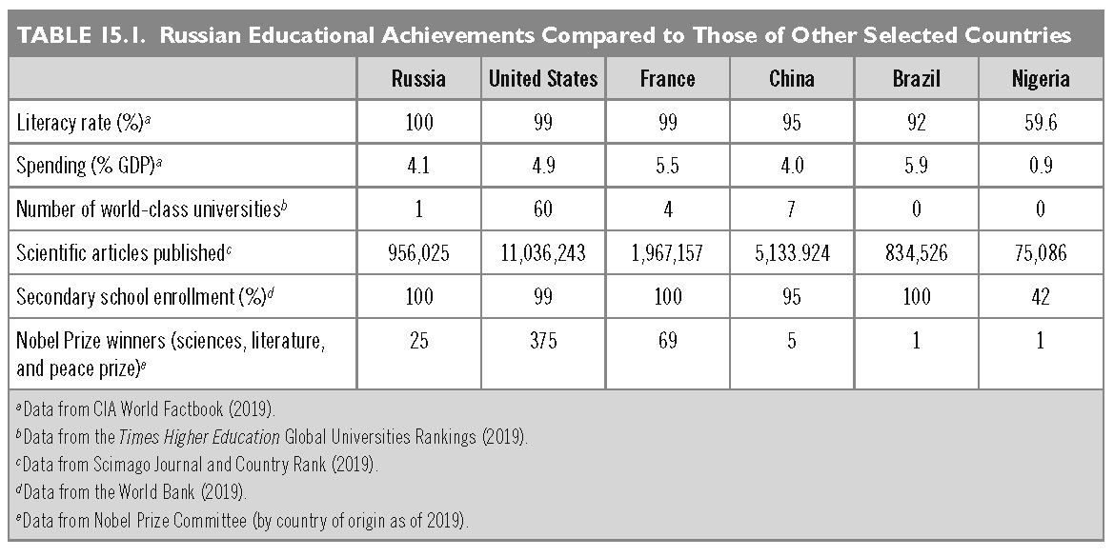
This slide is a supplement to A Geography of Russia and Its Neighbors, Second Edition by Mikhail S. Blinnikov. Copyright © 2021 The Guilford Press.

Slide 8
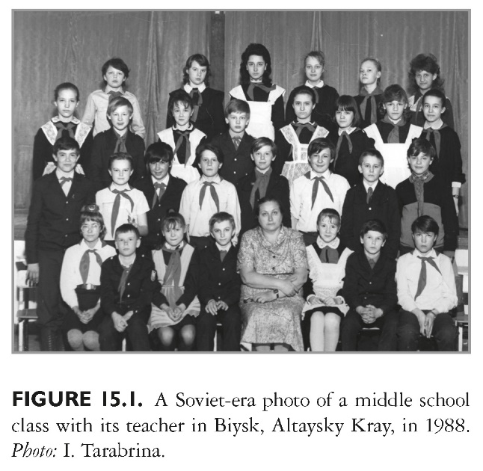
This slide is a supplement to A Geography of Russia and Its Neighbors, Second Edition by Mikhail S. Blinnikov. Copyright © 2021 The Guilford Press.

Slide 9
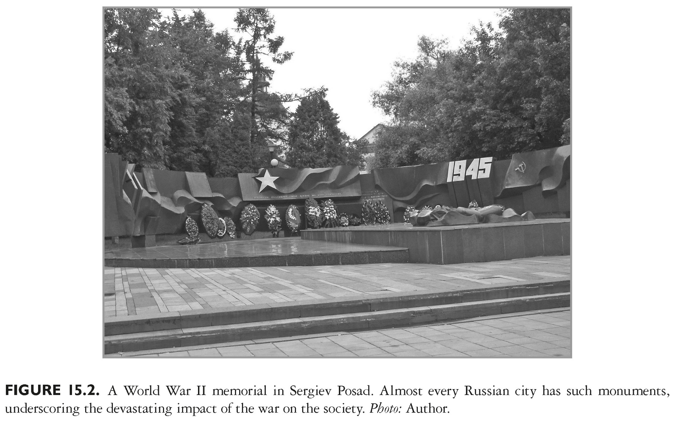
This slide is a supplement to A Geography of Russia and Its Neighbors, Second Edition by Mikhail S. Blinnikov. Copyright © 2021 The Guilford Press.

Slide 10
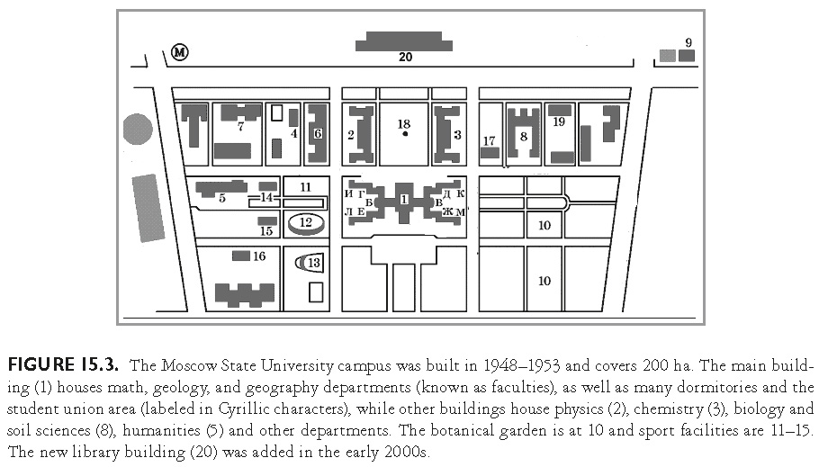
This slide is a supplement to A Geography of Russia and Its Neighbors, Second Edition by Mikhail S. Blinnikov. Copyright © 2021 The Guilford Press.

Slide 11
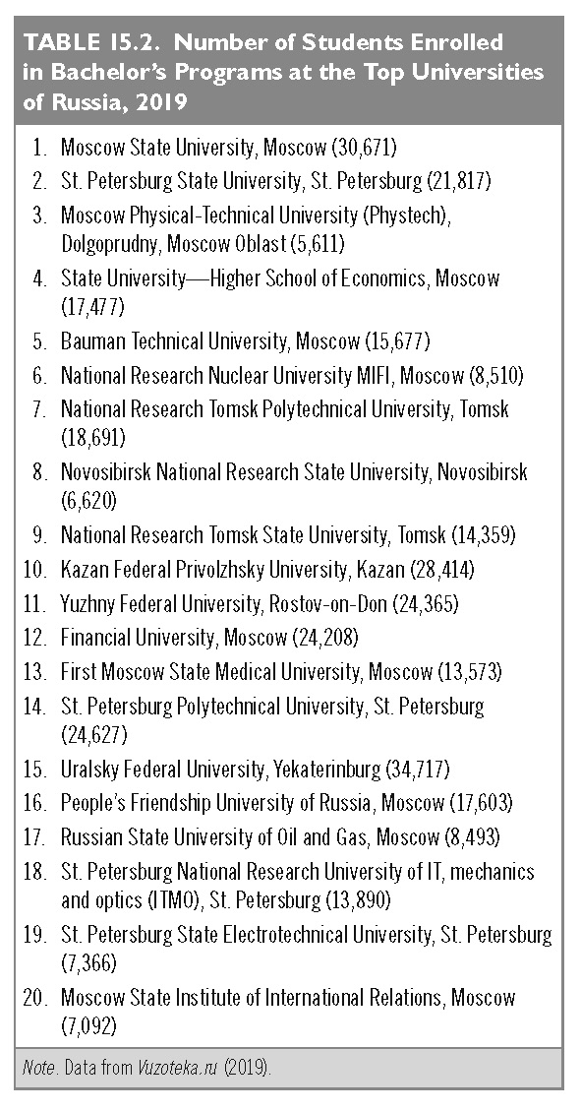
This slide is a supplement to A Geography of Russia and Its Neighbors, Second Edition by Mikhail S. Blinnikov. Copyright © 2021 The Guilford Press.

Slide 12
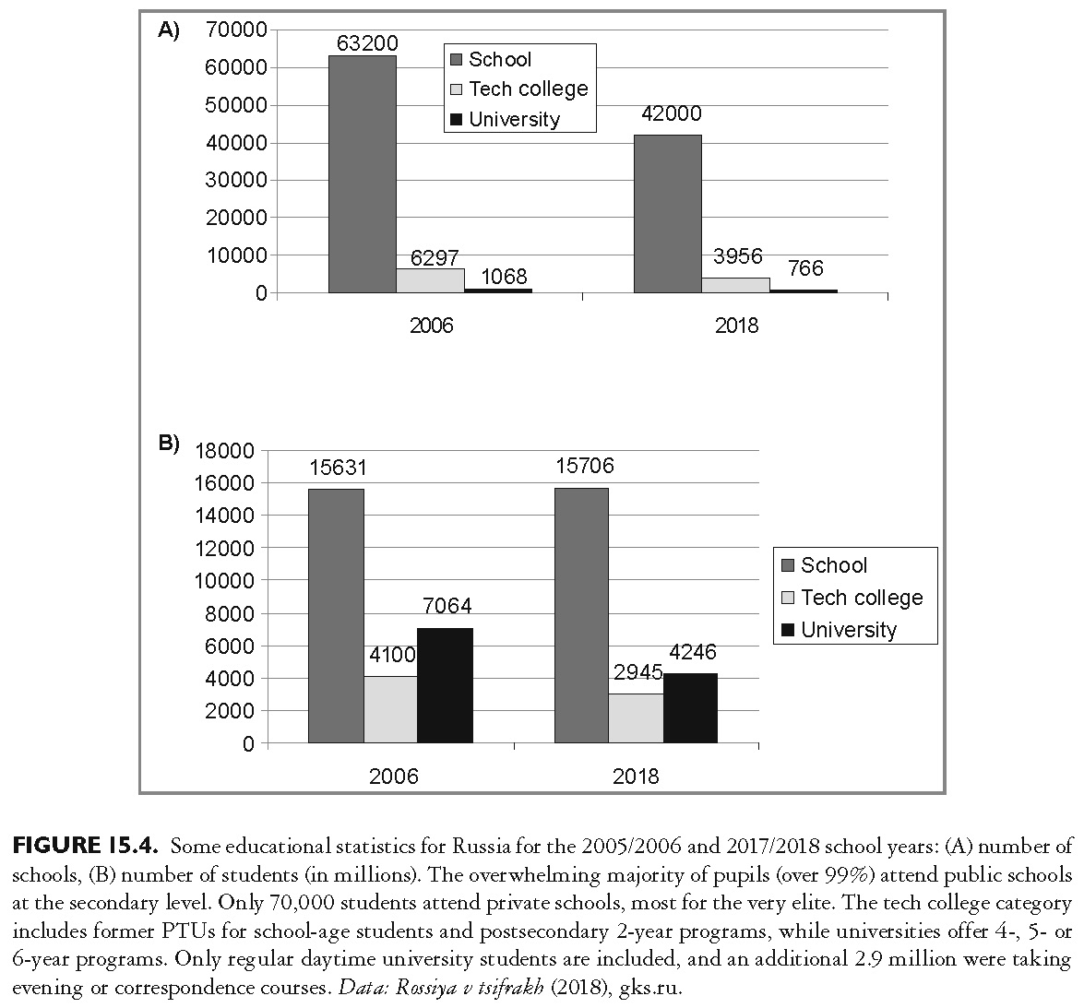
This slide is a supplement to A Geography of Russia and Its Neighbors, Second Edition by Mikhail S. Blinnikov. Copyright © 2021 The Guilford Press.

Slide 13
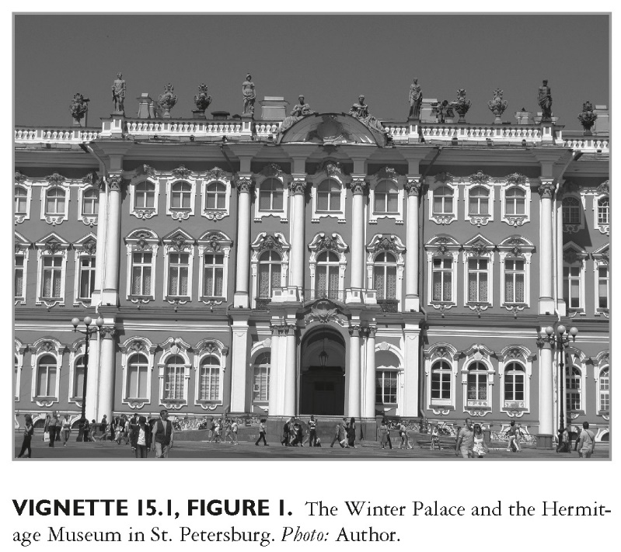
This slide is a supplement to A Geography of Russia and Its Neighbors, Second Edition by Mikhail S. Blinnikov. Copyright © 2021 The Guilford Press.

Slide 14
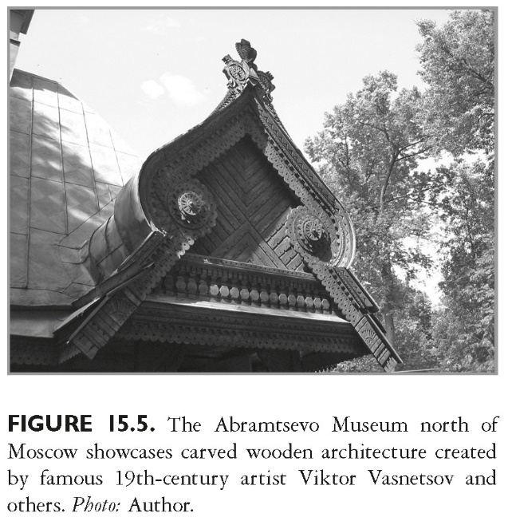
This slide is a supplement to A Geography of Russia and Its Neighbors, Second Edition by Mikhail S. Blinnikov. Copyright © 2021 The Guilford Press.

Slide 15
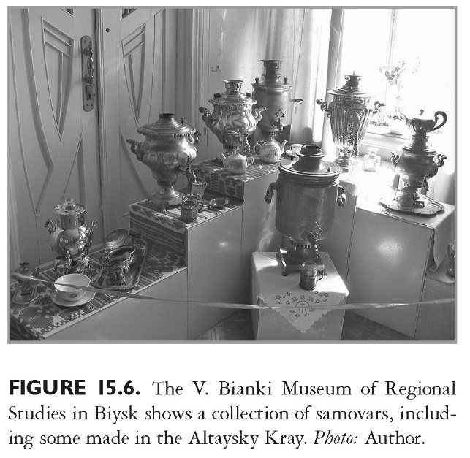
This slide is a supplement to A Geography of Russia and Its Neighbors, Second Edition by Mikhail S. Blinnikov. Copyright © 2021 The Guilford Press.

Slide 16
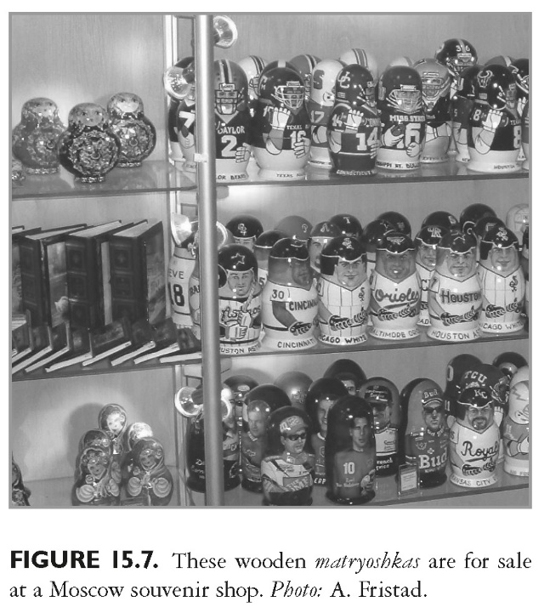
This slide is a supplement to A Geography of Russia and Its Neighbors, Second Edition by Mikhail S. Blinnikov. Copyright © 2021 The Guilford Press.

Slide 17
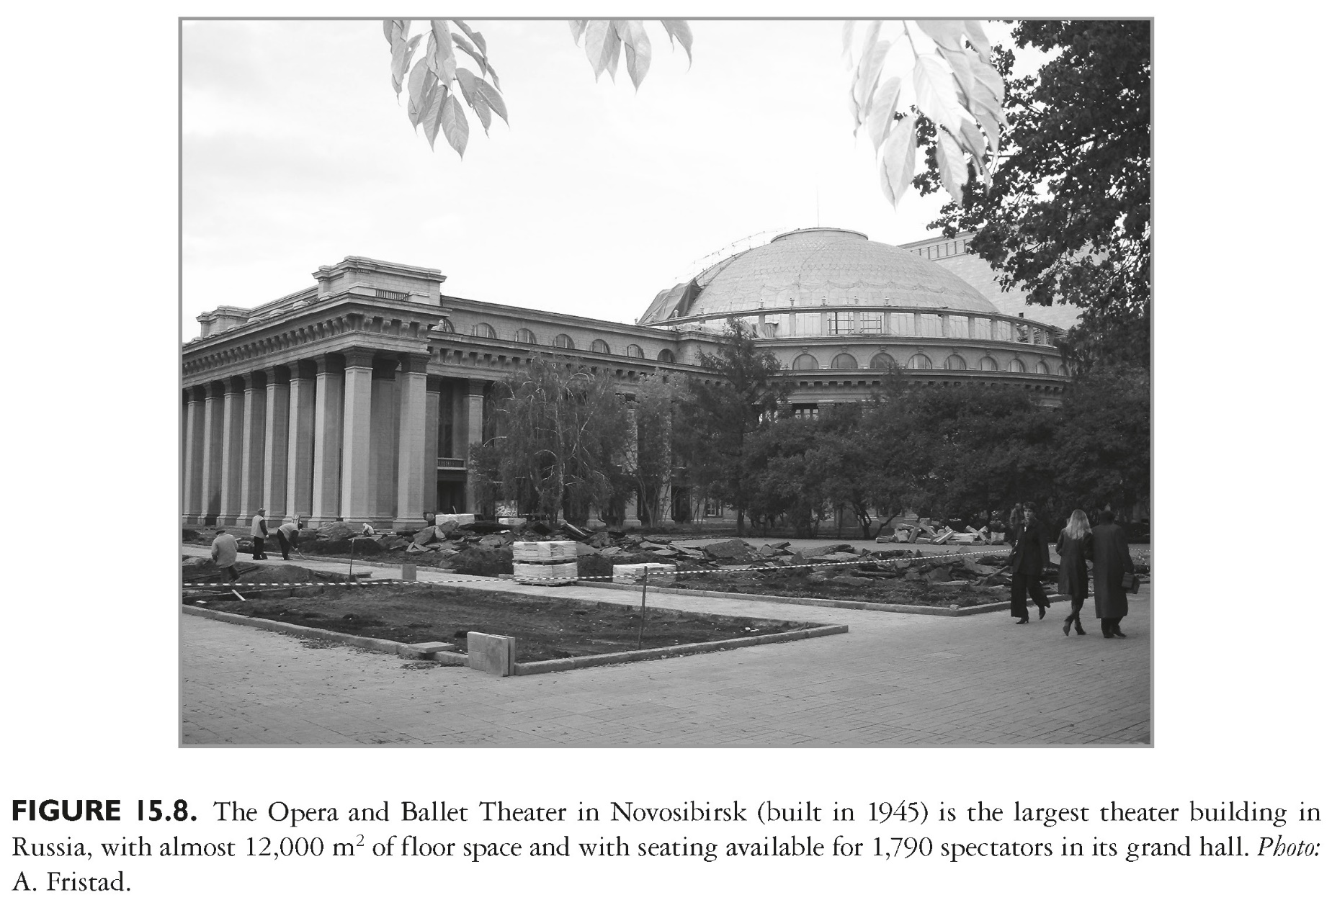
This slide is a supplement to A Geography of Russia and Its Neighbors, Second Edition by Mikhail S. Blinnikov. Copyright © 2021 The Guilford Press.

Slide 18
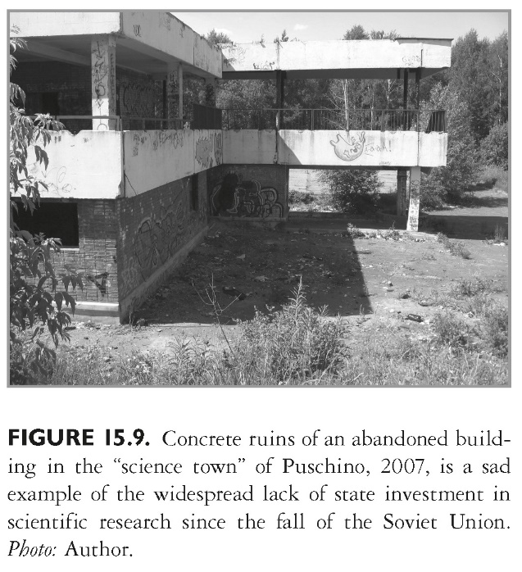
This slide is a supplement to A Geography of Russia and Its Neighbors, Second Edition by Mikhail S. Blinnikov. Copyright © 2021 The Guilford Press.

Slide 19
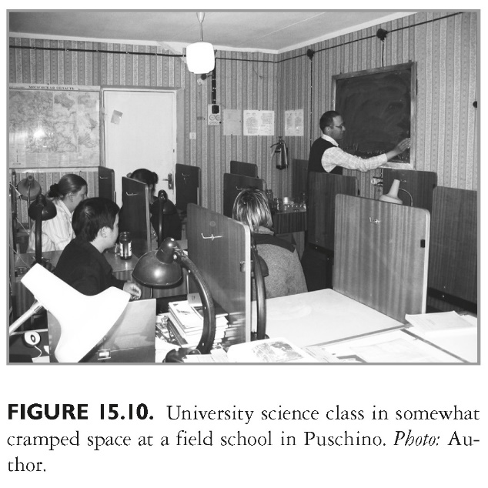
This slide is a supplement to A Geography of Russia and Its Neighbors, Second Edition by Mikhail S. Blinnikov. Copyright © 2021 The Guilford Press.

Slide 20
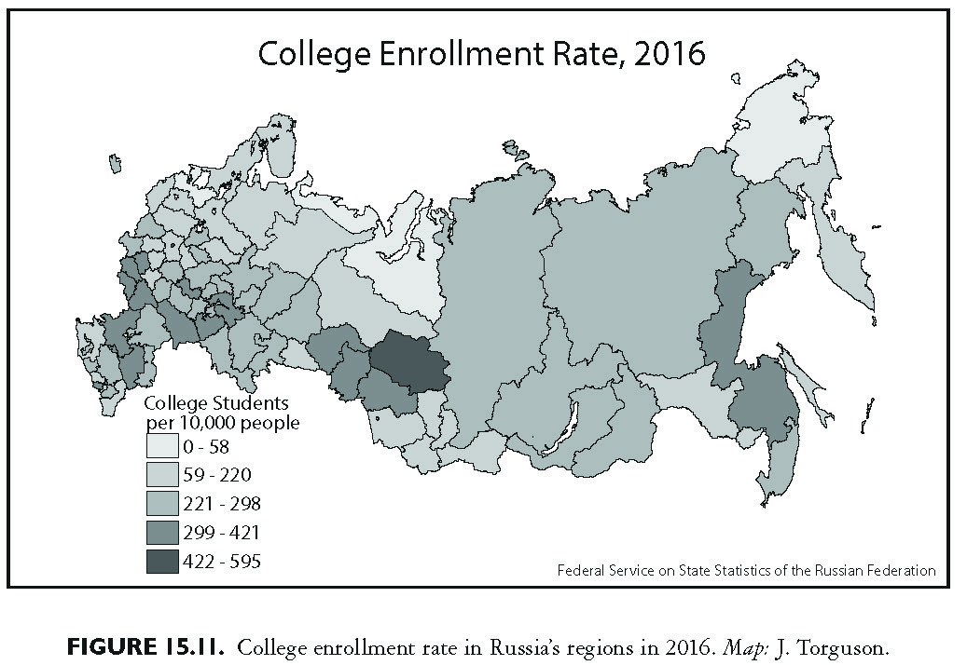
This slide is a supplement to A Geography of Russia and Its Neighbors, Second Edition by Mikhail S. Blinnikov. Copyright © 2021 The Guilford Press.

Slide 21
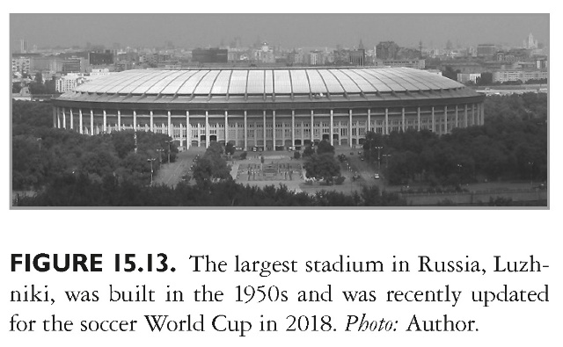
This slide is a supplement to A Geography of Russia and Its Neighbors, Second Edition by Mikhail S. Blinnikov. Copyright © 2021 The Guilford Press.

Slide 22
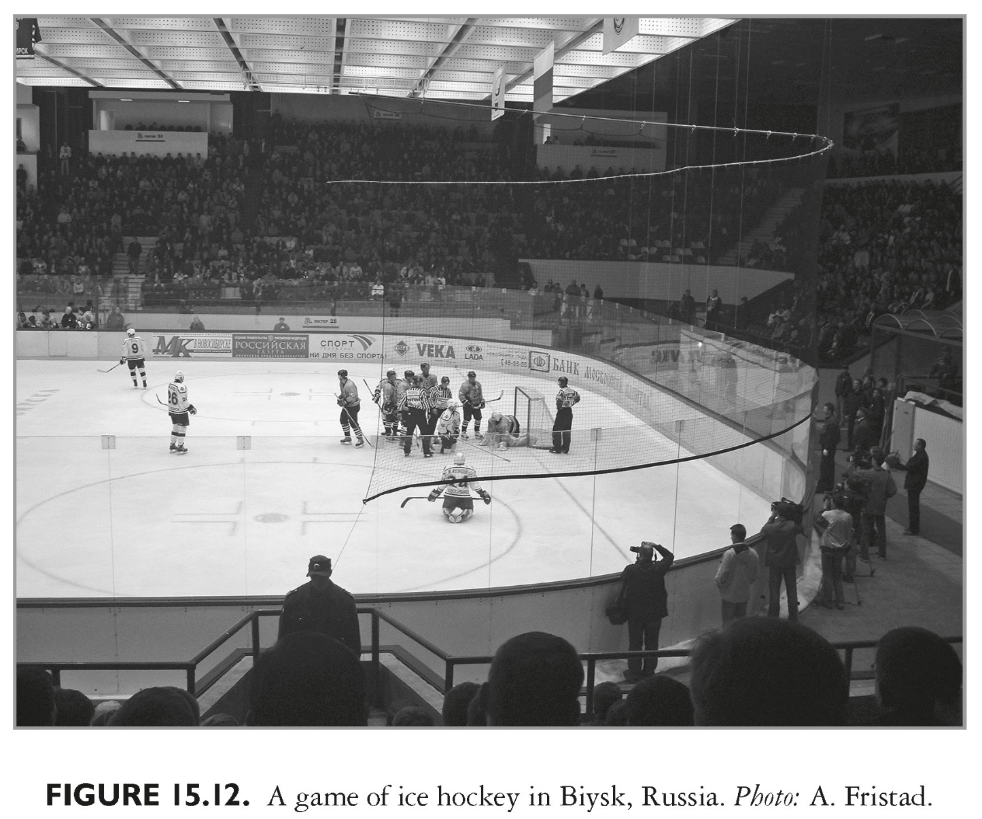
This slide is a supplement to A Geography of Russia and Its Neighbors, Second Edition by Mikhail S. Blinnikov. Copyright © 2021 The Guilford Press.

