Slide 1
This slide is a supplement to A Geography of Russia and Its Neighbors, Second Edition by Mikhail S. Blinnikov. Copyright © 2021 The Guilford Press.
Chapter 16. Tourism
Domestic tourism was under-developed in the Soviet Union
Mass tourism in health resorts
Historical heritage tours
Self-organized “wild” tourism –rentals and camping
International tourism – almost non-existent
Intourist tours for foreigners
In 1970 only about 5,000 Americans were allowed in
Almost no options for Soviet citizens to go abroad (Bulgaria, Poland, Cuba)
Challenges for domestic tourism now:
Distances (expensive domestic flights, bad roads)
infrastructure is slowly improving, especially hotels and restaurants
lack of marketing
Most Russians spend vacations at their dachas due to lack of money to go elsewhere
Tourism today as share of exports
About 2% of Russia’s exports
World’s average is 7%
USA 9% of all exports, some EU countries >16%

Slide 2
This slide is a supplement to A Geography of Russia and Its Neighbors, Second Edition by Mikhail S. Blinnikov. Copyright © 2021 The Guilford Press.
UNWTO report from 2019
Russia was 7th biggest sender of tourists abroad in 2018
Russia was 7th biggest spender on foreign trips in 2018 ($35 billion), 5th in 2014
24.5 million visits to Russia in 2018, but <5 million were actual leisure tourists
This puts Russia in about 14th place worldwide as a recipient of tourists
Most were VFR and <2 million were business visitors
Russians abroad are very noticeable, typically come on packaged all-inclusive tours
11 million went abroad in 2010
In 2015 – 40% drop! (why?)
Top destinations in 2018
Turkey, Abkhazia, Finland, Kazakhstan, Ukraine (Crimea), China, Estonia, Georgia, Germany, Italy
Biggest growth recently in Russians going to:
Georgia, Italy, UAE, Tunisia, Armenia
Russians abroad are perceived as generous, but obnoxious, i.e., loud, drinking, and not very polite (just like Americans :)
Major issues cited in surveys: drink too much, pushy, don’t know foreign languages
World class destinations in Russia

Slide 3
This slide is a supplement to A Geography of Russia and Its Neighbors, Second Edition by Mikhail S. Blinnikov. Copyright © 2021 The Guilford Press.
World Heritage sites in Russia
Historic Centre of Saint Petersburg and Related Groups of Monuments (1990) C
Kizhi Pogost (1990) C
Kremlin and Red Square, Moscow (1990) C
Cultural and Historic Ensemble of the Solovetsky Islands (1992) C
Historic Monuments of Novgorod and Surroundings (1992) C
White Monuments of Vladimir and Suzdal (1992) C
Architectural Ensemble of the Trinity Sergius Lavra in Sergiev Posad (1993) C
Church of the Ascension, Kolomenskoye (1994) C
Ensemble of the Ferrapontov Monastery (2000) C
Historic and Architectural Complex of the Kazan Kremlin (2000) C
Citadel, Ancient City and Fortress Buildings of Derbent (2003) C
Ensemble of the Novodevichy Convent (2004) C
Historical Centre of the City of Yaroslavl (2005) C
Struve Geodetic Arc (2005) C
Virgin Komi Forests (1995) N
Lake Baikal (1996) N
Volcanoes of Kamchatka (1996, 2001) N
Golden Mountains of Altay (1998) N
Western Caucasus (1999) N
Curonian Spit (2000) N
Central Sikhote-Alin (2001) N
Ubsu Nuur Basin (2003) N
Natural System of Wrangel Island Reserve (2004) N
whc.unesco.org

Slide 4
This slide is a supplement to A Geography of Russia and Its Neighbors, Second Edition by Mikhail S. Blinnikov. Copyright © 2021 The Guilford Press.
Domestic tourists by approximate numbers of participants inside Russia (author’s estimates based on available options on tour agency websites)
Beach tourism (sand, sea, sun) 40%
Cultural heritage tourism 20%
Business tourism 16%
Active and adventure 8%
Health tourism 7%
Cruises (mainly on the Volga and canals) 3%
Rural tourism 2%
Religious 1%
Ecotourism 1%
Medical tourism into Russia from expats, who live in the USA and even some European countries
You can save a lot of money getting your dental work or Lasik surgery, for example
Other forms? Sex tourism (illegal in most FSU countries except Latvia, but widely practiced with minimal penalties)
Dark tourism (sewers of Moscow, Chernobyl radiation exclusion zone, military bunkers used now for rave parties)

Slide 5
This slide is a supplement to A Geography of Russia and Its Neighbors, Second Edition by Mikhail S. Blinnikov. Copyright © 2021 The Guilford Press.
Look up the following destinations (pictures)
Sochi
Anapa
Gelendzhik
Kislovodsk
St. Petersburg
Rostov the Great
Yaroslavl
Suzdal (and other cities on the Golden Ring itinerary)
Uglich
Myshkin
Velikij Ustyug
Kasimov
Belokurikha
River cruises are popular down the Volga and between Moscow and St. Petersburg via canals
Valaam Monastery and Kizhi on lakes

Slide 6
This slide is a supplement to A Geography of Russia and Its Neighbors, Second Edition by Mikhail S. Blinnikov. Copyright © 2021 The Guilford Press.
Challenges
Quality of hotels is still lower than Europe or North America, but improving – and some are very nice now, even in the provincial areas, AirBnBs are popular
Ruble collapse in 2015 led to more Russians staying home
Lack of interest in formal domestic tourism, most Russians would rather go abroad
Lack of investment and support from the state
Distances and railroad monopoly on pricing
Bad airports (except about 20, there is a national program to improve additional few dozen)
Roads are better now, car tourism is very popular and affordable now
Opportunities
Lots to see!
Infrastructure is improving
Shift to more domestic tourism
Well-trained staff, at least in Russian
Lots of small companies and hotels competing for business
Private parks, e.g., Etnomir and Rus near Moscow
Cheap for foreign tourists given the exchange rate (about 50% cheaper than western Europe, for example)
Some regions made strategic investments (Kaluga, Krasnodar, Buryatia, Tatarstan, St. Petersburg, the Altay Republic)

Slide 7
This slide is a supplement to A Geography of Russia and Its Neighbors, Second Edition by Mikhail S. Blinnikov. Copyright © 2021 The Guilford Press.
Crimea’s “return” to Russia presents unique challenges
Capacity about 3 million visitors per year
New railroad and highway link
Tavrida freeway
Increased investments in sanatoria
Siloviki cannot go abroad anymore, so they come to Crimea
Relative to Turkey, Crimea’s resorts are not nearly as nice at slightly higher prices
Sea can be polluted near big cities
Lack of fresh water
Other FSU countries
Baltic states have robust domestic and inbound international tourism
  Riga and Tallinn – capitals
  Palanga and Jurmala – seaside resorts
  Sex tourism in Riga
  Lots of small national parks and village tourism
  Moldova and Belarus are similar in that respect too
Georgia, Armenia, and Azerbaijan are excellent cultural destinations
  Georgia also has seaside tourism
  Wine tasting tours
  Legendary hospitality
  Abkhazia is separatist, mainly Russians go there

Slide 8
This slide is a supplement to A Geography of Russia and Its Neighbors, Second Edition by Mikhail S. Blinnikov. Copyright © 2021 The Guilford Press.
Ukraine
  Lots of options, but without Crimea there is no more access to the beach tourism as much
  Cultural heritage especially in Western Ukraine
  Ski resorts in the Carpathians
  Lots of village tourism potential, which is underutilized
Kazakhstan, Kyrgyzstan and Uzbekistan
  Cultural tourism related to history of the Silk Route and Turkic culture
  Lake Issyk-Kol
  Amazing mountains, some for extreme mountaineering
  Developing ski resorts
  Access from outside is hard (few flights, expensive)

Slide 9
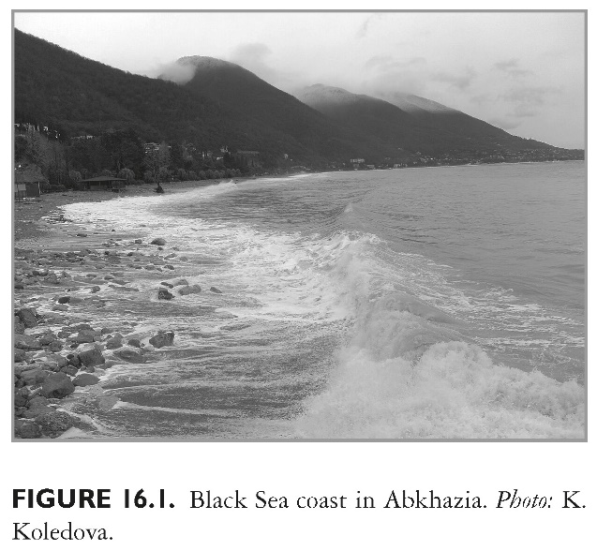
This slide is a supplement to A Geography of Russia and Its Neighbors, Second Edition by Mikhail S. Blinnikov. Copyright © 2021 The Guilford Press.

Slide 10
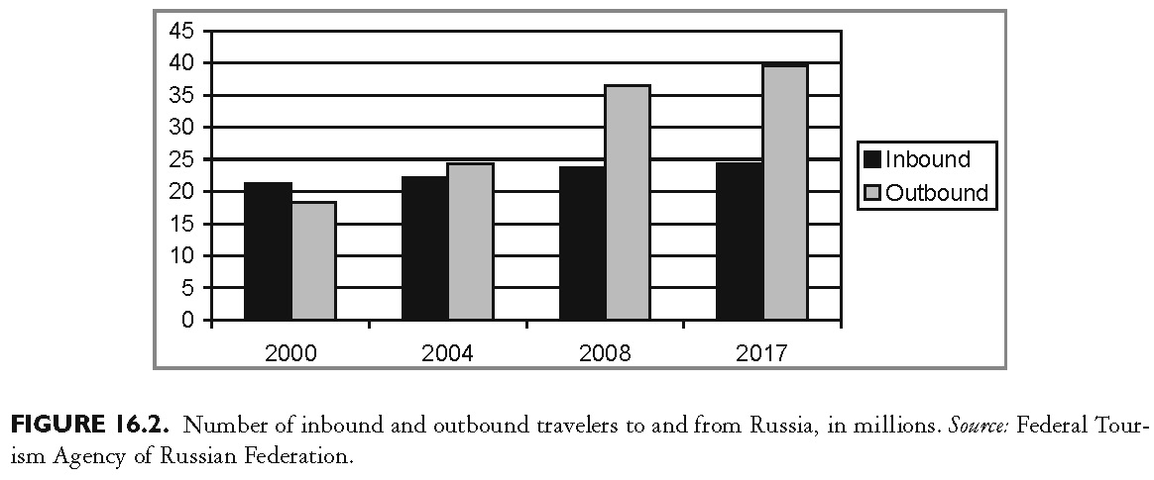
This slide is a supplement to A Geography of Russia and Its Neighbors, Second Edition by Mikhail S. Blinnikov. Copyright © 2021 The Guilford Press.

Slide 11
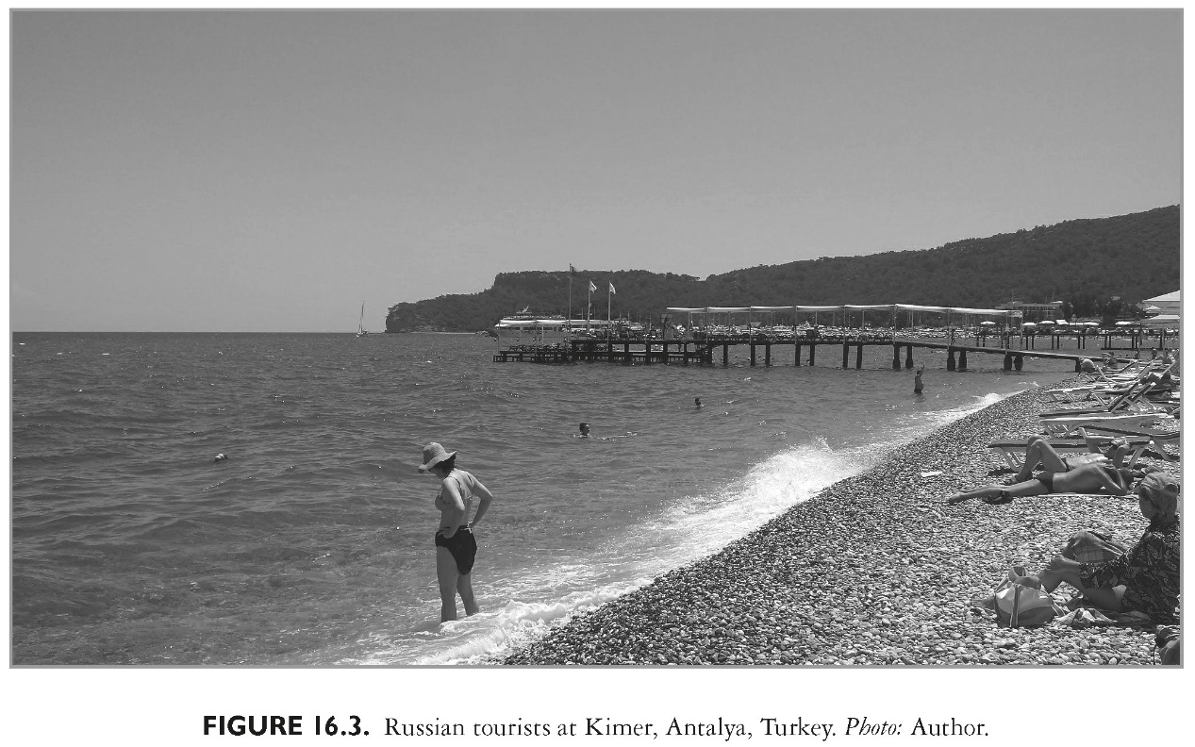
This slide is a supplement to A Geography of Russia and Its Neighbors, Second Edition by Mikhail S. Blinnikov. Copyright © 2021 The Guilford Press.

Slide 12
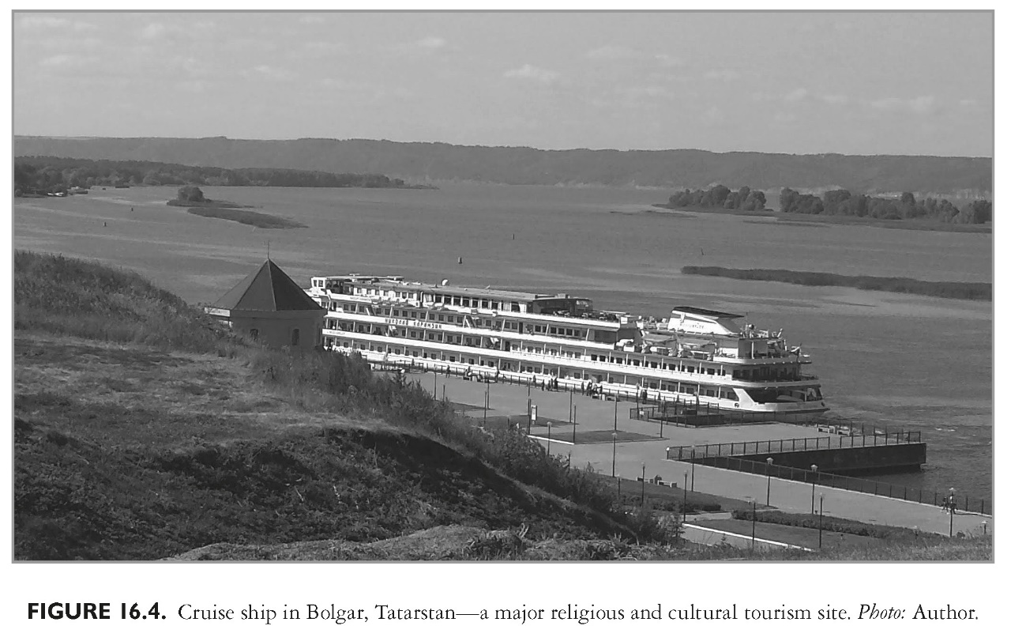
This slide is a supplement to A Geography of Russia and Its Neighbors, Second Edition by Mikhail S. Blinnikov. Copyright © 2021 The Guilford Press.

Slide 13
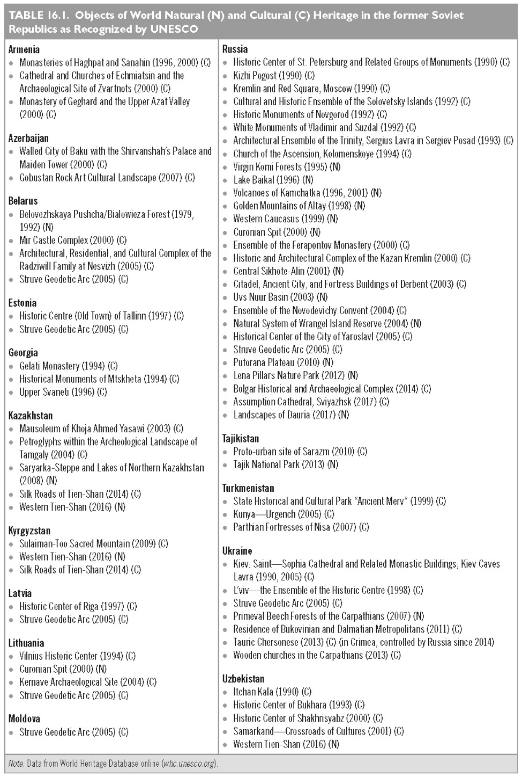
This slide is a supplement to A Geography of Russia and Its Neighbors, Second Edition by Mikhail S. Blinnikov. Copyright © 2021 The Guilford Press.

Slide 14
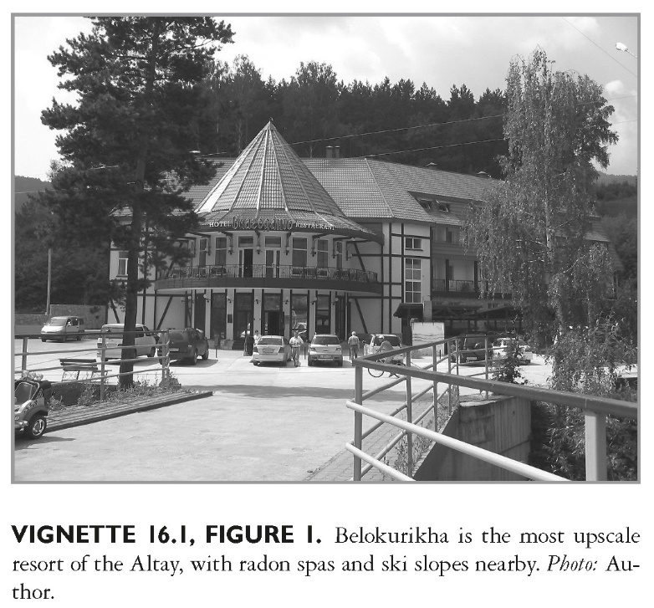
This slide is a supplement to A Geography of Russia and Its Neighbors, Second Edition by Mikhail S. Blinnikov. Copyright © 2021 The Guilford Press.

Slide 15
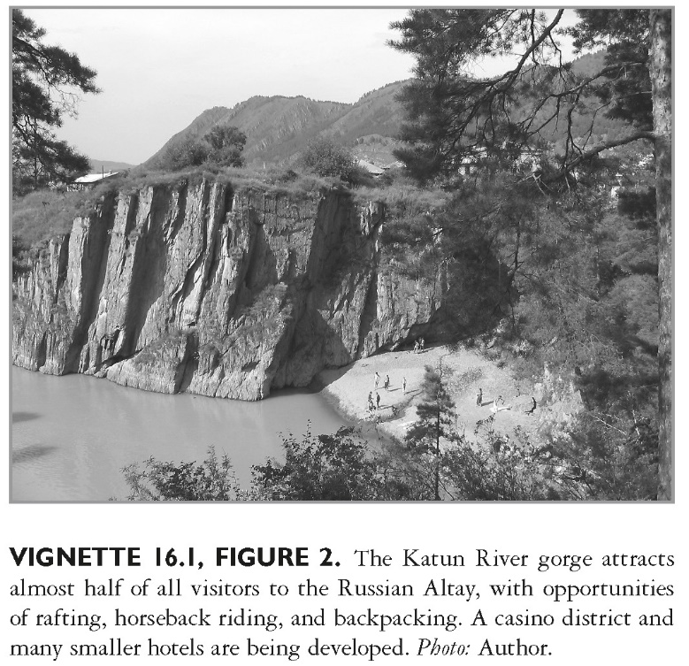
This slide is a supplement to A Geography of Russia and Its Neighbors, Second Edition by Mikhail S. Blinnikov. Copyright © 2021 The Guilford Press.

Slide 16
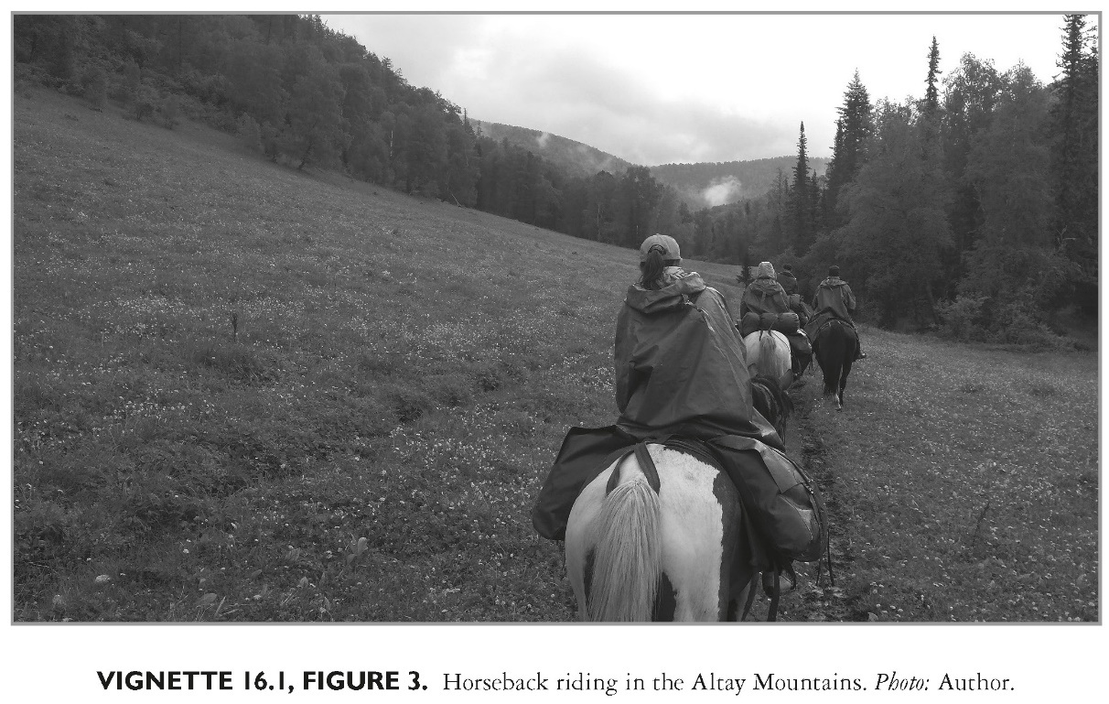
This slide is a supplement to A Geography of Russia and Its Neighbors, Second Edition by Mikhail S. Blinnikov. Copyright © 2021 The Guilford Press.

Slide 17
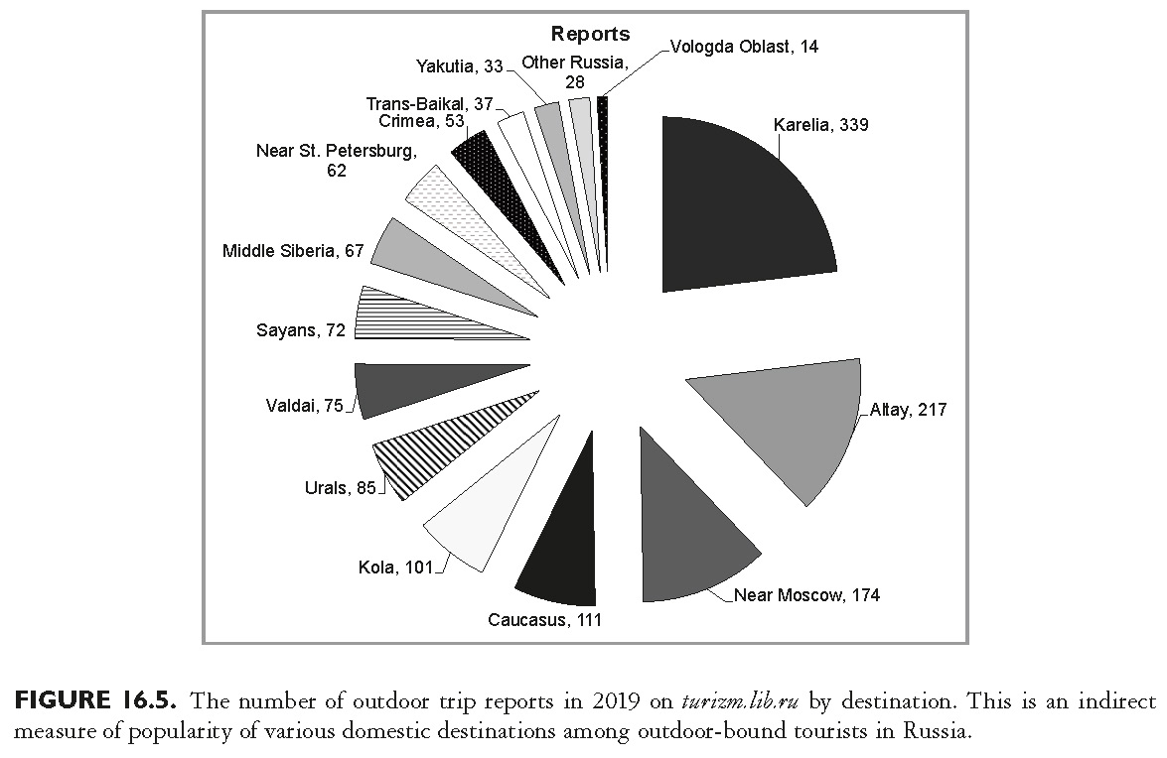
This slide is a supplement to A Geography of Russia and Its Neighbors, Second Edition by Mikhail S. Blinnikov. Copyright © 2021 The Guilford Press.

Slide 18
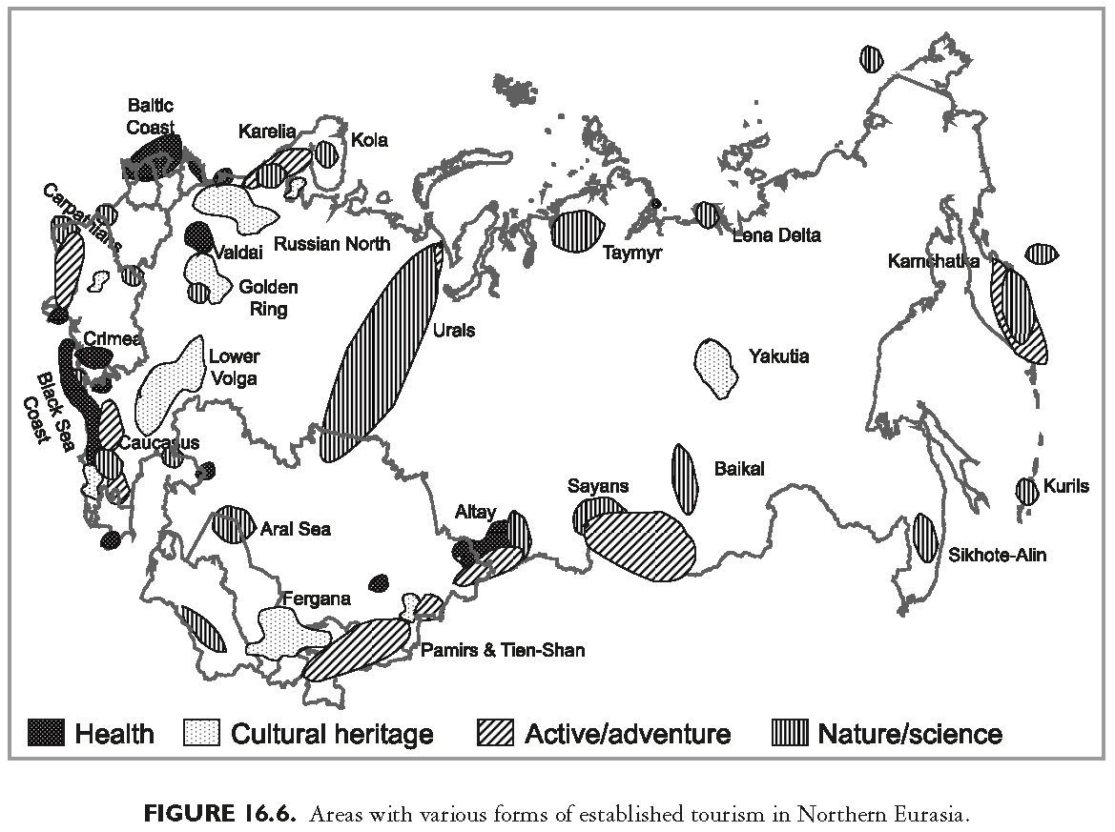
This slide is a supplement to A Geography of Russia and Its Neighbors, Second Edition by Mikhail S. Blinnikov. Copyright © 2021 The Guilford Press.

