Slide 1
This slide is a supplement to A Geography of Russia and Its Neighbors, Second Edition by Mikhail S. Blinnikov. Copyright © 2021 The Guilford Press.
Chapter 17. Oil, Gas, and Other Energy Sources
Russian industry composition (chart) – what is the share of fossil fuels?
Russia’s top companies vs. vs. US Fortune 500 companies
Top companies in Russia are mainly energy (oil and gas) and metals production (Gazprom, Rosneft)
Top US companies are IT and medical related, also retail and some manufacturing and energy
Reasons? Vastly different economic profiles of each country
Fossil fuel-based economy
Oil: Russia is tied with Saudi Arabia as top exporter, #3 producer after Saudi Arabia and USA
Gas: #2 after USA, supplies Bel, Baltics, Poland, Czech Rep., Germany, Italy
Coal: #6
Energy = overall mix
Russia’s energy mix: see for yourself at https://www.iea.org/sankey/
Fig. 17.2
About 1510 mtoe per year, of which
Gas 606, Oil 558, coal 240, nuclear 54, hydro and other renewables are very low

Slide 2
This slide is a supplement to A Geography of Russia and Its Neighbors, Second Edition by Mikhail S. Blinnikov. Copyright © 2021 The Guilford Press.
About 600 mtoe is exported
Earliest oil fields were developed in
Caspian Sea – 1882
Volga Basin – 1930s
West Siberia – 1960s
East Siberia and Sakhalin – 1980s
Most recently attempts to develop Barents Sea reserves and some very distant fields in Eastern Siberia
Top Russian petroleum companies
Rosneft (took over Yukos of M. Khodorkovsky) and is mainly state-owned
BP-TNK – is merging with Rosneft
Lukoil (largest private)
Surgutneftegaz
Gazpromneft (former Sibneft of R. Abramovich)
Others include Tatneft, Bashneft, Slavneft and Russneft and some smaller companies
Transneft maintains state monopoly on oil pipelines
Also large involvement of ExxonMobil, Shell, BP, and Japanese and Chinese companies in Sakhalin island offshore drilling projects (Sakhalin-1, Sakhalin-2, etc.)

Slide 3
This slide is a supplement to A Geography of Russia and Its Neighbors, Second Edition by Mikhail S. Blinnikov. Copyright © 2021 The Guilford Press.
Other countries in FSU with substantial petroleum reserves are Kazakhstan and Azerbaijan
Russia has about 105 bbs in reserves (Saudi Arabia 181, USA 41)
Most in West Siberia, especially Khanty-Mansi AO
Secondary fields in the Lena Basin, Middle Volga and Sakhalin
World uses about 84 mbs per day, or 30 bbs per year!!
Petroleum peak was feared in mid-2000s
“Hubbert Curve”
American scientist M. King Hubbert proposed in 1950s that conventional oil will run out and that peak can be predicted based on knowledge of new well discoveries (lag of 20–30 years)
Noticed bell shape for oil discoveries and production
His theory: production depends only on the yet unrecovered oil still in the ground P = f(r)
  Flow of oil rises sharply and starts declining when about one half of all the oil is produced
  The peak can be predicted (i) on the shape production curve alone
  Or (ii) on timing of peak in discoveries’ curve + time lag of 20 years
  He correctly predicted peak oil for US in 1970, and worldwide in 2000 (actually delayed by a few years)
  However, since 2010 fracking and deep sea drilling for oil because more significant, and thus the peak oil was postponed

Slide 4
This slide is a supplement to A Geography of Russia and Its Neighbors, Second Edition by Mikhail S. Blinnikov. Copyright © 2021 The Guilford Press.
Surgut – the capital of oil (find good photos)
Nice, very developed city with great infrastructure
Lukoil headquarters in Moscow example of a large modern office building
Gazprom new headquarters called Lakhta tower is now the tallest skyscraper in Europe
(in St. Petersburg)
Oil and gas pipelines map – two sectors, Europe and Asia
Natural gas
How natural gas is different from petroleum?
Cannot ship as easily (pressurized pipeline or liquid natural gas via very expensive tankers
Production is concentrated in Yamal (Yamalo-Nenetsky AO)
Shipping from Russia is mainly by huge pipelines, including some underwater in the Black and Baltic Seas
Consumption – much of Russian electricity generation and energy for heavy industry, buses and trucks are commonly using propane
Environmental impacts are less severe than from coal or oil

Slide 5
This slide is a supplement to A Geography of Russia and Its Neighbors, Second Edition by Mikhail S. Blinnikov. Copyright © 2021 The Guilford Press.
Natural gas reserves (trillion ft³, 2009)
Russia 1,680,000
Iran 1,046,000
Qatar 899,000
Turkmenistan 265,000
Saudi Arabia 264,000
USA 245,000
UAE 214,000
Venezuela 176,000
Very uneven distribution, even less so than with oil (only a handful countries dominate)
Russian pipelines vs. western-backed projects
Political issue – e.g., Azerbaijan and Turkey have both oil and gas export capacity bypassing Russia
Nord Stream I and II under the Baltic Sea bypasses Ukraine and is opposed by USA, who wants to sell its own LNG to Europe instead
Generally, more pro-Russian countries in Europe are biggest natural gas recipients (e.g., Germany, Italy, Slovakia, Hungary, Bulgaria and Serbia)
Discussion

Slide 6
This slide is a supplement to A Geography of Russia and Its Neighbors, Second Edition by Mikhail S. Blinnikov. Copyright © 2021 The Guilford Press.
Most petroleum-rich countries suffer from high level of corruption and have low level of democracy (examples?) – Why?
Most countries for which petroleum and natural gas account for >50% of their foreign earnings suffer from “Dutch disease” – structural imbalance in the economy whereby all other industries are greatly underdeveloped. Why is that and what can be done to fix that?
Worldwide coal production (mst, 2009)
China 3,210
USA 1073
India 631
Australia 450
Indonesia 335
Russia 322
South Africa 257
World total about 7,300
Underground coal mining is one of the 5 deadliest jobs
100s of miners die in Russia and Ukraine every year (Donbass)
Coal is most abundant and dirtiest fossil fuel

Slide 7
This slide is a supplement to A Geography of Russia and Its Neighbors, Second Edition by Mikhail S. Blinnikov. Copyright © 2021 The Guilford Press.
Coal
Donetsk basin in Ukraine and SW Russia (underground mines, old and decrepit)
Pechora basin NE European Russia
Kuznetsk basin in Central Siberia (biggest currently, open pit and underground)
Kansk-Achinsk basin in East Siberia(biggest reserves, open pit)
Shipping costs – railroads, ships
Nuclear energy
Russia, Ukraine, Belarus and Armenia have nuclear powerplants, Lithuania closed theirs
Russian Rosatom (www.rosatom.ru) is the leading supplier of nuclear energy and technology to make more worldwide with construction sites in >10 countries, 16% of global nuclear market
Full cycle: uranium extraction, enrichment, operation of reactors, disposal of nuclear waste
Big customers: India, Turkey, Iran
Unique nuclear icebreaker fleet in the Arctic
Legacy of Chernobyl lives on
Capability to produce military grade uranium and plutonium

Slide 8
This slide is a supplement to A Geography of Russia and Its Neighbors, Second Edition by Mikhail S. Blinnikov. Copyright © 2021 The Guilford Press.
Renewable energy
Huge, unrealized potential
Could satisfy about 30% of need easily
At present – only 3%, and almost all of that is hydropower
Wind
Solar
Geothermal
Biomass and biofuels
There is little political incentive to develop these…why?
Ukraine and Kazakhstan are more progressive, than Russia, in bringing renewables into the mix

Slide 9
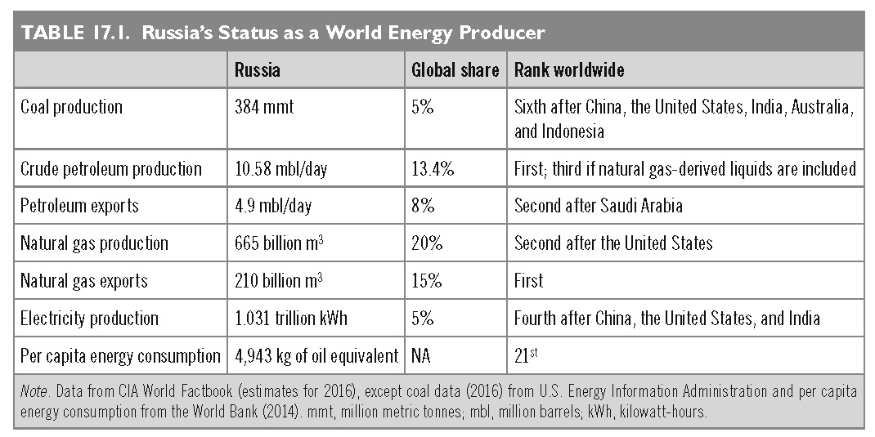
This slide is a supplement to A Geography of Russia and Its Neighbors, Second Edition by Mikhail S. Blinnikov. Copyright © 2021 The Guilford Press.

Slide 10
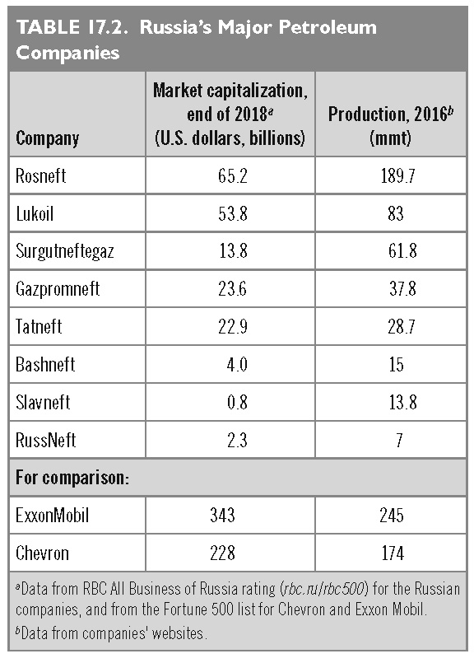
This slide is a supplement to A Geography of Russia and Its Neighbors, Second Edition by Mikhail S. Blinnikov. Copyright © 2021 The Guilford Press.

Slide 11
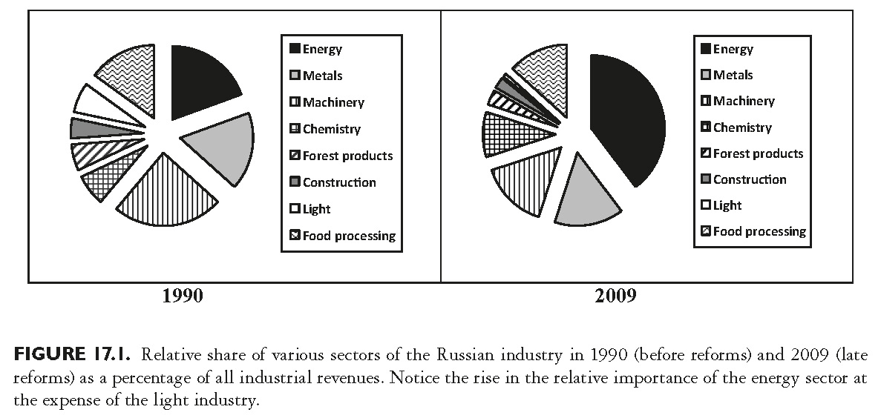
This slide is a supplement to A Geography of Russia and Its Neighbors, Second Edition by Mikhail S. Blinnikov. Copyright © 2021 The Guilford Press.

Slide 12
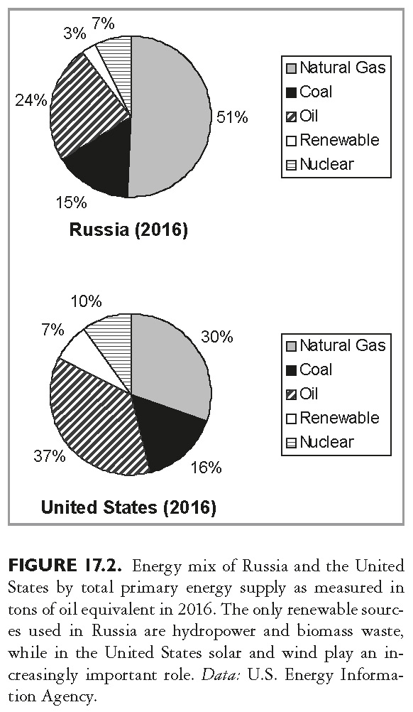
This slide is a supplement to A Geography of Russia and Its Neighbors, Second Edition by Mikhail S. Blinnikov. Copyright © 2021 The Guilford Press.

Slide 13
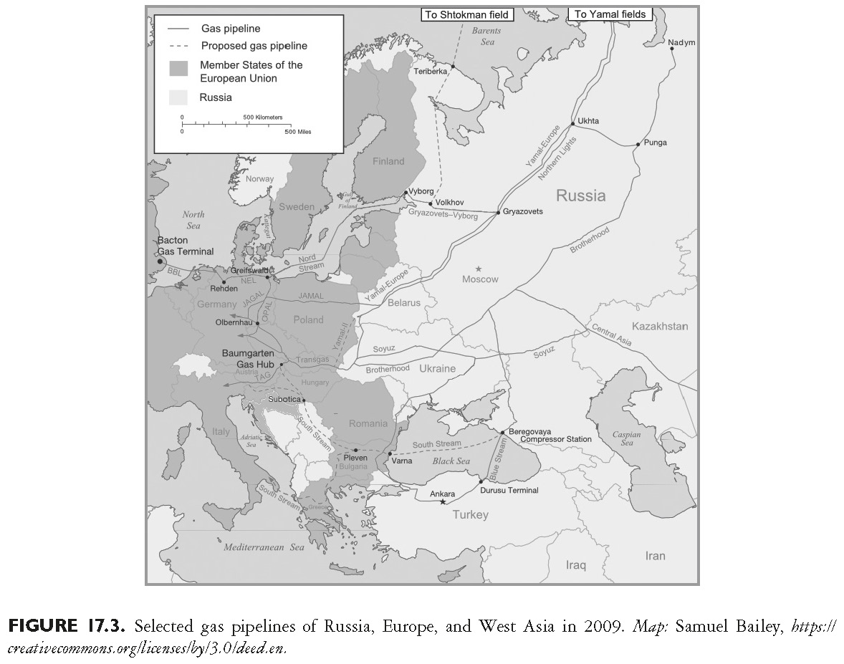
This slide is a supplement to A Geography of Russia and Its Neighbors, Second Edition by Mikhail S. Blinnikov. Copyright © 2021 The Guilford Press.

Slide 14
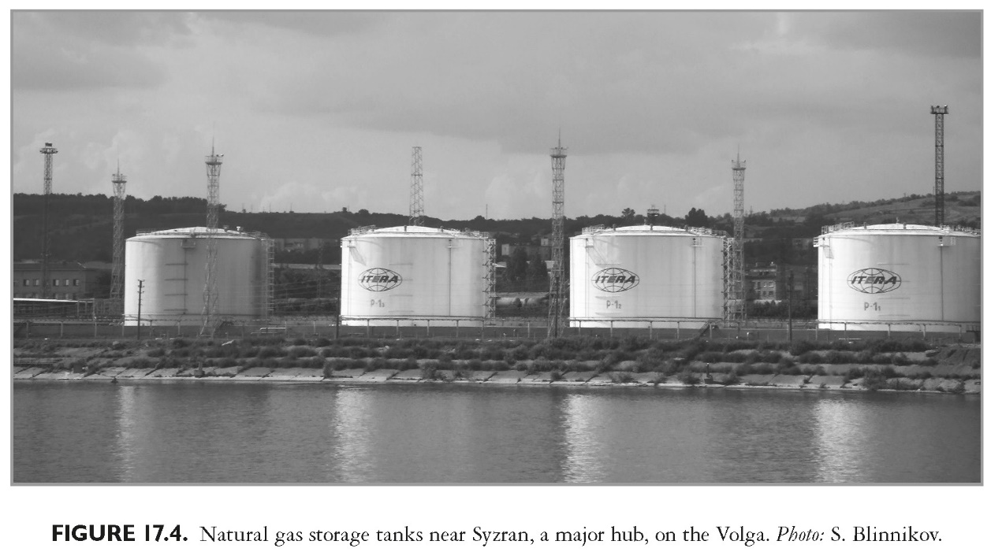
This slide is a supplement to A Geography of Russia and Its Neighbors, Second Edition by Mikhail S. Blinnikov. Copyright © 2021 The Guilford Press.

Slide 15
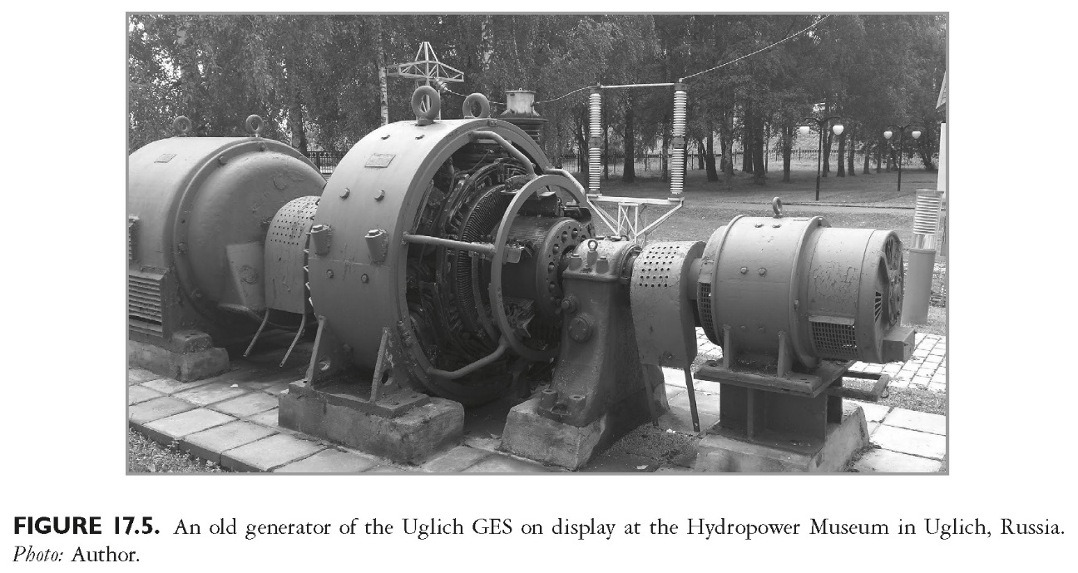
This slide is a supplement to A Geography of Russia and Its Neighbors, Second Edition by Mikhail S. Blinnikov. Copyright © 2021 The Guilford Press.

Slide 16
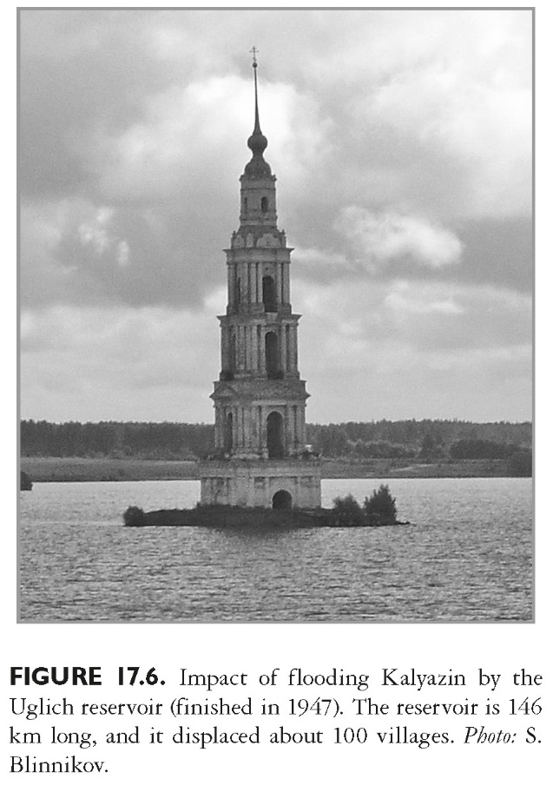
This slide is a supplement to A Geography of Russia and Its Neighbors, Second Edition by Mikhail S. Blinnikov. Copyright © 2021 The Guilford Press.

Slide 17
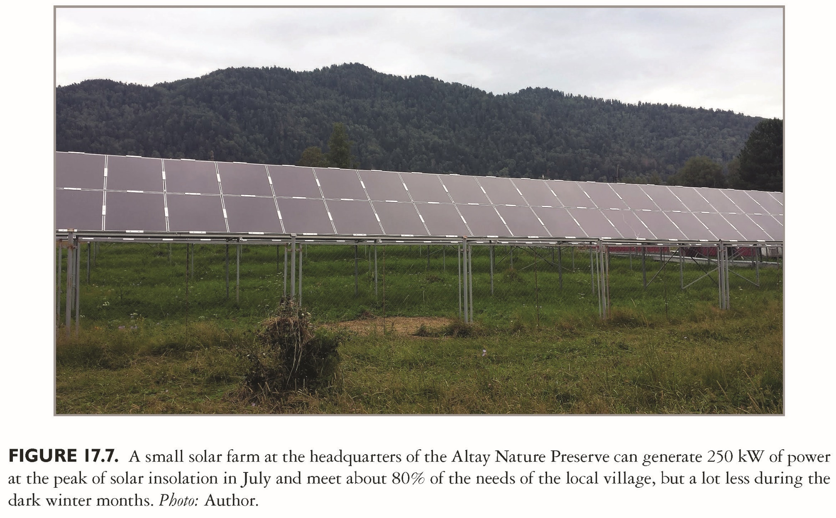
This slide is a supplement to A Geography of Russia and Its Neighbors, Second Edition by Mikhail S. Blinnikov. Copyright © 2021 The Guilford Press.

