Slide 1
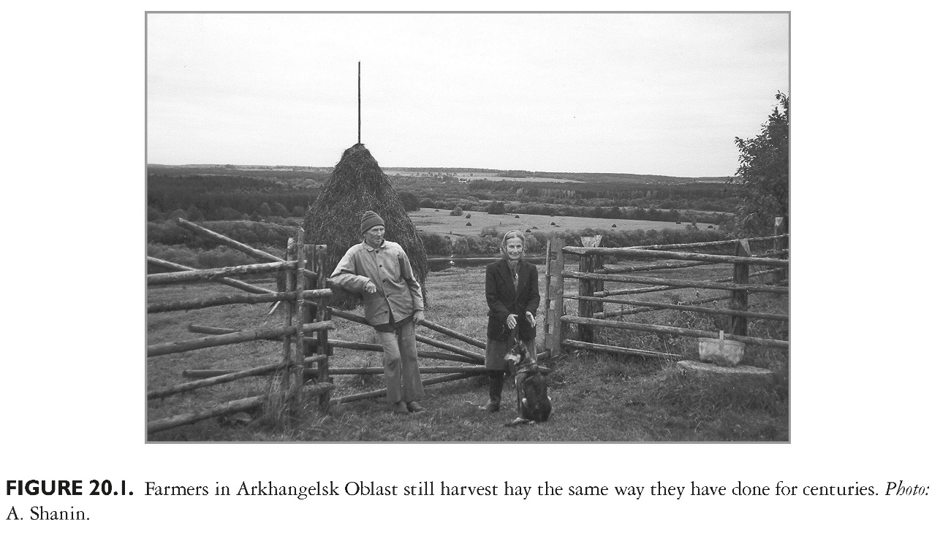
This slide is a supplement to A Geography of Russia and Its Neighbors, Second Edition by Mikhail S. Blinnikov. Copyright © 2021 The Guilford Press.

Slide 2
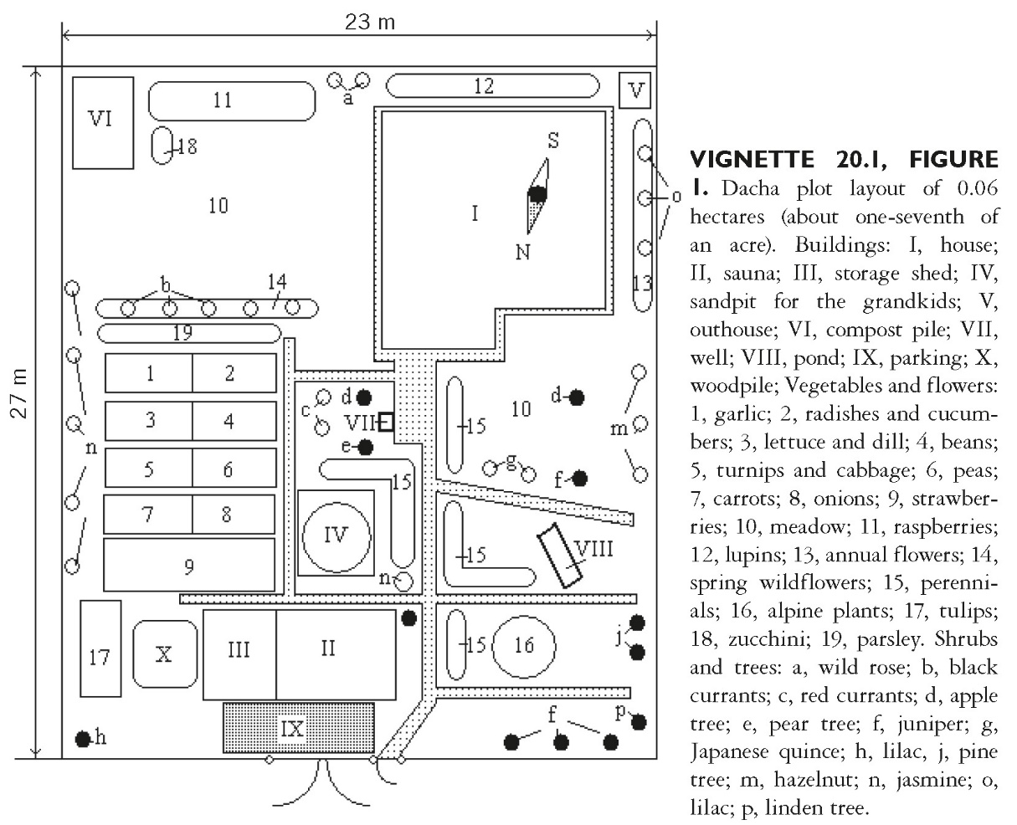
This slide is a supplement to A Geography of Russia and Its Neighbors, Second Edition by Mikhail S. Blinnikov. Copyright © 2021 The Guilford Press.

Slide 3
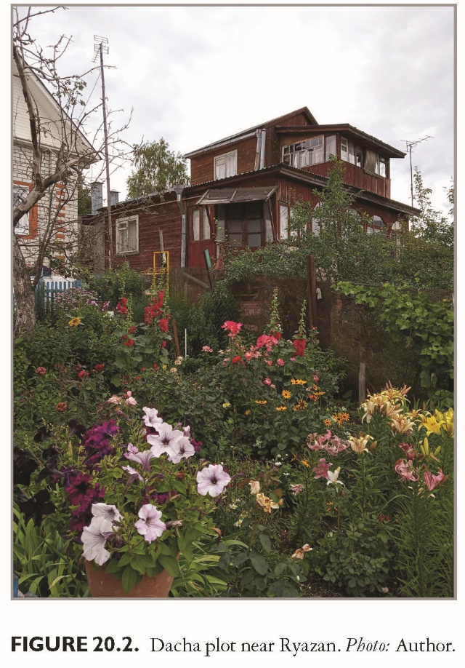
This slide is a supplement to A Geography of Russia and Its Neighbors, Second Edition by Mikhail S. Blinnikov. Copyright © 2021 The Guilford Press.

Slide 4
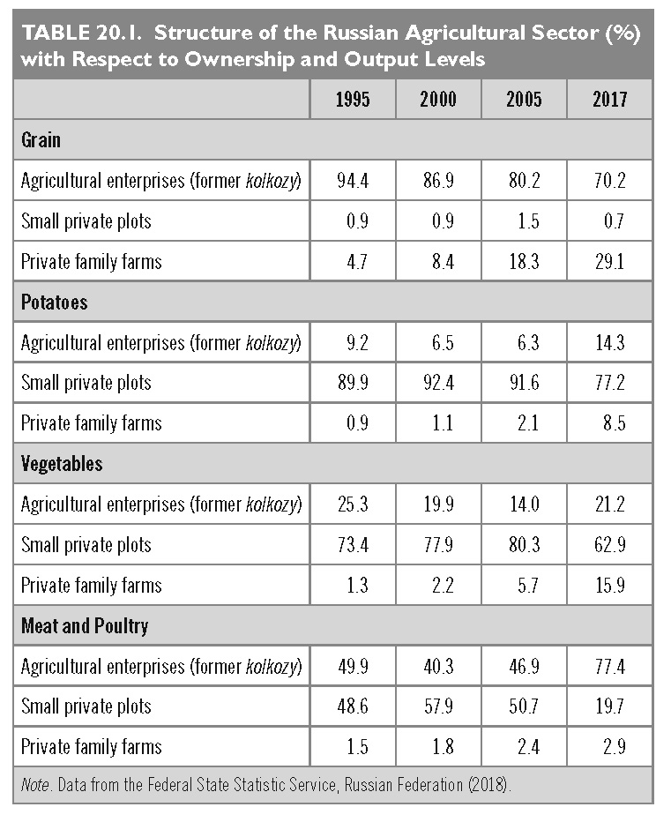
This slide is a supplement to A Geography of Russia and Its Neighbors, Second Edition by Mikhail S. Blinnikov. Copyright © 2021 The Guilford Press.

Slide 5
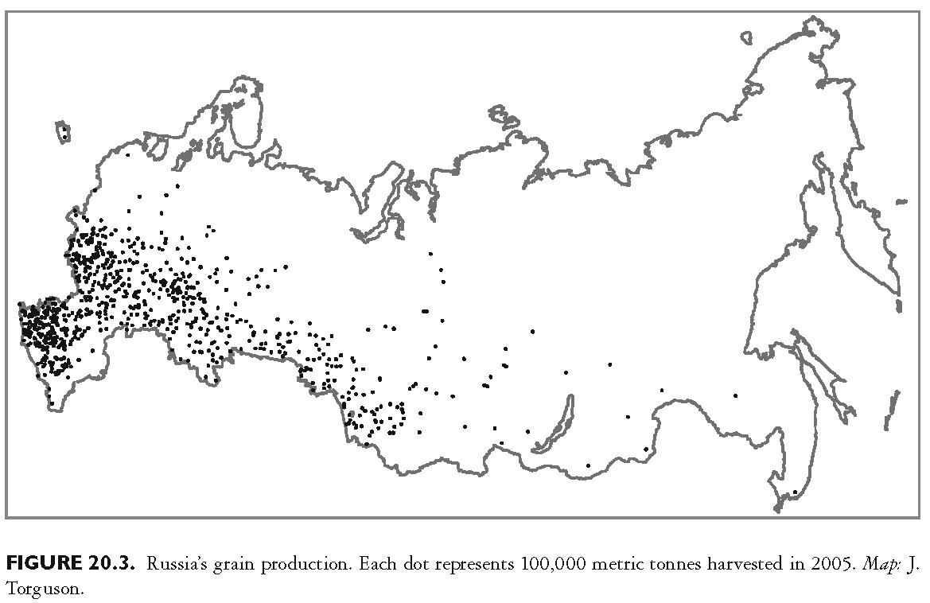
This slide is a supplement to A Geography of Russia and Its Neighbors, Second Edition by Mikhail S. Blinnikov. Copyright © 2021 The Guilford Press.

Slide 6
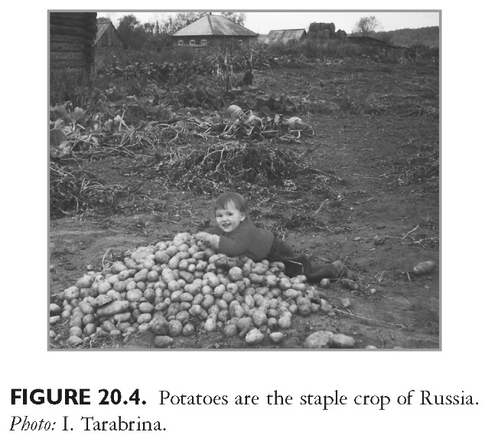
This slide is a supplement to A Geography of Russia and Its Neighbors, Second Edition by Mikhail S. Blinnikov. Copyright © 2021 The Guilford Press.

Slide 7
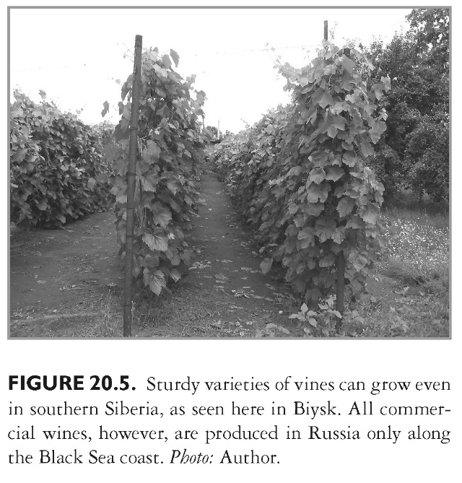
This slide is a supplement to A Geography of Russia and Its Neighbors, Second Edition by Mikhail S. Blinnikov. Copyright © 2021 The Guilford Press.

Slide 8
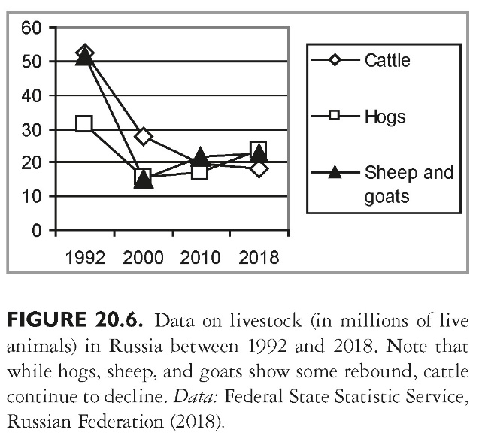
This slide is a supplement to A Geography of Russia and Its Neighbors, Second Edition by Mikhail S. Blinnikov. Copyright © 2021 The Guilford Press.

Slide 9
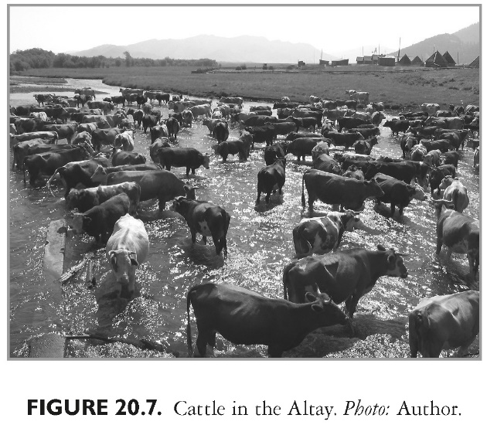
This slide is a supplement to A Geography of Russia and Its Neighbors, Second Edition by Mikhail S. Blinnikov. Copyright © 2021 The Guilford Press.

Slide 10
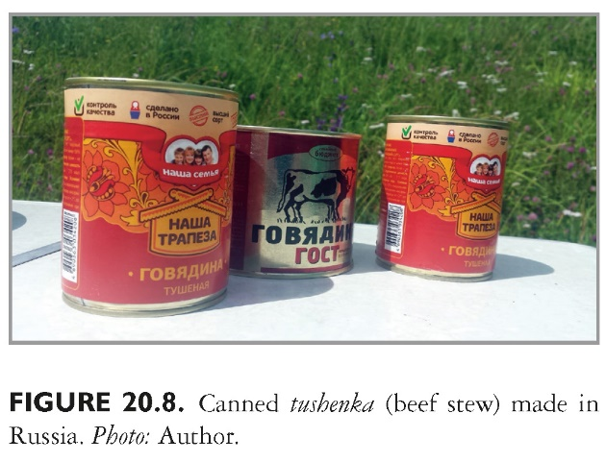
This slide is a supplement to A Geography of Russia and Its Neighbors, Second Edition by Mikhail S. Blinnikov. Copyright © 2021 The Guilford Press.

Slide 11
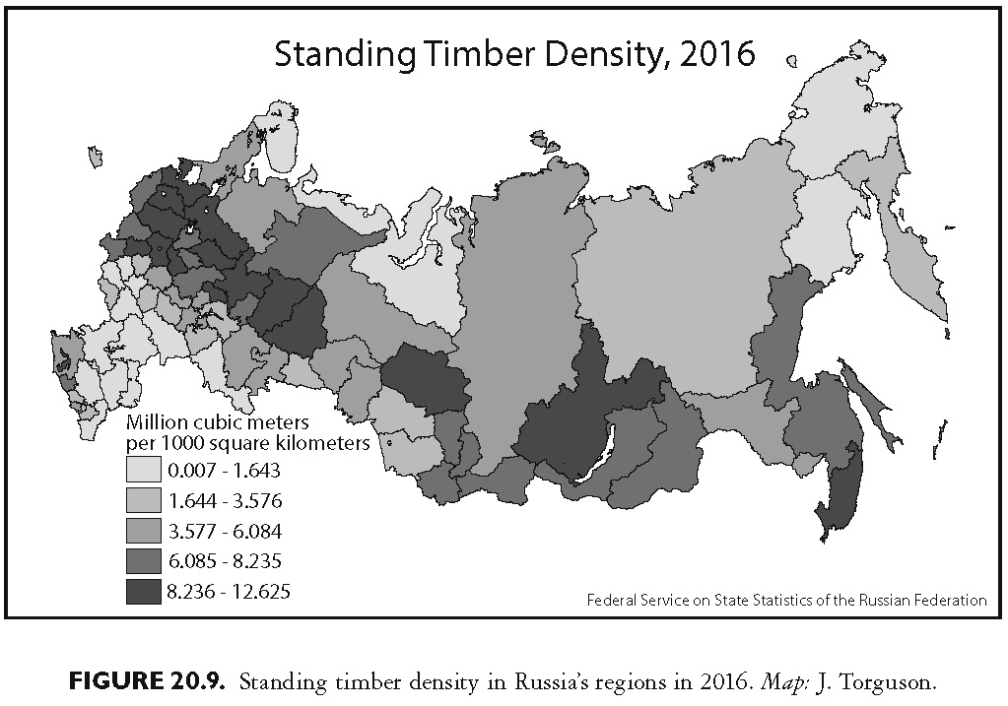
This slide is a supplement to A Geography of Russia and Its Neighbors, Second Edition by Mikhail S. Blinnikov. Copyright © 2021 The Guilford Press.

